Slide 1
Protection of Human Rights:
Treaty Body System
Heisoo Shin, Ph. D.
Member, Committee on Economic, Social and Cultural Rights
heisoo@gmail.com
Workshop on Thematic Human Rights Topics from Around the Asia Region, 29 August 2016, Bali

Slide 2
Development of Core HR Treaties
International Bill of Human Rights
1948 Universal Declaration of Human Rights (UDHR)
1966 International Covenant on Economic, Social and Cultural Rights (ICESCR)
1966 International Covenant on Civil and Political Rights (ICCPR)

Slide 3
More human rights treaties…
Covering the issues of:
Racial discrimination
Discrimination against women
Torture
Children’s rights
Migrant workers
Enforced disappearances
Disabilities

Slide 4
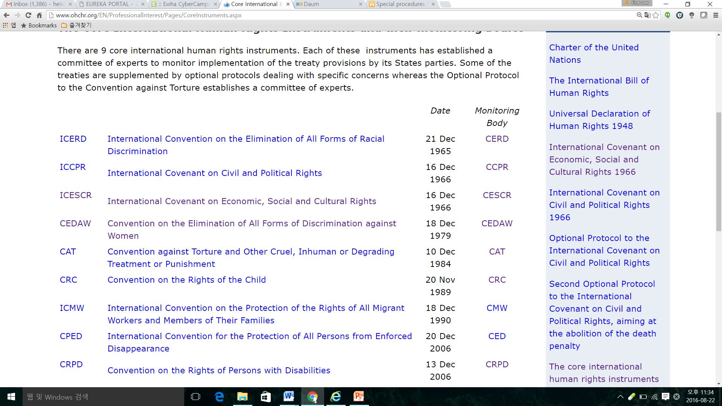
9 Core HR Treaties / Monitoring Bodies

Slide 5
State Party’s obligations under a human rights treaty
Implementation of the human rights treaty
Reporting on implementation
Being reviewed by the treaty monitoring body
Implementation of the treaty body’s Concluding Observations

Slide 6
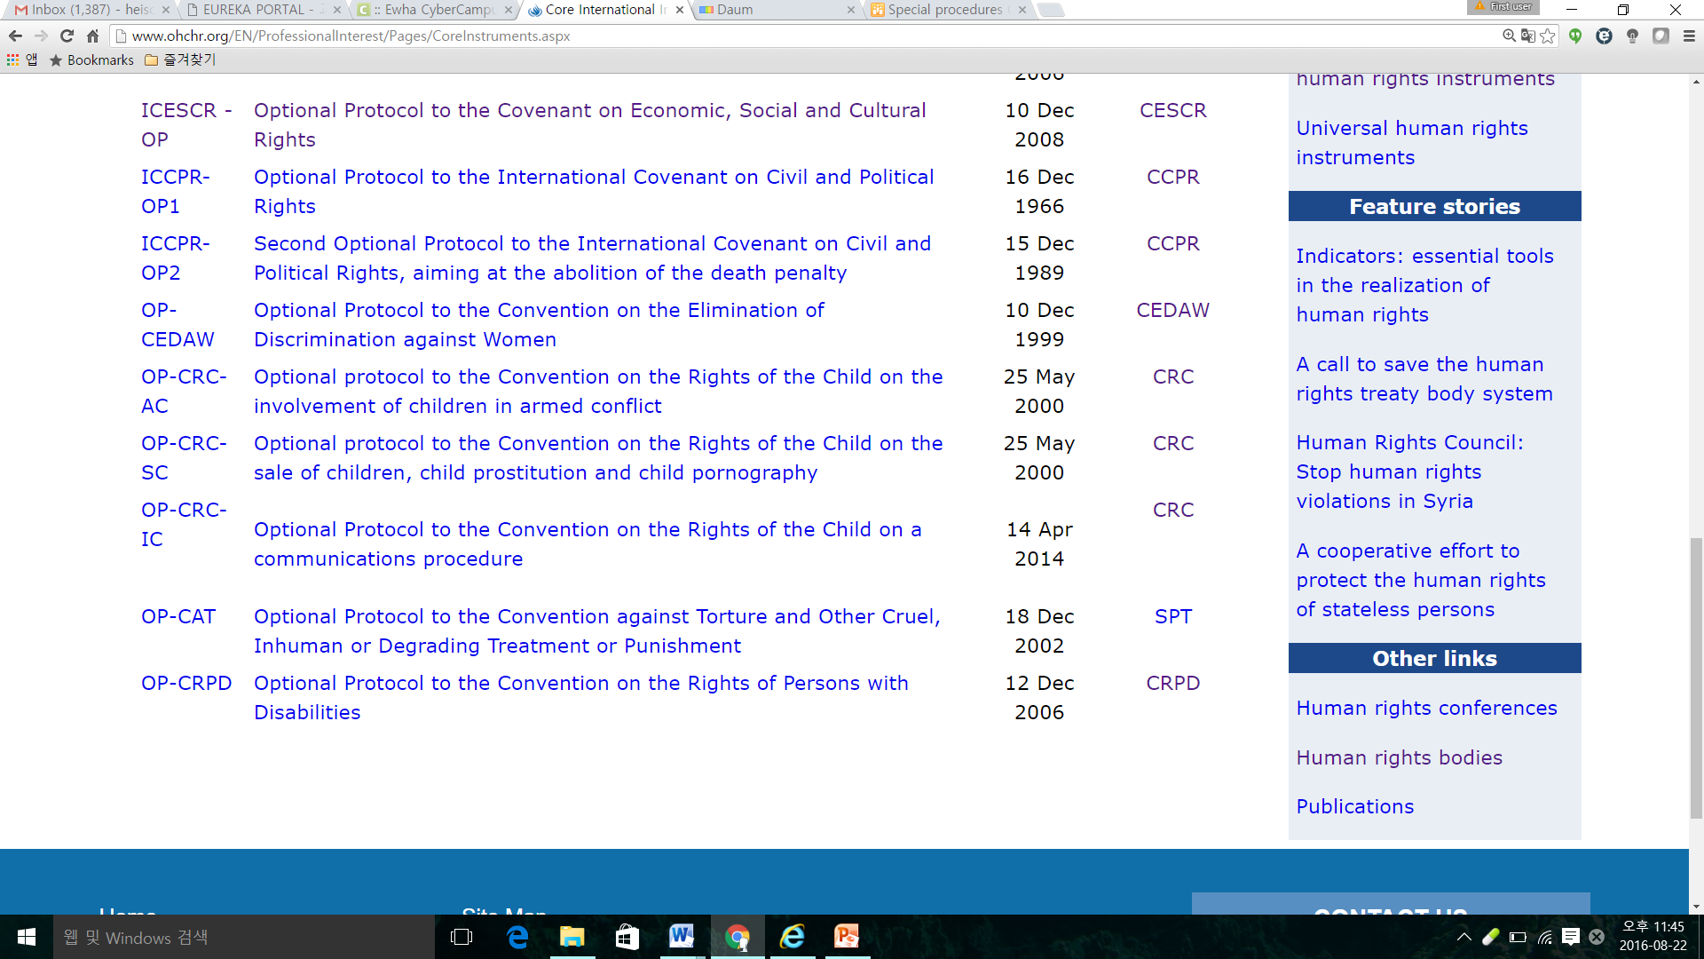
Optional Protocols to HR Treaties

Slide 7
Optional Protocols allow---
Individual Communications procedure
victims(s) can file a complaint to a treaty body
after exhaustion of domestic remedies
deals with HR violations happened after the entry of the OP
Inquiry by TB
in case of grave or systematic violations
cooperation of the government needed

Slide 8
CESCR: Committee on Economic, Social and Cultural Rights
Monitoring body of ICESCR
18 experts, with a 4-year term & regional representation
Nominated by the States parties, elected by ECOSOC
Once elected, independence and impartiality required

Slide 9
Economic, Social and Cultural Rights
Right to work
Right to just and favorable conditions of work
Right to trade union
Right to social security
Right to family
Right to a decent standard of living (food, housing, water, sanitation, …)
Right to health
Right to education
Right to cultural life

Slide 10
CSO / Victim’s participation
Submission of alternative/parallel NGO report (both for PSWG and for the session)
Participation and oral presentation to TBs
Lunchtime NGO Briefing at the session
Submission of individual complaints

Slide 11
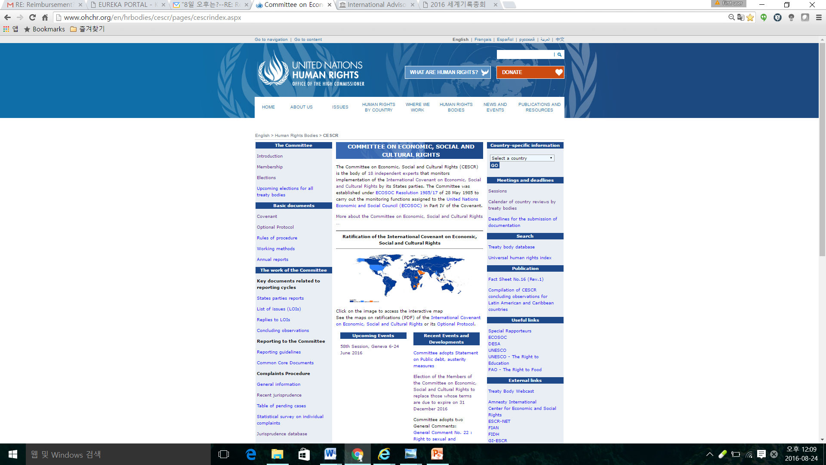

Slide 12
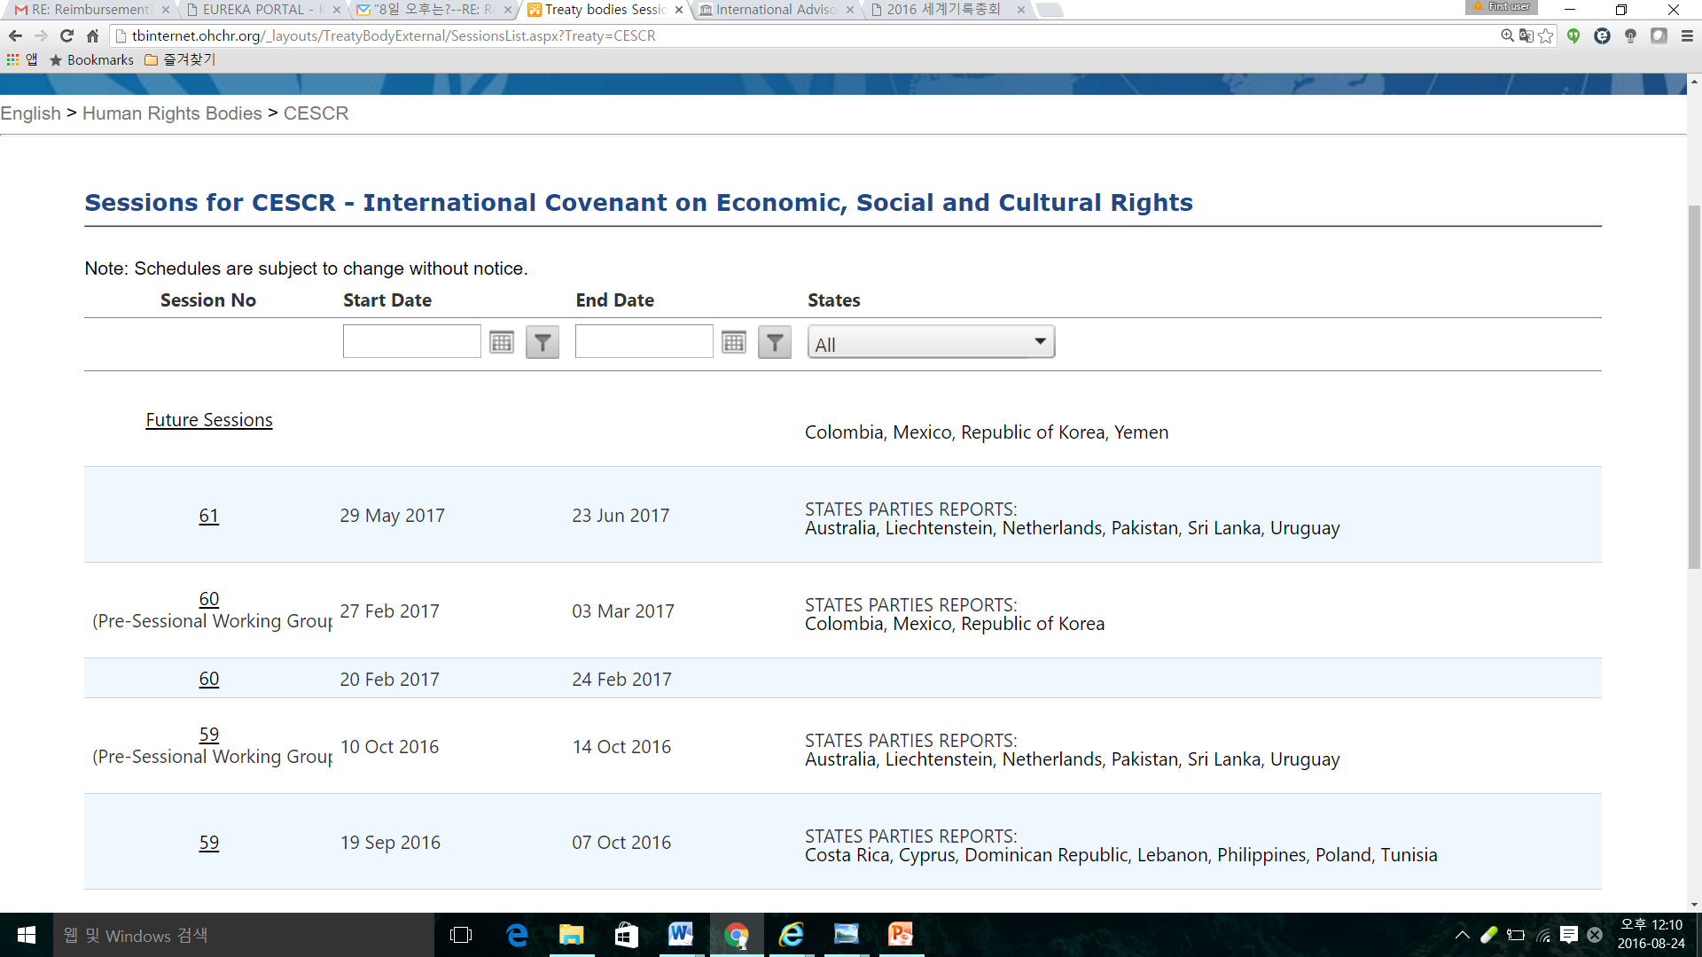
CESCR’s Up-Coming Sessions

Slide 13
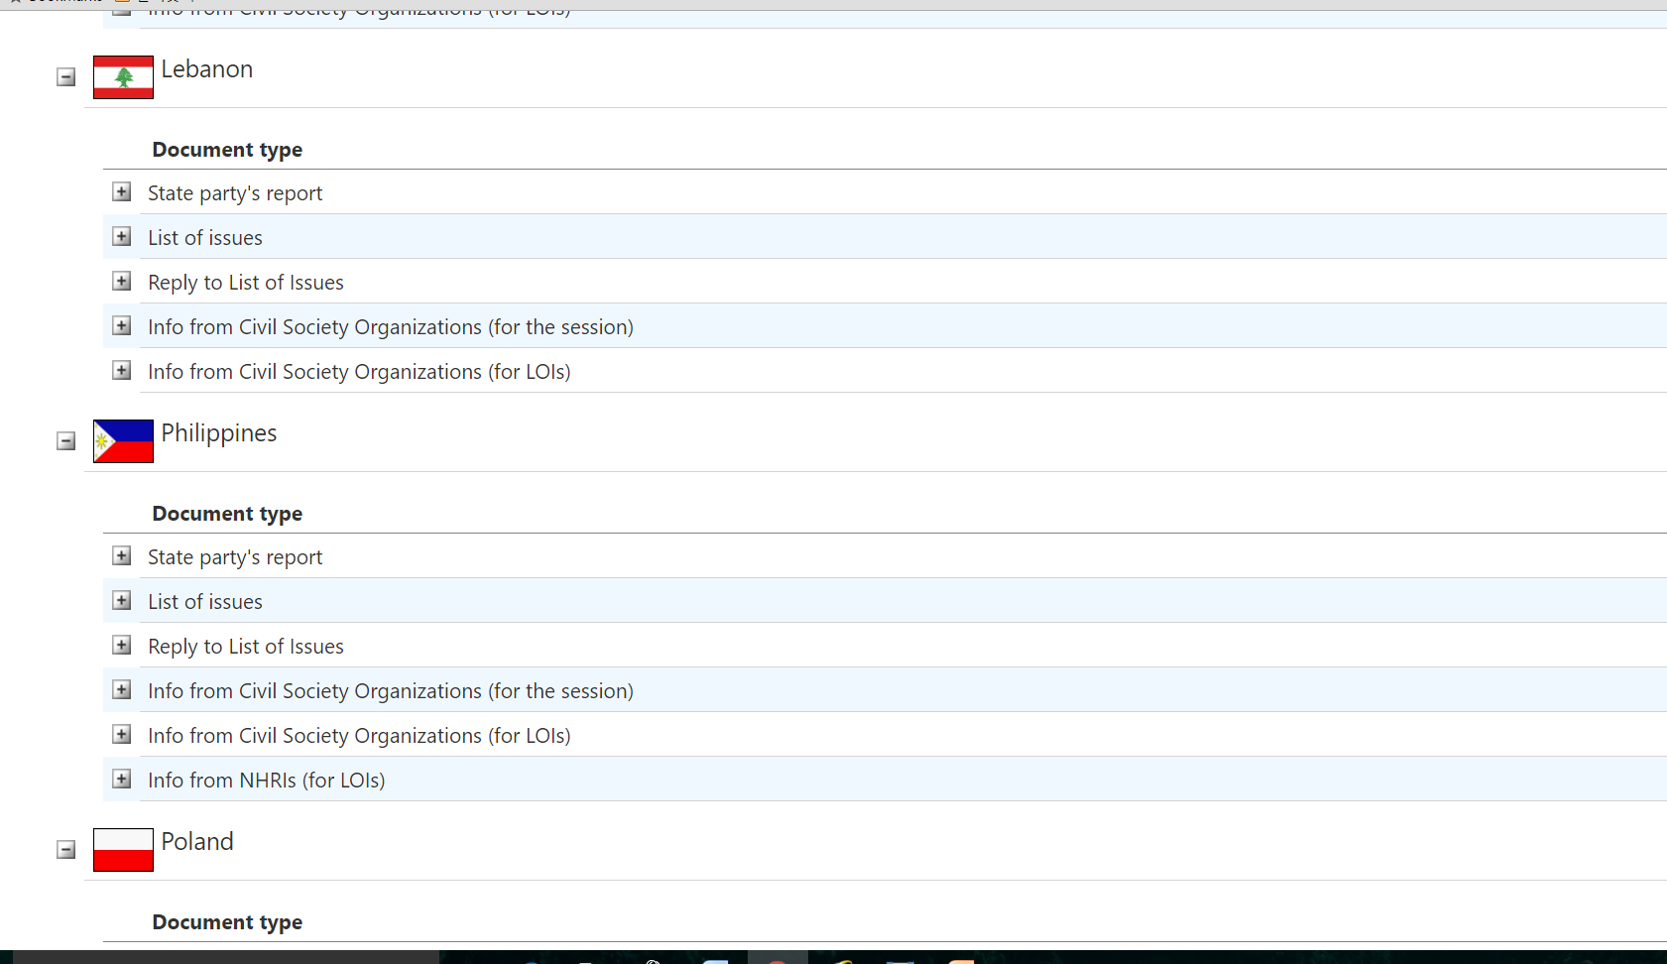
Gov’t Report, plus many more…

Slide 14
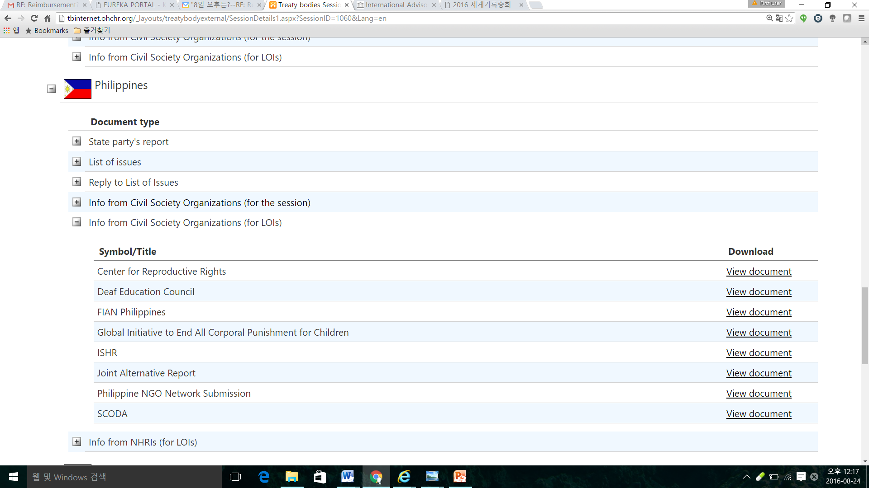
CSO Submissions on Philippines

Slide 15
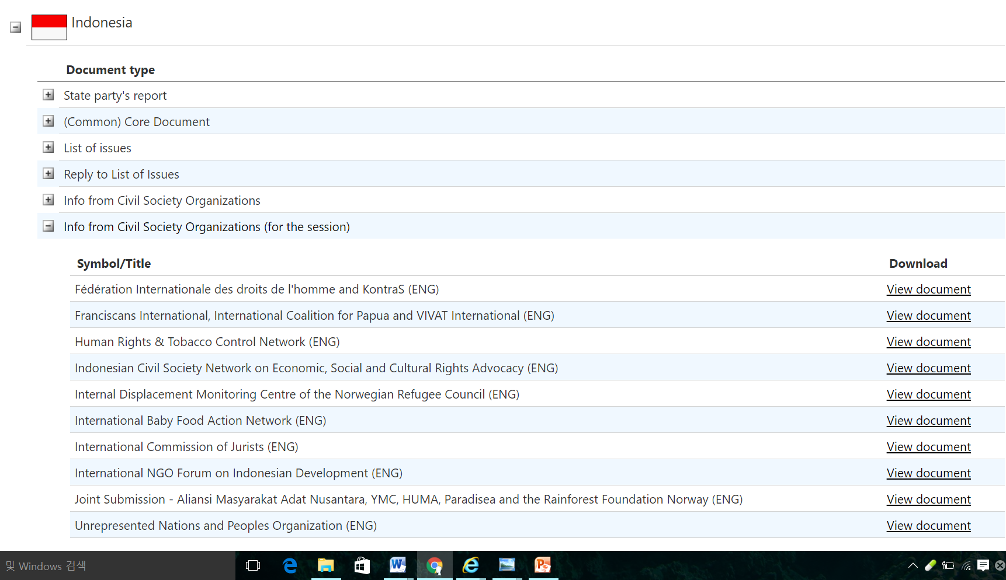
Indonesia considered by CESCR (30 April & 1 May 2014)

Slide 16
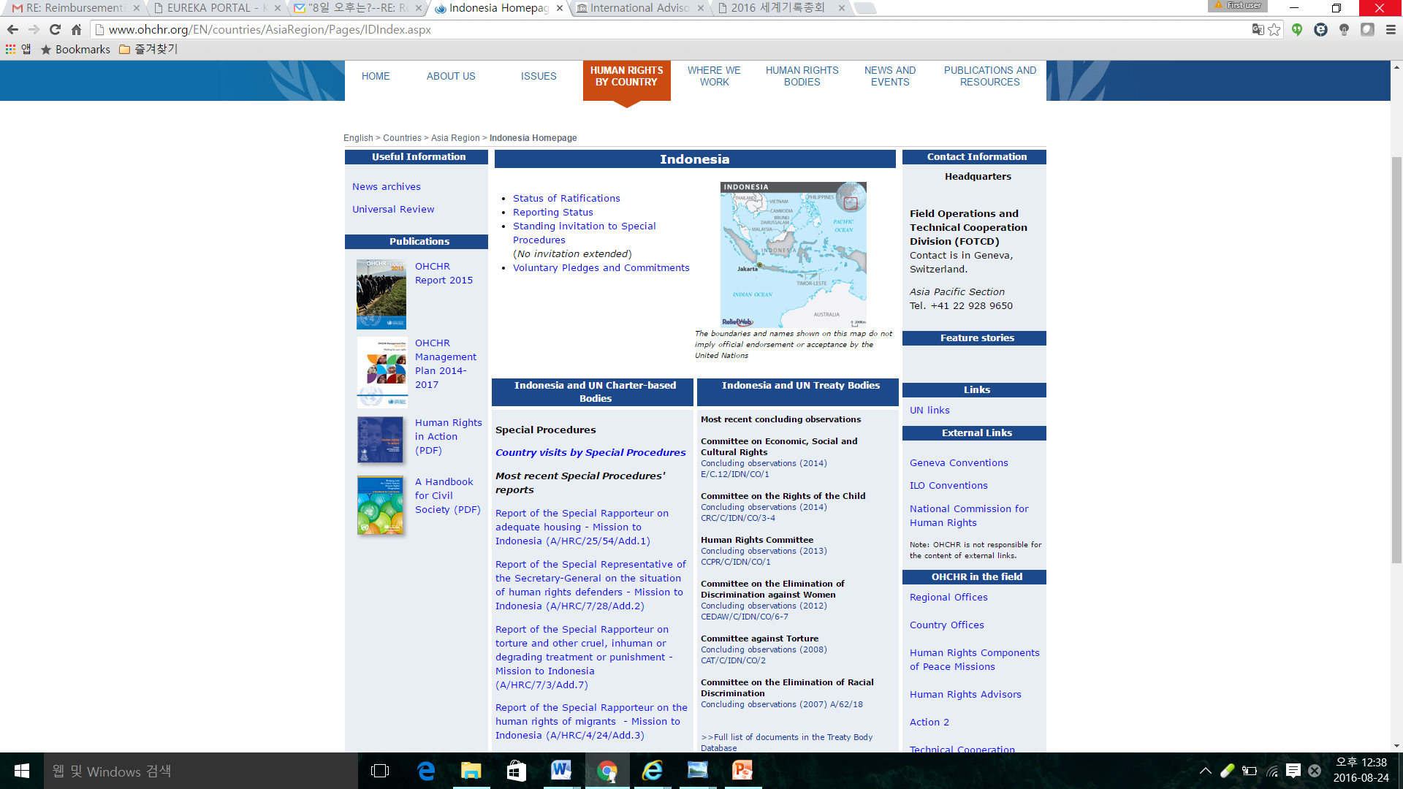
INDONESIA and the UN
Human
Rights Mechanism

Slide 17
Victims bringing cases to CESCR
Indigenous fishermen (Russia)
Two women with psycho-social disability (Norway)
Inter-sex person (Germany)
Forced eviction cases (Nepal, ….)
Water pollution in the village (Ecuador)

Slide 18
Useful websites
http://www.ohchr.org
http://www.ohchr.org/EN/HRBodies/Pages/TreatyBodies.aspx
http://www.ohchr.org/en/hrbodies/cescr/pages/cescrindex.aspx

