Slide 1
Panel 4: Cooperation in relation to specific groups in focus (Persons with Disabilities) International Workshop on Enhancing Cooperation between United Nations and Regional Human Rights Mechanisms 5 October 2016, Geneva, Palais des Nations
PANEL 4
Dr. Seree Nonthasoot
Representative of Thailand to the ASEAN Intergovernmental Commission on Human Rights

Slide 2
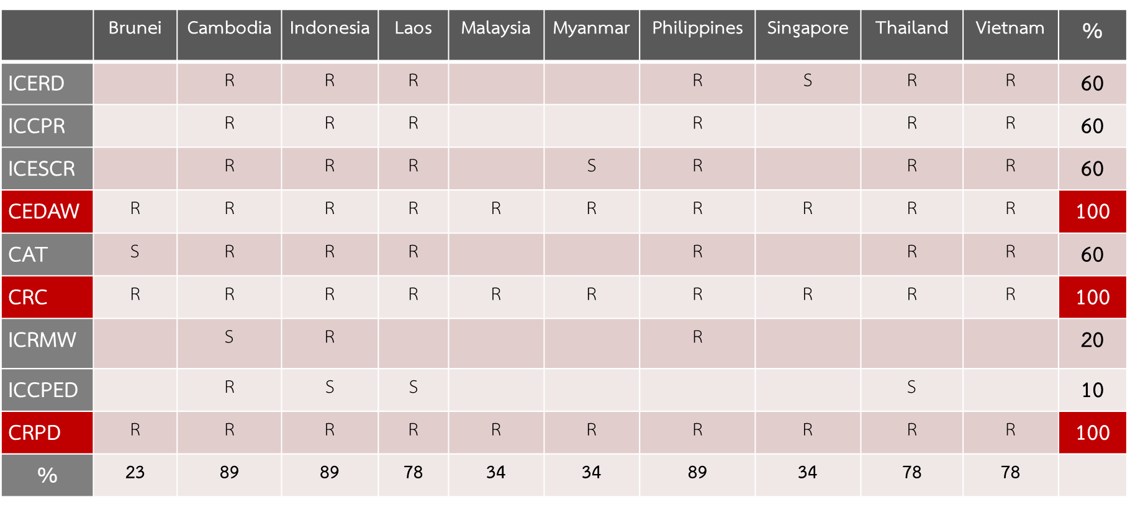
Ratification to Core Human Rights Treaties
Dr. Seree Nonthasoot, AICHR Thailand

Slide 3
Mainstreaming Disability Rights: Issues
ASEAN as ‘duty bearer’ to persons with disabilities (along side Member States that have primary responsibilities for the promotion and protection of their rights)
ASEAN enters the historic phase of becoming a fully fledged Community in 2016 but the compartmentalization or pillarization of its structure and organ has rendered challenging mainstreaming of human rights principles, including disability rights
Statistics (Right to be recognized as a person). Significant discrepancy; ESCAP/WHO est 10 percent of population with disabilities. Some ASEAN Member States report less than 0.1%. Some do not have statistical system available to give account of their identity.
Models of promotion and protection: from charity & social welfare model to human rights-based approach
Impairment or disabilities still viewed as burden or stigma, leading to prejudices and exclusion
Dr. Seree Nonthasoot, AICHR Thailand

Slide 4
Framework for Disability Rights in ASEAN
Bali Declaration on The Enhancement of The Role and Participation of The Persons with Disabilities in ASEAN Community declaring the ASEAN Decade for Persons with Disabilities 2011-2020
ASEAN Declaration on Strengthening Social Protection 2014 seeking to create social inclusion for persons with disabilities
Since April 2016, the Convention on the Rights of Persons with Disabilities has become the third human rights convention that is ratified by all ten ASEAN Member States (after CRC and CEDAW; 2016 also the 10th Anniversary of the CRPD)
Dr. Seree Nonthasoot, AICHR Thailand

Slide 5
AICHR & Disability Rights
Three Regional Dialogues on the Mainstreaming of the Rights of Persons with Disabilities, designed as a cross-cutting forum on disabilities and engaging multi-stakeholders including ASEAN bodies, UN bodies, DPOs
1st Dialogue (2015) on general framework of promotion & protection, political rights
2nd Dialogue (2016) on health, education and employment
3rd Dialogue (2017) on universal design & Role of ICT, access to justice and participation in decision-making
AICHR Training on the Rights of Persons with Disabilities (11-14 October in Bangkok, Thailand)
Appointment of Task Force on the Mainstreaming of the Rights of Persons with Disabilities, with a mandate to develop a Regional Action Plan on the Mainstreaming of the Rights of Persons with Disabilities by 2017 (50th Anniversary of ASEAN)
Dr. Seree Nonthasoot, AICHR Thailand

Slide 6
Mainstreaming Disability Rights: Principles
ASEAN Charter
ASEAN Human Rights Declaration 2012
ASEAN Vision 2025: Forging Ahead Together
Bali Declaration
Incheon strategy to 'make the right real' for persons with disabilities in Asia and the Pacific
Convention of the Rights of Persons with Disabilities
Sustainable Development Goals
Dr. Seree Nonthasoot, AICHR Thailand

Slide 7
ASEAN Structure
List of Selected ASEAN Sectoral Ministerial Bodies (Source: ASEAN Charter)
ASEAN Political-Security Community | ASEAN Economic Community | ASEAN Socio-Cultural Community
ASEAN Foreign Ministers Meeting ASEAN Defence Ministers Meeting ASEAN Law Ministers Meeting ASEAN Senior Law Officials Meeting (ASLOM) ASEAN Ministerial Meeting on Transnational Crime Senior Official Meeting on Transnational Crime (SOMTC) Directors-General of Immigration Departments and Heads of Consular Affairs Divisions of Ministries of Foreign Affairs Meeting (DGICM) | ASEAN Economic Ministers Meeting Senior Economic Officials Meeting (SEOM) ASEAN Free Trade Area (AFTA) Council ASEAN Investment Area (AIA) Council ASEAN Ministers Meetings on Agriculture and Forestry (AMAF) ASEAN Ministers on Energy Meeting (AMEM) ASEAN Ministerial Meeting on Science and Technology (AMMST) | ASEAN Ministers Responsible for Information (AMRI) Senior Officials Meeting Responsible for Information (SOMRI) ASEAN Ministers Responsible for Culture and Arts (AMCA) ASEAN Education Ministers Meeting (ASED) Senior Officials Meeting on Education (SOM-ED) ASEAN Ministerial Meeting on Disaster Management ASEAN Committee on Disaster Management (ACDM) ASEAN Ministerial Meeting on the Environment (AMME)
Dr. Seree Nonthasoot, AICHR Thailand

Slide 8
ASEAN Structure
List of Selected ASEAN Sectoral Ministerial Bodies (Source: ASEAN Charter)
ASEAN Political-Security Community | ASEAN Economic Community | ASEAN Socio-Cultural Community
 | ASEAN Telecommunications and Information Technology Ministers Meeting (TELMIN) Telecommunications and Information Technology Senior Officials Meeting (TELSOM) ASEAN Transport Ministers Meeting (ATM) Senior Transport Officials Meeting (STOM) Meeting of the ASEAN Tourism Ministers (M-ATM) Meeting of the ASEAN National Tourism Organisations (ASEAN NTOs) | ASEAN Ministerial Meeting on the Environment (AMME) ASEAN Senior Officials on the Environment (ASOEN) ASEAN Health Ministers Meeting (AHMM) Senior Officials Meeting on Health Development (SOMHD) ASEAN Labour Ministers Meeting (ALMM) Senior Labour Officials Meeting (SLOM) ASEAN Ministers on Rural Development and Poverty Eradication (AMRDPE) Senior Official Meeting on Rural Development and Poverty Eradication (SOMRDPE)
Dr. Seree Nonthasoot, AICHR Thailand

Slide 9
ASEAN Structure
List of Selected ASEAN Sectoral Ministerial Bodies (Source: ASEAN Charter)
ASEAN Political-Security Community | ASEAN Economic Community | ASEAN Socio-Cultural Community
 |  | ASEAN Ministerial Meeting on Social Welfare and Development (AMMSWD) Senior Officials Meeting on Social Welfare and Development (SOMSWD) ASEAN Ministerial Meeting on Youth (AMMY) Senior Officials Meeting on Youth (SOMY) ASEAN Conference on Civil Service Matters (ACCSM) ASEAN Coordinating Centre for Humanitarian Assistance on Disaster Management (AHA Centre) ASEAN University Network (AUN)
Dr. Seree Nonthasoot, AICHR Thailand

Slide 10
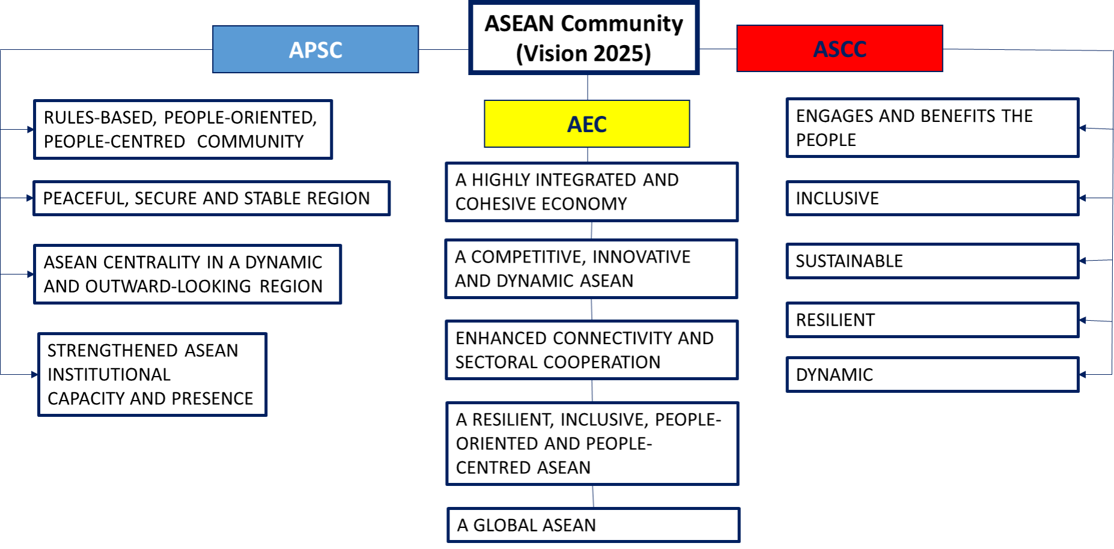
ASEAN Vision 2025
Dr. Seree Nonthasoot, AICHR Thailand

Slide 11
Possible Actions/ Measures for RAP
Data collection/ disaggregation → statistical unit for disabilities
Dedicated unit for policy coordination/monitoring & evaluation → establishment of an ASEAN Commission on Persons with Disabilities (ACPD) or an ASEAN Special Rapporteur on Disabilities (ASRD)
Mainstreaming SDGs → creation of ASEAN indicators integrating SDGs to ASEAN policy-making and implementation
Encouraging ratification of optional protocol → reiterating commitment by ASEAN Leaders
Cooperating with stakeholders from other regions/UN bodies → Council of Europe’s example of mainstreaming with the adoption of Disability Action Plan (2017-2023)/ regularization of OHCHR & CRPD Committee interface with ASEAN bodies
Dr. Seree Nonthasoot, AICHR Thailand

