Slide 1
Panel 1(b): Taking stock of developments in cooperation between United Nations and regional human rights mechanisms International Workshop on Enhancing Cooperation between United Nations and Regional Human Rights Mechanisms 4 October 2016, Geneva, Palais des Nations
Panel 1(b)
Dr. Seree Nonthasoot
Representative of Thailand to the ASEAN Intergovernmental Commission on Human Rights

Slide 2
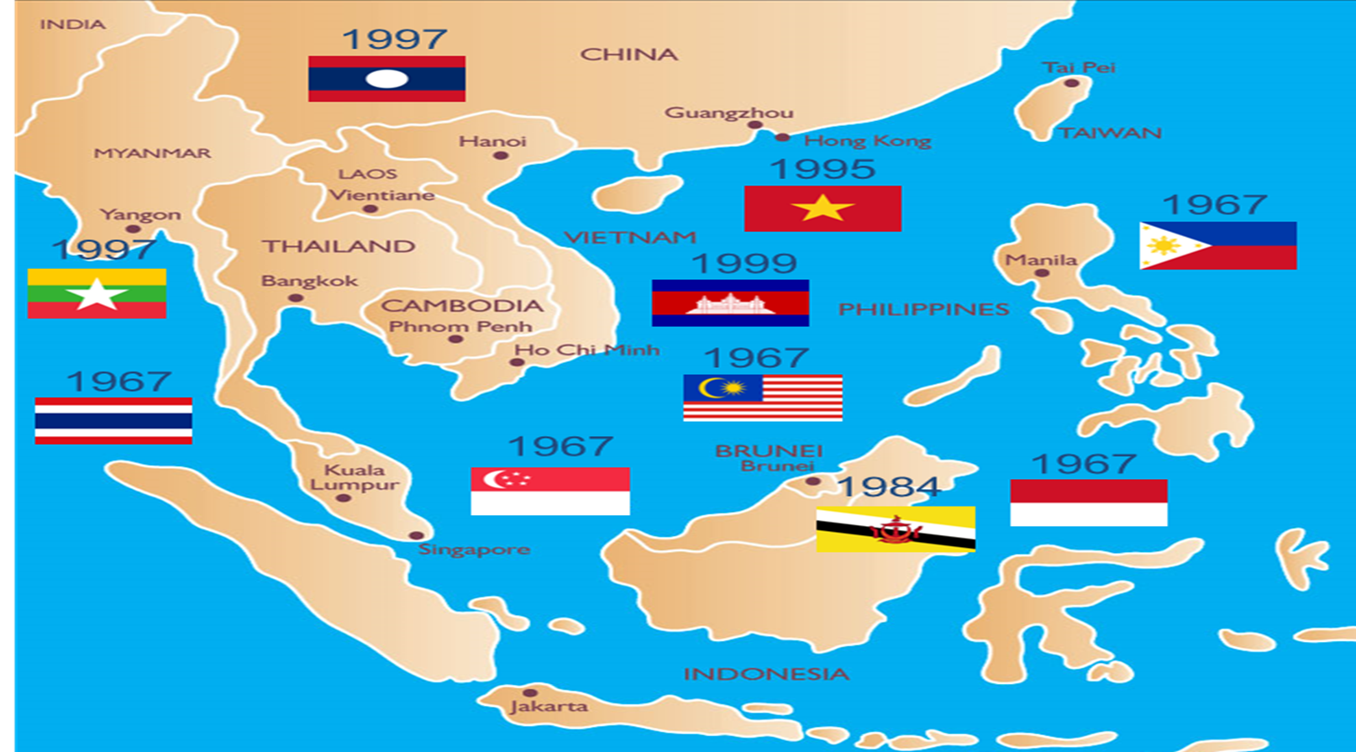
The ASEAN Community
Dr. Seree Nonthasoot, AICHR Thailand

Slide 3
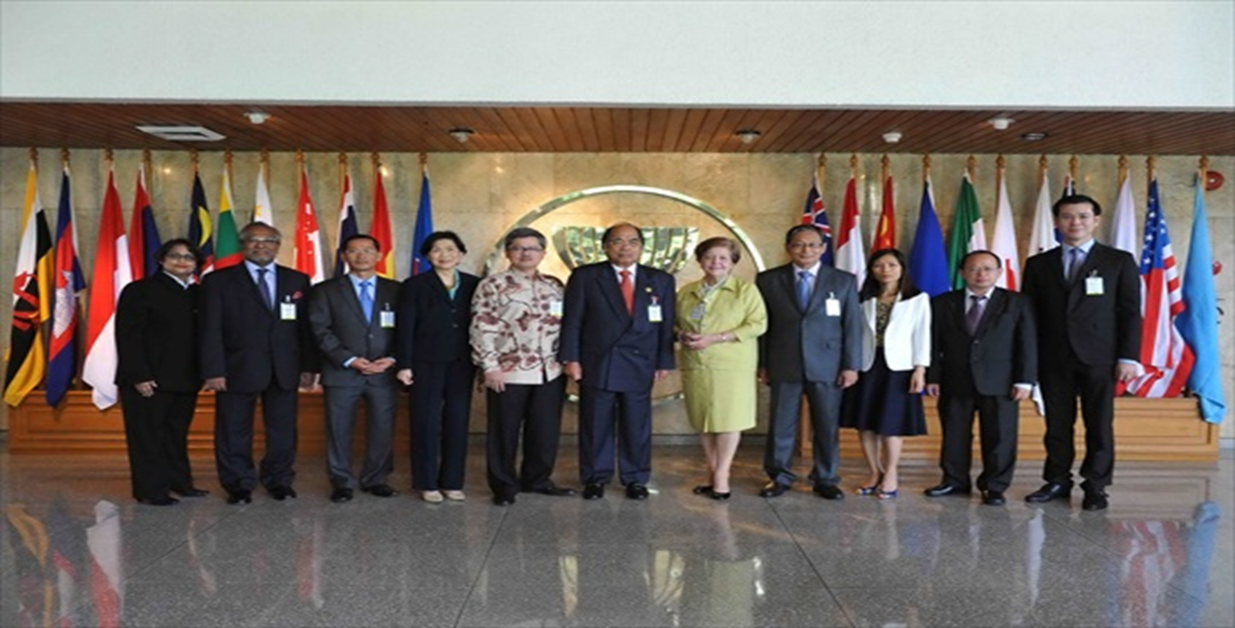
ASEAN Intergovernmental Commission on Human Rights
Dr. Seree Nonthasoot, AICHR Thailand

Slide 4
ASEAN Intergovernmental Commission on Human Rights
Inaugurated in 2009 (according to Article 14 of the ASEAN Charter)
10 Representatives, each appointed by respective ASEAN Member State with the term of 3 years, renewable once
Created as a consultative body with 14 mandates and functions, pertaining to promotion & protection of HRs
The Chair of AICHR is the Representative of the country serving as the Chair of ASEAN
Decision based on consultation and consensus
Required to hold two regular meetings, average number of meetings per year = 6
Line of reporting to the ASEAN Foreign Ministers Meeting with an annual interface
Interacting with CSOs through Guidelines on the AICHR’s Relations with Civil Society Organisations, based on ECOSOC Guidelines for NGOs and adopted in 2015 [Currently 11 CSOs have been endorsed with consultative status]
Interacting/Cooperating with a number of UN agencies (UNWomen, UNICEF, OHCHR, UNDP, UNESCO)
Apart from Workshop on RHRM organized in Bangkok in 2014, no regular cooperation with other RHRMs
Dr. Seree Nonthasoot, AICHR Thailand

Slide 5
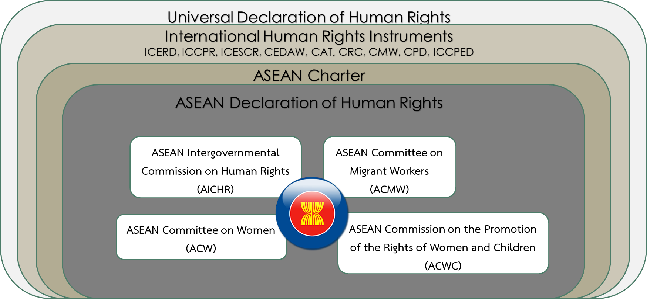
ASEAN Human Rights Mechanism
Dr. Seree Nonthasoot, AICHR Thailand

Slide 6
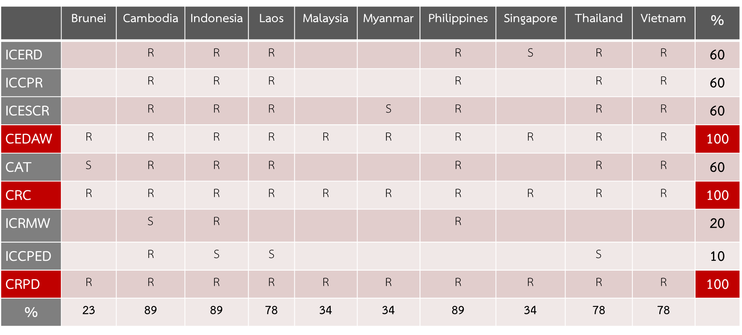
Ratification to Core Human Rights Treaties
Dr. Seree Nonthasoot, AICHR Thailand

Slide 7
Previous Cooperation with UN
OHCHR
Technical cooperation/ sending experts to join workshops
UNHCR
Cooperating on CRVS and right to nationality (lapsing in 2014)
Cooperating with individual representatives on CRVS (Birth registration)
Cooperating with ASEAN Commission on Women and Children (ACWC) on nationality laws
UNWomen
Support institutional capacity building and organization of various events
Provide technical support on development of regional plan of action on elimination of violence against children and against women (launched in 2015 by ACWC)
UNDP (recent)
Access to justice (Thematic study on legal aid)
UNESCO (recent)
Education rights/ the role of media/ cultural rights
Dr. Seree Nonthasoot, AICHR Thailand

Slide 8
Priority Programmes for 2017
Disability Rights
Mainstreaming disability rights across ASEAN pillars/organs
Set up a Task Force to develop a Regional Action Plan to mainstream the rights
Anti-Trafficking in Persons, especially Women and Children
Encourage ratification of ASEAN Convention against Trafficking in Persons, especially Women & Children
Mainstreaming right-based approach to trafficking
Business and Human Rights
Launched in 2014 the first thematic study on CSR
Follow up and consider developing Regional Action Plan on BHR, in parallel with promotion NAPs?
Human Rights, Environment and Climate Change
Organized already two workshops on the subject
Planning a follow up workshop on the development of a regional transboundary EIA
Dr. Seree Nonthasoot, AICHR Thailand

Slide 9
Areas for Further Actions/ Considerations
Review and revision of the Terms of Reference to enhance protection mandate
Enhanced cooperation with National Human Rights Institutions (currently 5 in ASEAN), especially in extraterritorial cases, eg transboundary environmental issues and irregular migration
Institutionalize interface with UN agencies that have already been in contact (UNWomen, OHCHR, UNHCR, UNDP, UNESCO)
Establish interaction with other UN agencies (ILO, WHO, World Bank)
Improving standards and requirements for engagement with CSOs (review of the Guidelines)
Engagement with UPR process of Member States (currently varies among different states)
Cooperation with other regional mechanisms [AICHR organized in Bangkok in 2014 “Workshop on Regional Mechanisms on Human Rights” → reorganize in 2017?] Possible focus → “standard-setting by RHRMs” or “Business & HRs: the role of RHRMs” or “SDGs & Development of ASEAN Regional Indicators”
Dr. Seree Nonthasoot, AICHR Thailand

