Slide 1
COMBATING THE SEXUAL EXPLOITATION
OF CHILDREN ONLINE
Dorothy Rozga
Executive Director, ECPAT International
Monday 09 March 2015,
Notes:
ECPAT commends the Special Rapporteur and the SRSG for organizing this side event and the Governments of Costa Rica and the United Kingdom for their sponsorship. We thank you for the opportunity share the perspective a global network of civil society organizations, active in 78 countries, united with a common mission to end the sexual exploitation of children.

Slide 2
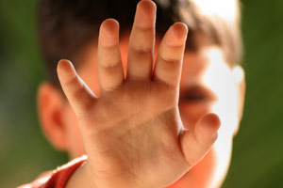
Notes:
We know that the Internet has completely transformed – revolutionized - the volume and nature of child sexual abuse images now in circulation. Each of these images is evidence of a crime against a child – a child who needs to be identified, rescued, supported, and ensured access to remedies, including reparation for the harm suffered.
To the extent that these images continue to be circulated, they represent flagrant violations children’s rights. Additionally, these images sustain or promote a sub-culture where the sexual exploitation of children – including very young children – is perceived and promoted as normal. This growing sub-culture represents a threat to children as yet unharmed.
Ending the online sexual exploitation of children requires strong partnerships across governments and strong partnerships between governments, law enforcement agencies, the private sector, and civil society.

Slide 3
Notes:
Civil Society organizations (such as ECPAT) have a crucial role to play. We can draw on the expertise of a very broad ‘family’ – spanning community and youth groups, professional associations, trade unions, faith-based organizations, and many more – all united around one common cause: the safety of children.
We are at the grassroots, working closely with victims and their families.
We are at the national level, pressuring for effective legislation and policies and for stronger capacity across law enforcement.
And we are at the international table, pushing for a global response and forging the networks that must be at the very heart of the response.

Slide 4
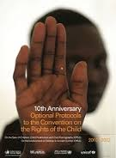
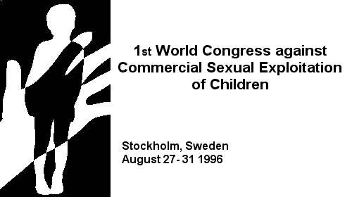
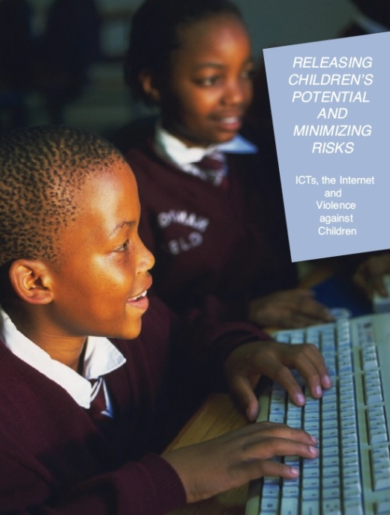
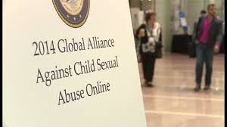
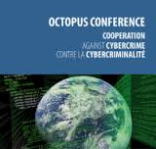
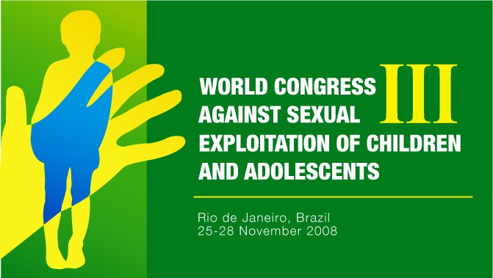
Notes:
Over the past two decade there have been many reports and events that provide recommendations on what needs to be done. And there have been many commitments to action.
Three World Congresses on the Sexual Exploitation of Children – in 1996, 2001 and 2008 all included commitments to address the situation.
Special Rapporteur de Boer’s first report to the Human Rights Council focused on the issue and provided a set of recommendations for a holistic response.
The SRSG’s annual reports and her 2014 publication Releasing children’s potential and minimizing risks ICTs give clear indications of what is required.
Civil Society Organizations –ECPAT, ICMEC, IWF, and INHOPE - to name a few - have issued repeated calls for action.
Through the Global Alliance against Child Sexual Abuse Online, commitments have been made by 54 national governments to take concrete actions to implement four shared policy targets.
And in December last year, the UK convened the #WeProtect Children Online Summit – which resulted in Statements of Action made by the ICT private sector, governments, CSOs, Interpol and UN agencies.
Without doubt, there are important reports and commitments and a growing consensus of what needs to be done.

Slide 5
“security and safety don’t just happen: they are the results of collective consensus and public investment” Nelson Mandela ....in his foreword to the 2002 World Report on Violence and Health
Notes:
So then why are the number of images and children abused online growing?
We now must address the chronic problem of under investment that significantly holds back the implementation of commitments. The resources available to combat child sexual exploitation online – at national, regional and global levels are far from what are needed.

Slide 6
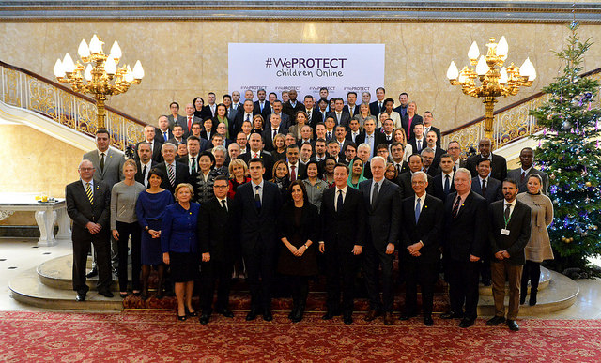
Notes:
The #WeProtect Summit was a breakthrough in addressing this under investment. The UK Government took the bold step of making available £50 million to help implement the promises made at the Summit.
At first glance the pledge of £50 seems quite substantial – however, when we look at magnitude of the problem and actions that need to be taken – we realize its limitation. Other bilateral and multinational donors, the UN, foundations, the private sector must follow the example of the UK, taking similar bold steps.... and making similar investments.

Slide 7
Notes:
In September of this year, Heads of State will agree on the Sustainable Development Goals (the SDGs). This new universal set of goals and targets will guide nations in framing their agendas, policies and investments over the next 15 years. The possible inclusion in the SDG’s of targets to end violence against child, presents a tremendous opportunity. During the next six months, our focus needs to be the inter-governmental processes that will define the SDGs, ensuring that the world’s new development agenda will include policies and provision to invest in protecting the world’s children from sexual exploitation online.

Slide 8
THANK YOU
for your attention

