Slide 1
HOW LANGUAGE SAVES LIVES
Aimee Ansari
Executive Director
Translators without Borders
#languagematters @Translatorswithoutborders info@translatorswithoutborders
Notes:
Information is key if people are to make informed decisions about their options – on every level. They need information to decide if they will flee their country – on the risks, benefits and processes. They need information in order to decide what their health care options are. Children need information in their language in school so that they can get a strong start in school while they learn the host country or even the official language of their country. Language is a critical aspect of people’s decision making. But just putting information out there is not enough.
[Hopefully we can use a short clip from the language barriers video here instead. Mention that it was made with support from the DfID-backed Mixed Migration Platform and Swiss Federal Department for Foreign Affairs (FDFA).]

Slide 2
TWB’s Program
Programs
Crisis
Development
Technology
Advocacy
Rapid response to support non-profits with community engagement
Creation of long-term content, simplified and
in local languages
Create content platforms to integrate with partner delivery channels
Evangelize the need for community engagement through local languages
Rapid creation of networks of local language experts
Monitoring of local language social media
Training of rapid response translators
Creation and/or translation of crisis-specific local language content (message libraries)
Assessments of content
Training new translators and interpreters
Connecting aid organizations with interpreters
Simplification of health content for community health workers
Training of new local translators in local languages
Translation of standard medical content into local lingua francas
Campaign-driven content into local languages
Rapid response message handling platform
Platform for volunteer translation of development content
Training all translators in translation, business and project management tools
Translation automation for local languages
Machine Translation for all languages
Innovative approach to distribution of content
Broaden understanding of the need for content in humanitarian work
Develop strategic planning influence on content needs for local communities
Comprehension studies and advocacy for information as a key component of response
Foster relations between agencies on content best practice
Notes:
A little about TWB

Slide 3
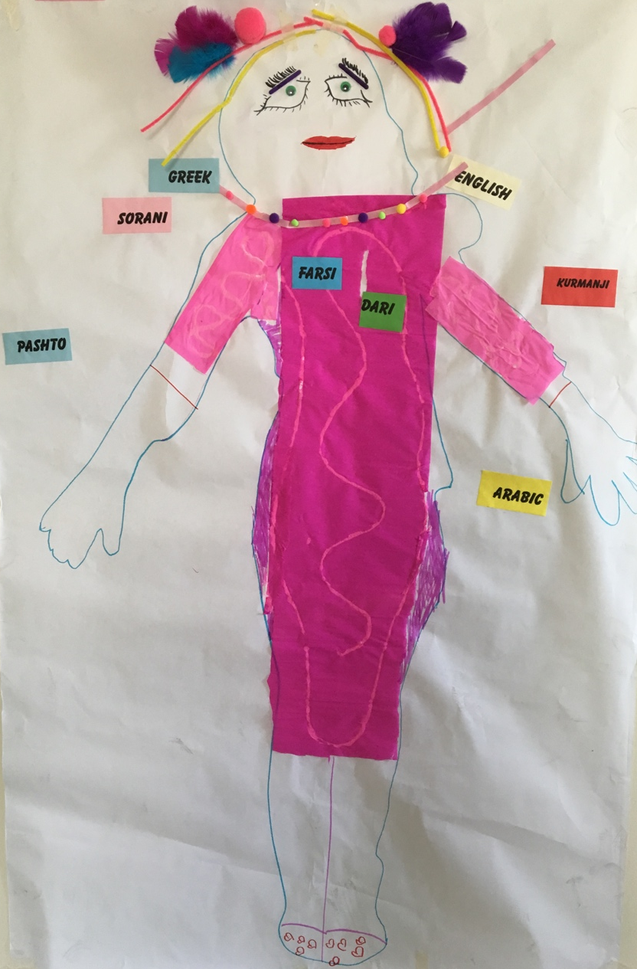
Migrants and Language
Is the information:
Accessible?
Readable?
Comprehensible?
Useful?
Notes:
This picture is a drawing that a child in Greece drew about her “language journey”. Even though migrant children speak a smattering of languages, it’s their mother tongue that they feel closest to – it’s inside them.
Key message: a failure to communicate with migrants has consequences. A little effort is needed to understand how to communicate effectively.
Some findings of our research with migrants in Greece:
88% preferred to receive information in their own language – so they can understand it
56% of those surveyed did not understand the information given to them in writing even in their own language – the content and format also need to be appropriate
They want it written down, even if they can’t understand it. They can take it to people they trust; they can triangulate it; take a photo and send it home.
Research also shows that:
Migrants are much more likely to believe someone (like a trafficker) who speaks their language and dialect, rather than an aid worker who gives them information. (from TWB’s research in Turkey and Italy)
Children and others who do not understand the information given them on their rights and protections, will resort to risky choices, including dropping out of the formal system. (REACH research): Leaflets issued to unaccompanied children at the Franco-Italian border were not in a language they could understand. As a result, ‘children resorted to taking less safe routes, such as walking through mountains, or paid smugglers in order to minimize the risk of being caught’
Notes, just in case someone asks:
The game took place at the camp of Skaramaga, in the Children Friendly Space area of Save the Children.
Skaramaga camp is the most populated refugee camp in Attica region, with a population of approximately 3100. It is one of the most diverse camps in terms of countries of origin and languages spoken. For this reason, SCI recommended we implement the game in this site.
The game was implemented on 26 and 27 April with three different group of children aged 7 to 14 (25 in total):
Farsi and Dari speaking children (5 boys and 3 girls)
Kurmanji and Sorani speaking children (5 boys and 4 girls)
Arabic speaking children (3 girls and 5 boys)

Slide 4
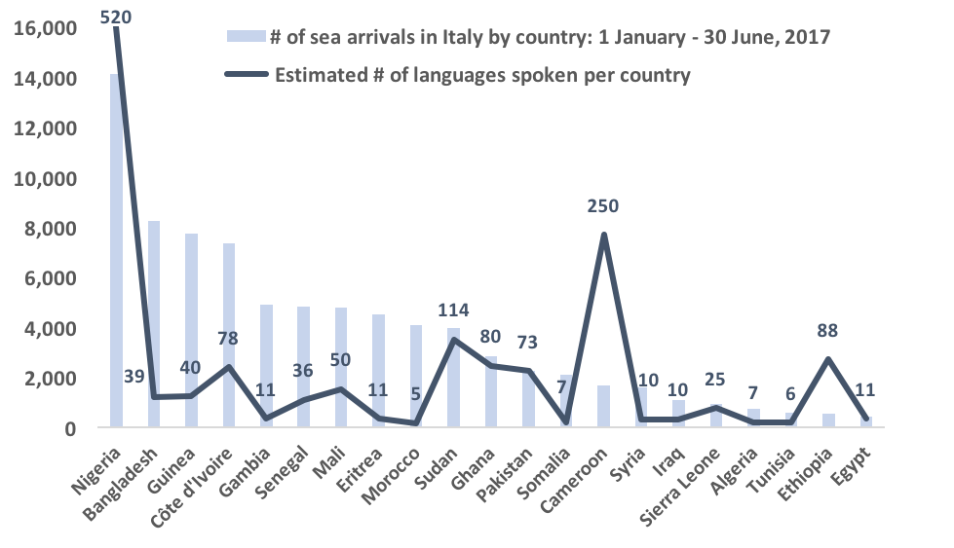
What language?
‘These are often Italians speaking English as a second language, trying to communicate with migrants speaking English as a second or third language. […] The migrants get frustrated so they leave the formal mechanisms.’- Social worker, Catania, Sicily
Notes:
So what’s important to help people get information – so they can decide to migrate or not? First, you have to know what languages they speak.
In Italy and Turkey, for example, none of the 46 humanitarian organizations consulted by TWB in Italy and Turkey routinely asked refugees and migrants their first language or which other languages they understand.
Without data on refugee and migrant languages, responders use country of origin as a proxy. Registered migrants entering Italy in the first six months of 2017 came from 21 countries, including Nigeria. Yet Nigeria is home to over 500 first languages, suggesting that country of origin is not a reliable indicator of the languages that migrants speak.
International’ languages such as English, French and Arabic are often incorrectly assumed to be an effective means of communicating with refugees and migrants.
90% of refugees and migrants interviewed by TWB in Greece in April 2017 had no knowledge of English.
In Izmir in western Turkey, many humanitarian organizations stated that they use Arabic almost exclusively to communicate with Syrian refugees and migrants because 91% percent of registered migrants in Turkey are Syrian. Yet not all Syrians speak Arabic – and the remaining 9% of migrants amount to 315,000 are a large and linguistically diverse population to disregard.
Key message – find out what languages people speak – collect the data. Nobody would plan services without vital facts such as the age and gender of the users.
When humanitarians can’t communicate in the right language, people’s needs go unheard and unmet. An inter-agency assessment team in Damasak, Nigeria in March 2017 lacked a Kanuri speaker, so asked a male soldier to help them ask returned refugee women and girls about any protection concerns. Unsurprisingly, the women reported that everything was just fine.

Slide 5
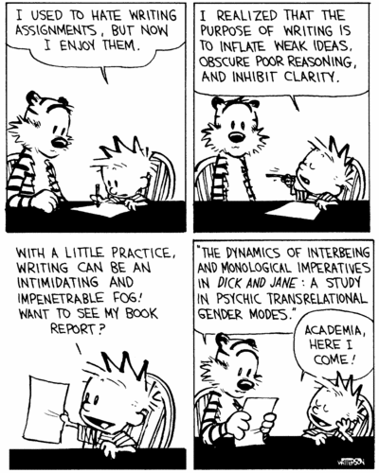
Understandable?
Notes:
Key message: make sure that you not only put information if the right language, but that it’s a message that people can understand.
Example: In Yemen, the word “cholera” was used in Arabic. No one in Yemen has any idea what cholera was, so didn’t follow the advice. When it was changed to “watery diarrhea”, people understood and could follow the advice.
Making sure the content is appropriately simplified and clear is particularly important for communicating with children, less literate people, and people digesting the information in a second or third language. I
Example: Unaccompanied migrant children at the six camps included in the TWB/Save the Children study in Greece were receiving long written documents inappropriate for their age. (Other children at the camps were not receiving any information directly.)

Slide 6
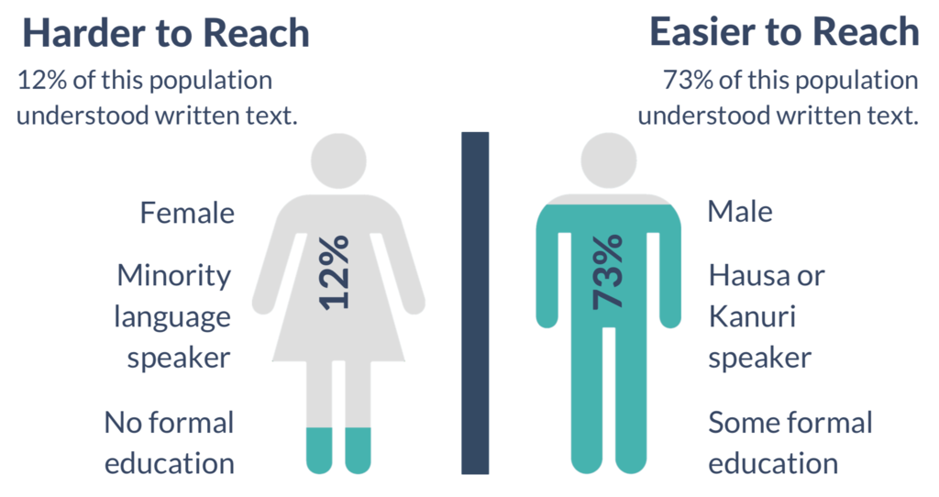
Glossary app for humanitarian interpreters
Format?
Notes:
Women in NE Nigeria cannot understand written text – in any language. Less educated women and those who speak minority languages are least likely of all to understand information in written or simple graphic form.
77% of a sample of nearly 1,000 IDPs and host community members could not answer a comprehension question on a simple text in Hausa or Kanuri – the two main languages humanitarians use to communicate with affected people.
The use of graphics in addition to text improved comprehension to 37%. But audio messaging in Hausa and Kanuri was the only effective format for this group.
Key message: reaching the most vulnerable is key – they are the ones that migrate and need the information the most. Make sure your information is in a format they can access – and that you KNOW where they get information.

Slide 7
LANGUAGE MATTERS
Aimee Ansari
Executive Director
Notes:
If we don’t communicate effectively with migrants (and refugees), there is little chance of achieving the Global Compacts’ aims of saving lives, reducing unsafe movement, and combating trafficking and exploitation of all migrants, regardless of status.
To communicate with migrants we need to:
Address a collective blind spot on language and communication – start seeing how essential it is to practical outcomes.
Collect the data needed to plan for language support, and resource that support appropriately.
Above all, as governments and and as humanitarian organizations, we need to make communicating with affected people the default position of migration management and refugee response.

