Slide 1




Discrimination of Mongolian TB patients access to medicines, diagnosis and treatment . Good practices of Mongolia in tackling these issues.
O.Batbayar
MPH ( London School of Hygiene and Tropical Medicine)
ED of Transparency International Mongolia
ED of Zero TB Initiative Mongolia
Chair of Mongolian TB doctors association
Chair of Medicines Transparency Alliance of Mongolia

Slide 2



Outline
General Info about Mongolia
TB epidemic in Corruption , capacity and resource scarcity environment
TB situation in Mongolia and discrimination
Information about META and META projects in Mongolia
Good practices of ZTB Mongolia and it’s activities to reduce discrimination

Slide 3
Mongolia has a leading land per capita in the world
Territory: 1.6 million sq. km
Population: 3.00 million (2015)
Mongolia Overview
GDP 2013 in USD billions
Population 2013in millions
RUSSIA
US$ 2,014
143
MONGOLIA
US$ 11,4
3
S.KOREA
CHINA
US $1,129
50
US$ 8,358
1,351
JAPAN
US$ 5,959
127
Source :World Bank, 2015

Slide 4
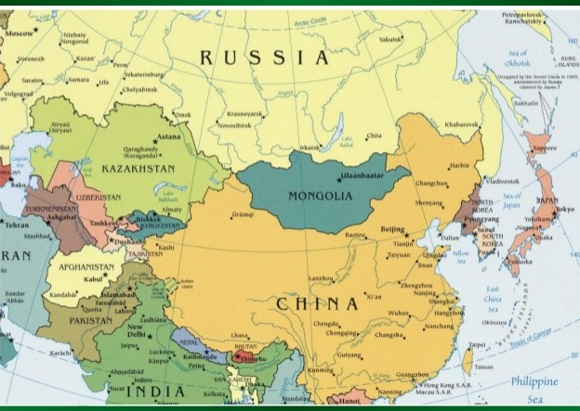
COUNTRY BACKGROUND
The Mongolia is a landlocked country in Central Asia
⁓ Area: 1.565 million km²
⁓ Population: 3.2 million
⁓ Capital city: Ulaanbaatar
⁓ Ethnic groups: Khalkh 81.9%, Kazakh 3.8%
⁓ Language: Mongolian 94%
⁓ Independence: 11 July 1911
⁓ Political system: Parliamentary
⁓ Economy: Agriculture 14.9%, industry 34.1%,
service 51.1%

Slide 5
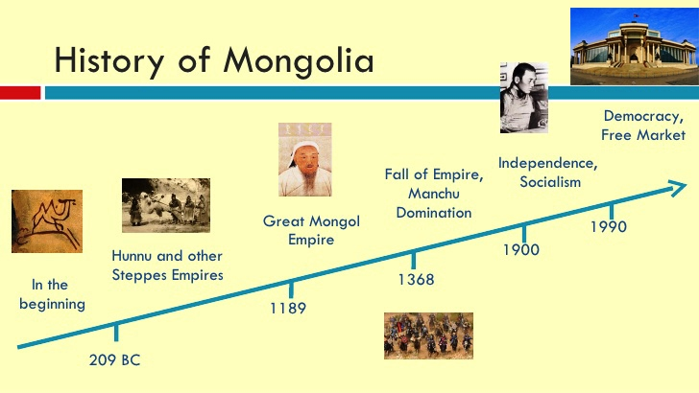

Slide 6
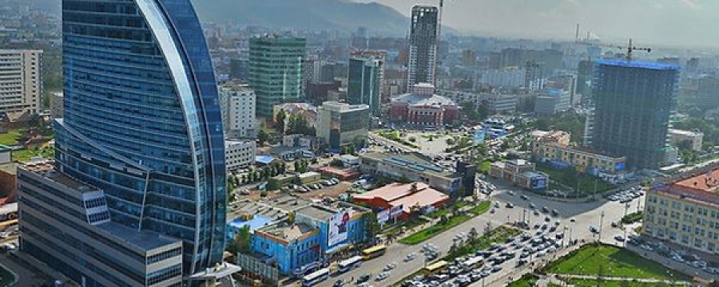
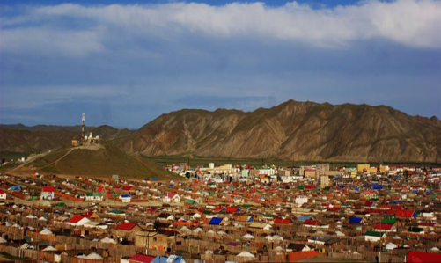
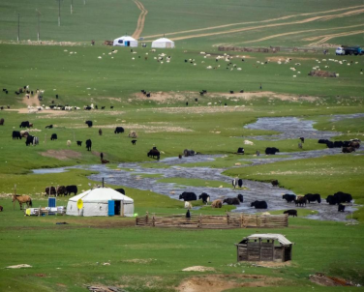
City
Provincial center
Rural soum (sub-provinces)

Slide 7

CLIMATE

Slide 8
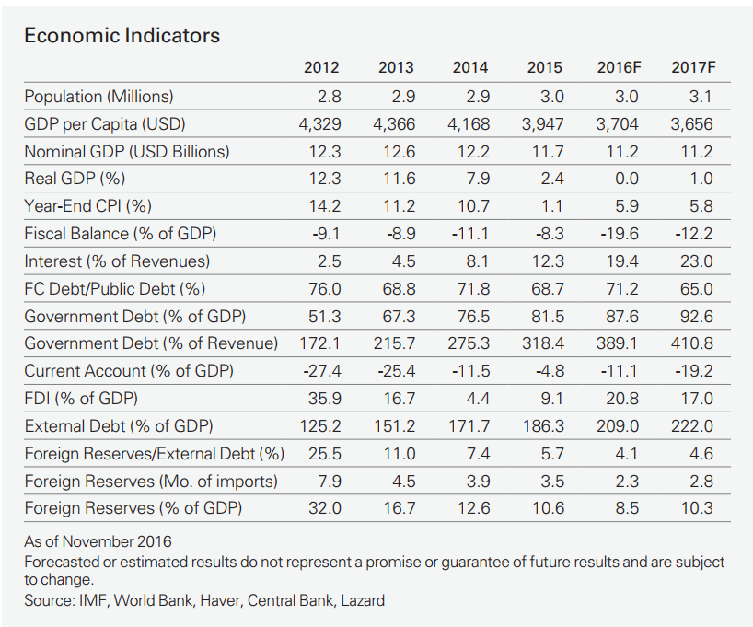
Mongolian macroeconomic indicators and recent bail out by IMF
Notes:
Rece

Slide 9
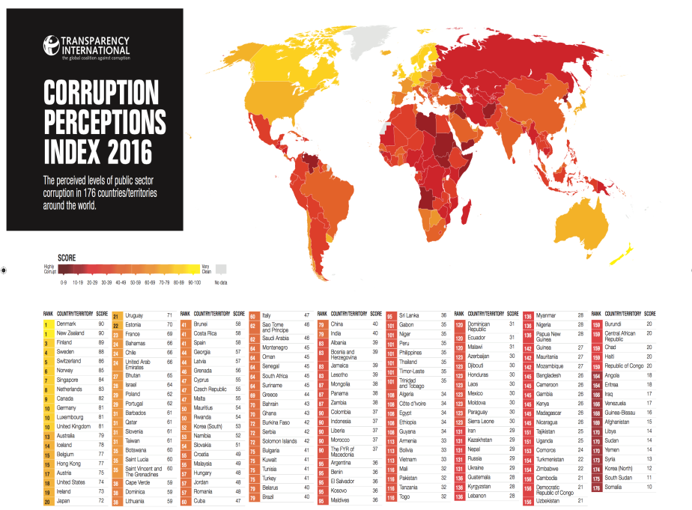
Corruption and human right in Mongolia

Slide 10
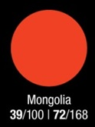
CPI Mongolia 2012-2016
39/100
2012
36/100
2013
38/100
2014
39/100
2015
39/100
2016
38/100
39/100
39/100

Slide 11
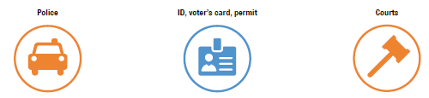

Public sector ( 2017 case of how Mongolian health Minister ended up in prison)
Most corrupt public sector by Mongolian citizens
16%
11%
*
10%
*
16%
.

Slide 12
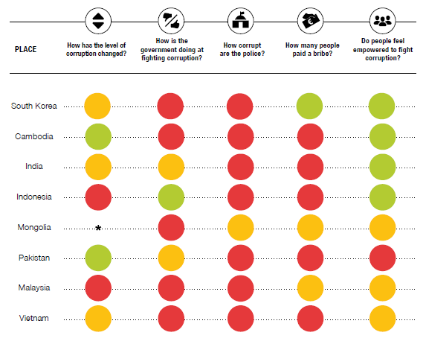
Corruption Barometer results 2016- Asia Pacific
* Question was not asked.

Slide 13
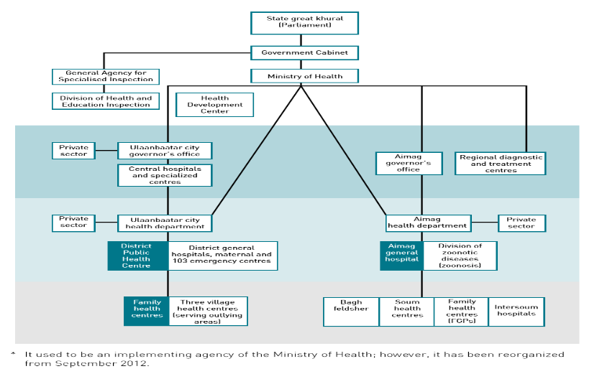
Health system’s organizational hierarchy and inefficiency

Slide 14
2016 outbreak of Measles and what is not reported ( hidden mortality number and drug quality)
Measles outbreak in Mongolia – FAQs
5 May 2016
OUTBREAK FACTS:
1. When, where and why did the outbreak start?
According to the currently available data there is a likelihood that the outbreak started before March 2015.
It’s unknown where the outbreak started but the first registered case was reported on 18 March 2015 from Chingeltei District of Ulaanbaatar city.
Laboratory results showed that the measles virus genotype identified from the first registered case was similar the measles virus circulating in China. The outbreak started due to presence of:
  imported measles virus from infected people;
  susceptible people(those without immunity to measles); and
  contact between infected and susceptible people in Mongolia.

Slide 15
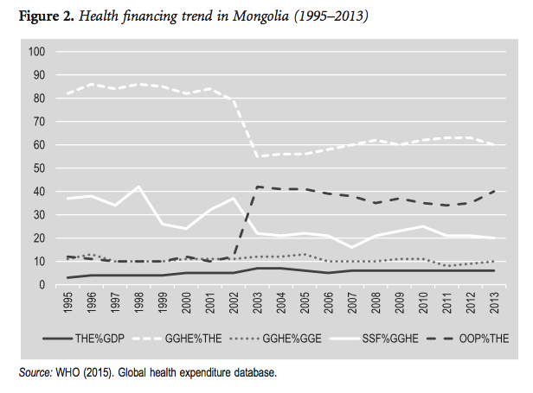
100% Health insurance coverage and 23% of cost only paid by insurance
Social health insurance development in Mongolia: Opportunities and challenges in moving towards Universal Health Coverage
Dorjsuren Bayarsaikhan, Soonman Kwon and Dashzeveg Chimeddagva
Word Health Organization, Geneva, Switzerland; Seoul National University, Republic of Korea; Macroeconomics and Health, Ulaanbaatar, Mongolia

Slide 16
What are the problems in Mongolian pharmaceutical sector ?
Poor availability: public sector 42.8% (EML meds), private sector 73% (all meds) and RDF outlets 60%
Poor quality: 14% substandard, 19% illegal
High prices: public sector procurement MPR 2.24
  Patient price public: 2.25; patient private: 7.23
Irrational use of antibiotics (=> resistance!)
Irrational use of injections (=>18% Hep-C!)
Local producers: many poor GMP, unregistered meds
Promotion of ineffective nutriceuticals, BAPs etc

Slide 17
Assessment of Pharmaceutical sector transparency and accountability by META . 07.2017
key pharmaceutical functions and result is shown as below.
Access to information and participation 67% High
Code of conduct and anti-corruption 86% High
Managing conflict of interest 50% Moderate
Registration and marketing authorization of 56% Moderate
Licensing premises
Medicines manufacturers 74% High
Medicines wholesalers 74% High
Pharmacies 64% Moderate
Regulatory Inspections
Medicines manufacturers 64% Moderate
Medicines wholesalers 64% Moderate
Pharmacies 64% Moderate
Contracted research organizations 18% Low
Pharmaceutical promotion and independent information 35% Moderate
Clinical Trials Oversight 31% Low
Medicine Selection and Reimbursement Lists 45% Low
Public Procurement 74% High
Distribution of publicly procured medicines 38% Moderate

Slide 18
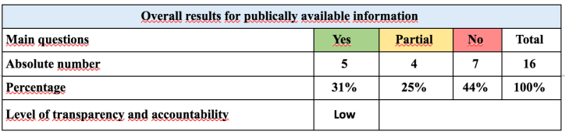
VI. Medicine Selection and Reimbursement Lists

Slide 19
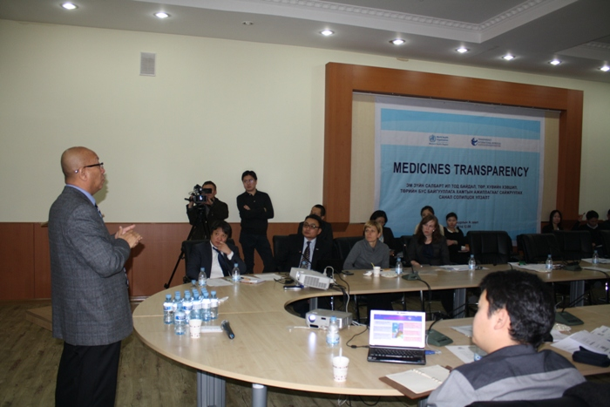
First meeting of Meta Alliance Building in Mongolia

Slide 20

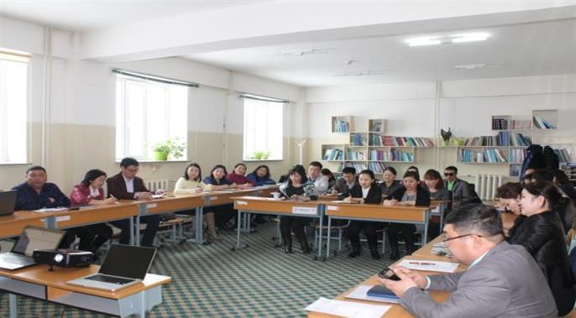
Uvs province World Bank and SDC project procurement of Drugs and social accountability by META ( result improved quality and price)

Slide 21

Building National Multi-nutrient Food-Fortification Policy in Emerging Democracies in the Context of Mongolia
October 2016
The workshop is organized around three issues related to food fortification in Mongolia. The first issue concerns challenges and stumbling blocks around food fortification. The second issue involves the exploration of how challenges related to food fortification were addressed in the US, in former Soviet countries, and through economic models of cost-effective fortification policies. The third issue focuses on examining the most effective way that collaborators concerned with food-fortification policy can overcome barriers to food fortification in Mongolia.
Result- Food fortification law being lobbied and in process of approved by parliament.

Slide 22
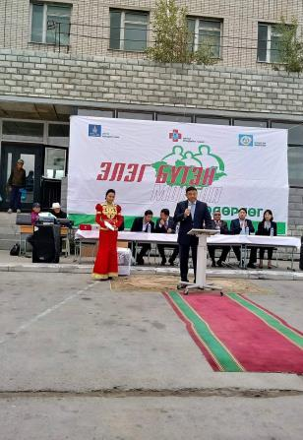

PPP- Hepatitis free Mongolia as good example of success
Implemented with great success
Fast registration of hepatitis drugs
Screening
Lab test
Treatment ( Harvoni) Fast registration of drug

Slide 23
High TB Burden in ASIA
Country, Year | Age | Smear Positive | Bact. Positive
Philippines, 2007 | 10y- | 260 (170-360) | 660 (510-880)
Viet Nam, 2007 | 15y- | 197 (149-254) | 307 (248-367)* *1 culture , CXR TB suspects
Myanmar, 2009 | 15y- | 242 (186-315) | 613 (502-748)
Cambodia, 2011 | 15y- | 271 (212-348) | 831 (707-977)
Lao PDR, 2011 | 15y- | 278 (199-356) | 595 (457-733)
Thailand, 2012** ** Provisional, Non-Bangkok | 15y- | 101 (56-181) | 242 (182-322)
Indonesia, 2013 | 15y- | 257 (210-303) | 759 (590-961)
Mongolia, 2014*** ***Provisional, Urban stratum | 15y- | 173 (113-233) | 567 (437-697)

Slide 24
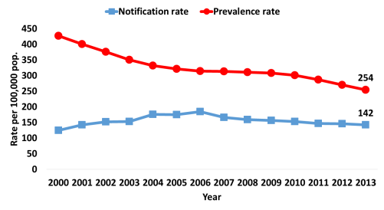
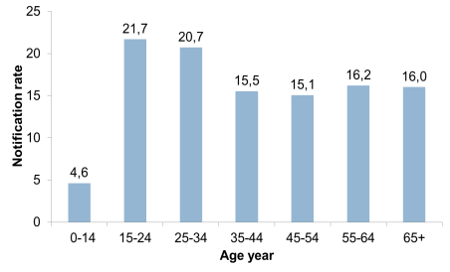
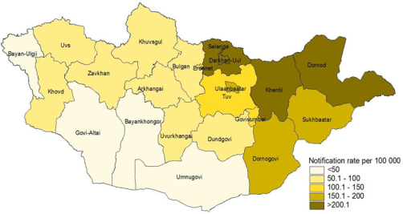
TB situation in Mongolia
Prevalence vs notification rate for all form TB
Age distribution of notified all form TB
Notification rate by provinces
MDR-TB

Slide 25
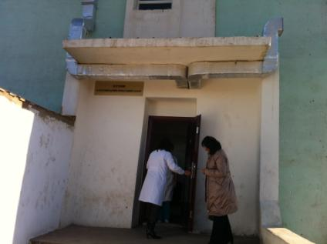
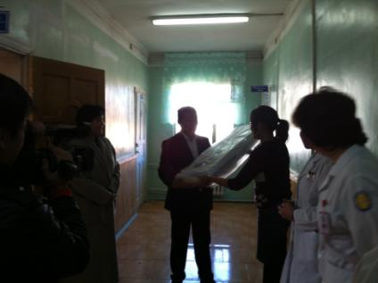
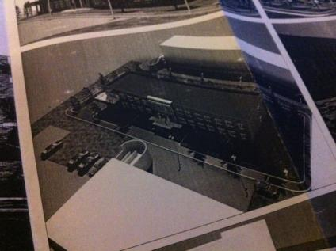
TB Health care workers discrimination in Mongolia ( improving IC and 30% bonus)

Slide 26
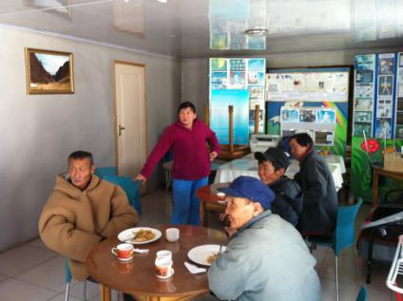
TB patients
Human right issues
Access issues
Discrimination
Drop out
Loss of job
Recent WHO study of TB patients catastrophic cost ( loss of income and direct expense)

Slide 27
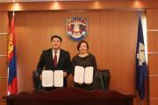
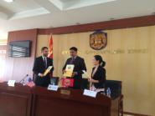

Timeline of Zero TB Mongolia launch
2017.1.7
MHI signed MOU with UB city Department of Health
Zero TB conference in Ulaanbaatar city, Khan-Uul district signed an agreement to become a 1st district to join Zero TB UB city
2017.6.5
2017.6.24
Mandal soum, a sub-province has signed an agreement to join Zero TB Mongolia
2017.9.20-
Zero TB Ulaanbaatar city launched and screened 500+ household contacts
2017.9.26
Zero TB Mongolia team has joined World ZeroTB conference

Slide 28


Prevalence and risk factors for M. tuberculosis infection in 9,137 Mongolian school children
Preliminary Results of a Randomized Clinical Trial in Ulaanbaatar, Mongolia
Ganmaa Davaasambuu, M.D., PhD.
Batbayar Ochirbat, M.D., PM.
Yanjmaa Jutmaan, PhD., PC.
Uyanga Buyanjargal, M.D., ED.
Sunjidmaa Bolormaa, B.M., LP.

Slide 29
Vitamin D in TB Prevention Trial
IGRA-negative primary schoolchildren
(n=8,020; Mongolia)
Randomize
14,000 IU vitamin D₃/weekly (n=4,010)
Placebo (n=4,010)
Follow-up (3 years)
Repeat QFT-Gold: compare rates of latent TB infection between arms

Slide 30
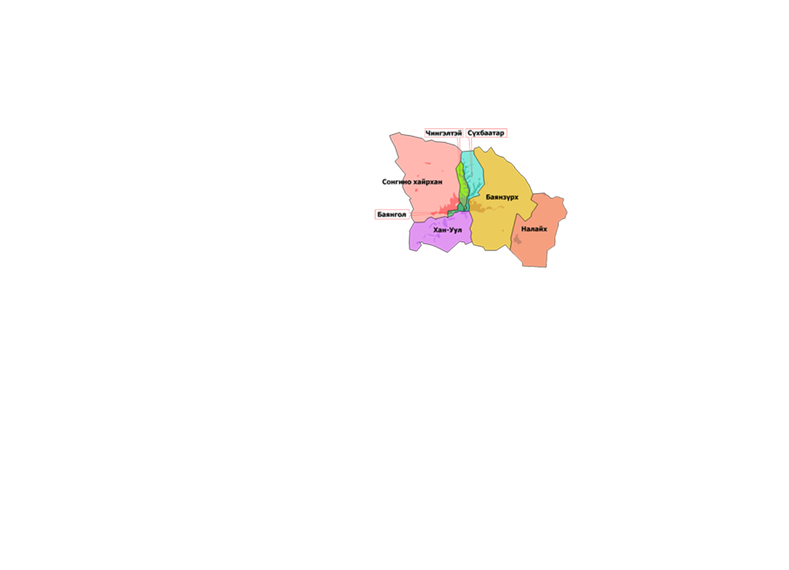
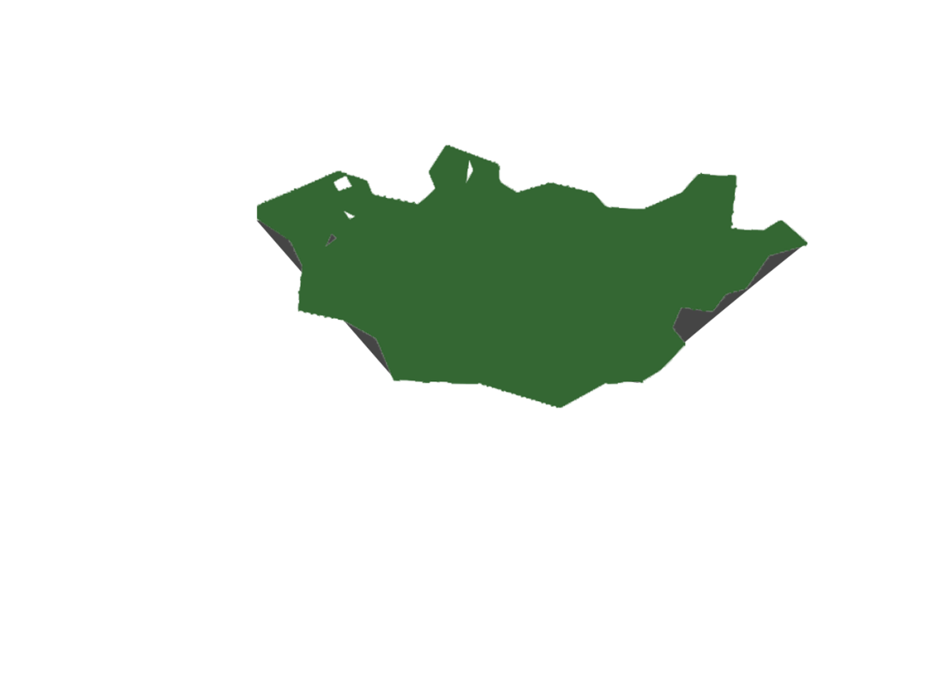
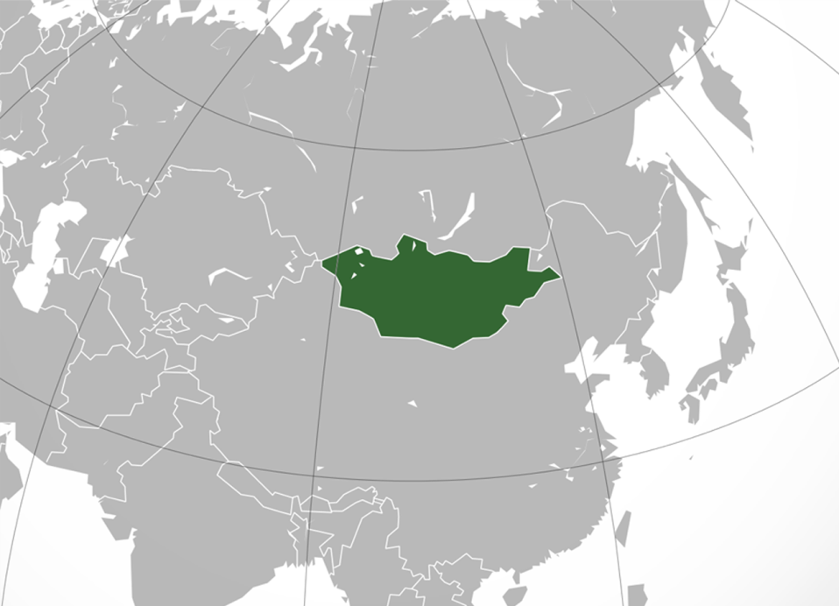
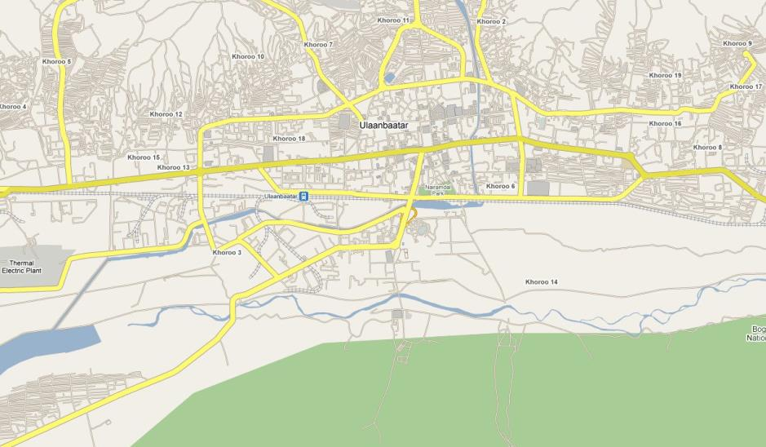

49
57
4
16
107
37
Shavi
76
113
21
92
12
65
34
60
10375 children from 15 schools from 6 districts of Ulaanbaatar invited to participate in study, of whom 8,214 were randomized.

Slide 31
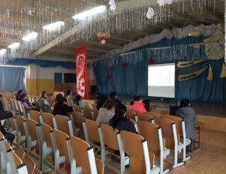
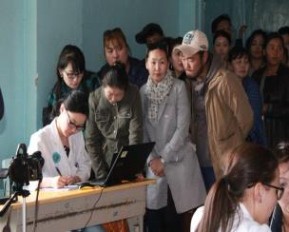
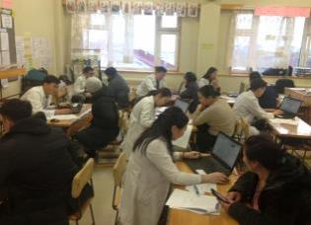
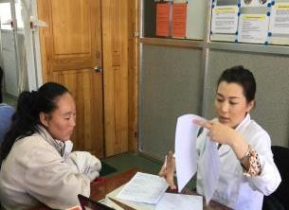
Recruitment Session
Informational session
Enrollment log registration
Data entry: Redcap
Obtaining assent and consent forms

Slide 32
Tb test result

Slide 33
Preliminary Results
LTBI prevalence 9940 per 100,000
Risk factors: age-child has 15% increase in risk of LTBI per one year of age increase
Residence: compared to kids with centrally heated apartments, child with not centrally heated dwellings have 30% more risk.
Passive smoking: each additional person smoking indoor increases the risk of LTBI by 22%
TB contact: the presence of anybody with TB in the house almost 4 times increases the risk of LTBI.

Slide 34
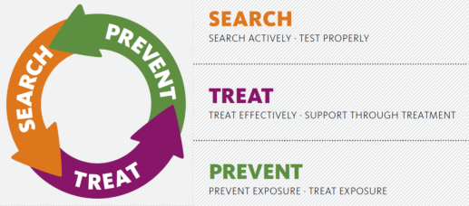
Zero TB initiative
Zero TB Mongolia’s fight against discrimination of children’s TB
Access to diagnostics
Access to screening
Access to latent TB diagnostics
Access to latent TB drugs

Slide 35
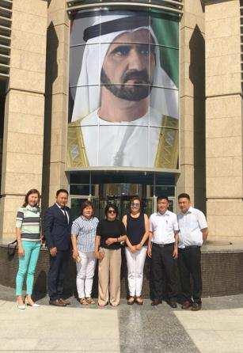
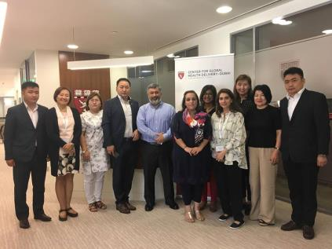
Dubai meeting on 29.09.2017 . Zero TB initiative
Mongolian team meeting Pakistan team

Slide 36
Timeline of Zero TB Mongolia launch
2017.1.7
MHI signed MOU with UB city Department of Health
Zero TB conference in Ulaanbaatar city, Khan-Uul district signed an agreement to become a 1st district to join Zero TB UB city
2017.6.5
2017.6.24
Mandal soum, a sub-province has signed an agreement to join Zero TB Mongolia
2017.9.20-
Zero TB Ulaanbaatar city launched and screened 500+ household contacts
2017.9.26
Zero TB Mongolia team has joined World ZeroTB conference

Slide 37
Conclusion
TB and HIV epidemics main problem in third world countries are corruption, capacity and scarcity of resources.
Political will of many politicians are lacking .
NGOs should take lead in promoting and protecting of human rights in the TB and HIV epidemics context.
There is already good practices such as META, ZETO TB innovative initiatives which WHO, GF and UN should support .

Slide 38
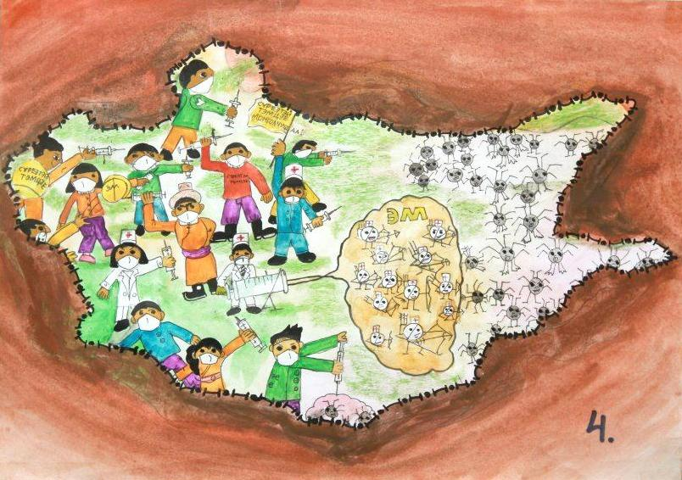
Thanks .

