Slide 1
The Right to health in Moldovan prisons: HIV/TB/HCV aspects
Dr. Svetlana Doltu, MPH
member of the Council for the Prevention of Torture, Republic of Moldova
Social Forum of the Human Rights Council,
Promotion and Protection of Human Rights in the context of HIV epidemic
Geneva, 03 October 2017

Slide 2
General Overview
Moldova population – 4 mln
Prison population – 7868 inmates, 6% women and 1% juvenile offenders
Total Number of prisons – 17
Incarceration rate – 265 per 100,000 population
Occupancy rate – 91%
Estimated nr. of PWUD prisons (2015) - 15% (1217 inmates)
HIV prevalence (1,6%) – 123, including 97 in ARV (78,9%)
HVC prevalence (4,5%) – 345 inmates, in treatment -5 people (
TB prevalence (1,6%)– 131, including 80 MDR TB
Drug dependency (6,3%) - 468 inmates, including 71 (15%) inmates in OST
*data as of July 2017

Slide 3
Notes:
The international standards on the right to health in prisons, specifically the United Nations Standard Minimum Rules for the treatment of Prisoners (the Nelson Mandela Rules).
Rules from 24 to 35 are on Health, however, rule 24 is specifically referring to HIV in prisons

Slide 4
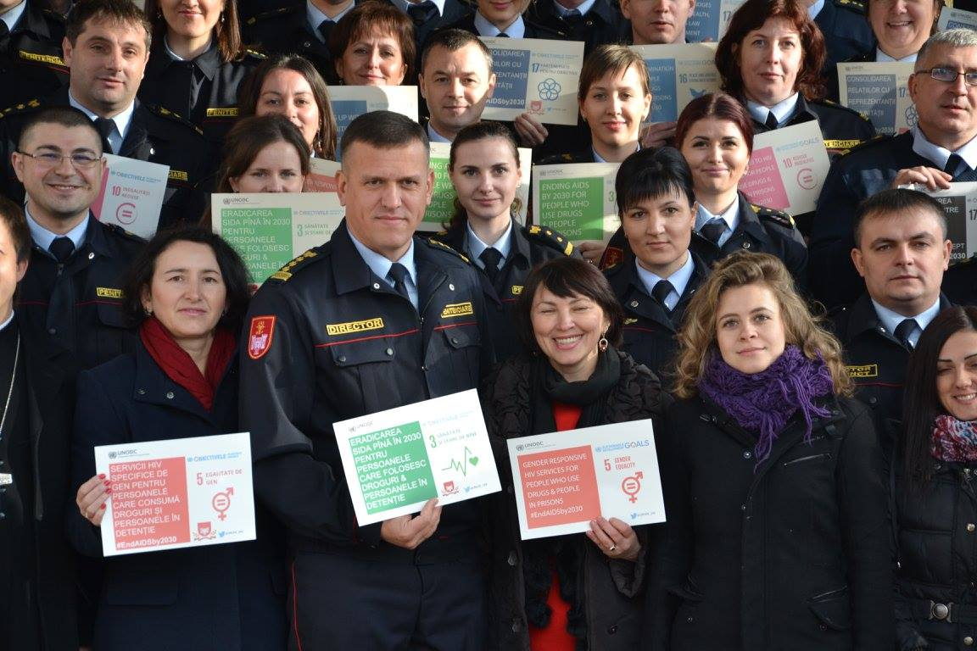
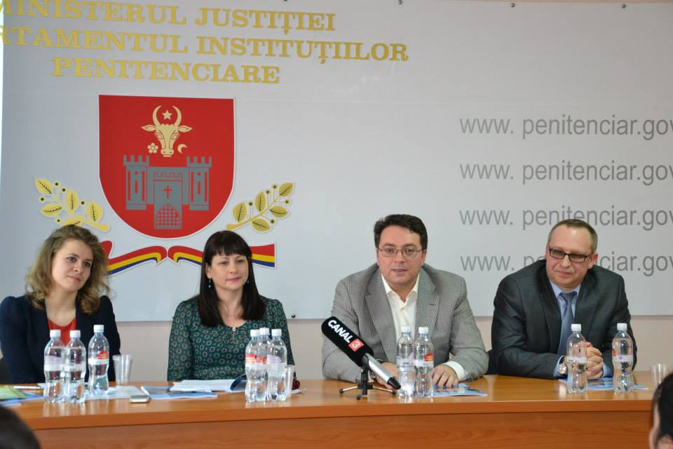
Moldovan Prison Authorities continuously demonstrate high level of commitment for building a comprehensive strategy on HIV/AIDS prevention, treatment and care in prisons by ensuring access of inmates to services equivalent to those available in the community
Notes:
За 16 лет внедрения комплексного пакета услуг, обучение высшего руководства власти.

Slide 5
Currently, the Moldovan prison system is implementing 13 out of 15 interventions recommended within the comprehensive package of services for PWIDs in prisons

Slide 6
The Most Important Implementation Steps
1999 - Needle exchange and condom provision programs
2001 - DOTS in tuberculosis treatment
2004 - ARV and the first DPI ordinance for HIV/AIDs prevention, treatment, care
2005 - Pharmacotherapy with Methadone, also treatment for TB MDR
2007 - End of the mandatory HIV testing of prisoners on entering prison
2008 - Initiation of HIV Voluntary Testing and Counselling services
2012 - (GeneXpert) the method for rapid diagnosis of TB
2013 – VCT services provided through NGO on saliva available for inmates
2014 - Overdose management (NSP sites in prisons have been equipped with Naloxone)
2014 – Procedures manuals for prison staff (NSP, OST) was aprouved by DPI
2015 - Biological waste management – with the support of UNODC, equipment was procured to ensure safe disposal of needle and syringes collected through NSP
2016 – started the monitoring visits of NPM, including public health aspects
2017 – Implementation of viral hepatitis treatment

Slide 7
Under the guidance of UNODC Moldova in partnership with the DPI, 2013-2014, 2 Guiding Procedure Manuals for prison medical services in implementing NSP and OST programs, approved by via DPI Ordinance 237/17.08.2014 and 237/19.08.2014

Slide 8
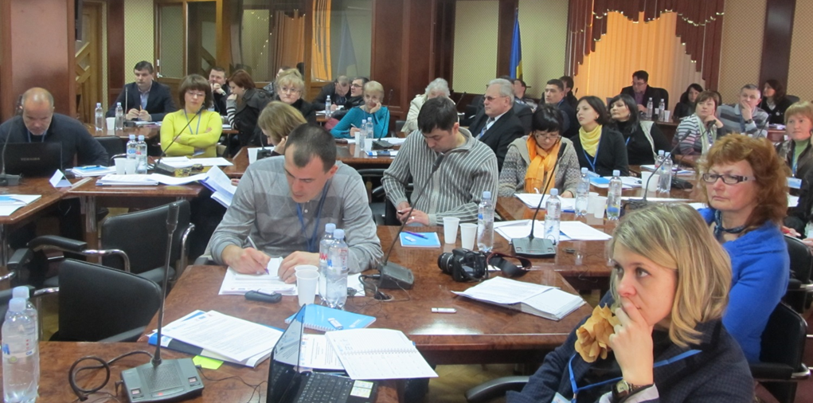
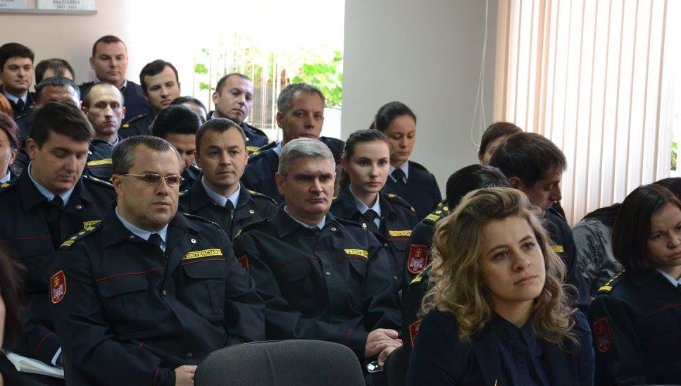
Continuous Advocacy and Strengthening of the Capacities of prisons authorities and staff is very important
Notes:
Most of new recruits are coming from police

Slide 9
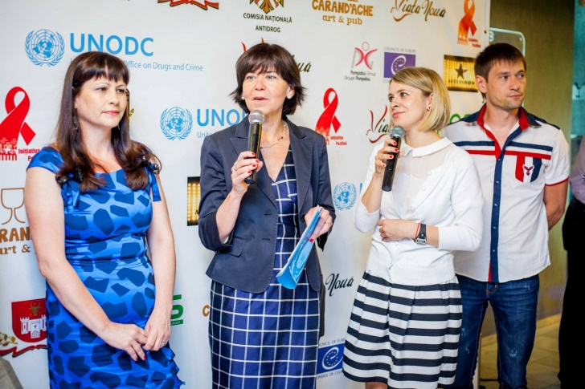
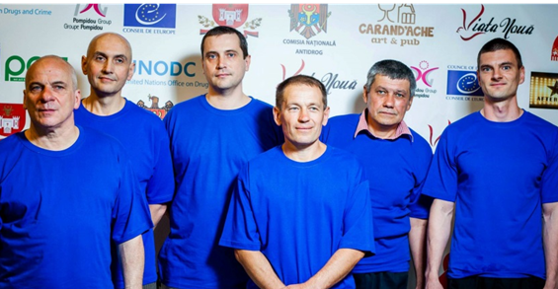
High-level advocacy and policy dialogs
Brain Ring Intellectual contest for inmates 2013 and 2014 on the occasion of the WDD
Notes:
Brain Ring - конкурс был организован в три этапа (местный - пенитенциарный, региональный - пенитенциарный и национальный финал - в общественном пространстве) с участием задержанных из 9 тюрем. В этих вопросах были проверены как общие знания о задержанных, так и проблемы, связанные с употреблением наркотиков, ВИЧ и туберкулезом. Во время финального раунда три команды из пенитенциарных учреждений, имеющие в качестве совместного оборудования известный общественный деятель, соревновались в свободном месте, общественном месте в городе Кишинэу. Родственникам и членам их семей также было предложено поддержать участников.

Slide 10
Monitoring of the right to health
The Council for the Prevention of Torture was established as a national mechanism for the prevention of torture in accordance with the Optional Protocol to the Convention against Torture and Other Cruel, Inhuman or Degrading Treatment or Punishment.
Many aspects of the detention are taken into account in this monitoring activity, including determinants of prisoners' health:
The right to a decent life (overcrowding, sanitary and hygienic conditions, poor ventilation, employment)
The right to food and quality water
Access to information and communication with the external environment
The right to non-discrimination
The right to health
*CPT missions and ECHR decisions for Moldova clearly indicate the presence of the issues in the health in prisons, including HIV / TB / HCV
Notes:
Визиты направленны на рассмотрение широкого круга прав (помимо права на здоровье), которые имеют важное значение в контексте инфекционных заболеваний и эпидемий.

Slide 11
Impact of intervention IBSS results amongst inmates show a decrease in blood-borne diseases such as HIV and viral Hepatitis * no publicate data (preliminary results)
Indicator | 2007 | 2010 | 2012 | 2016*
Average Age | 33,0 | 33,6 | 34,8 | 35,9
% of people who inject drugs in the last year | 4,7 | 3,0 | 2,7 | 4,2
% usage of sterile equipment in the last month | 100,0 | 100,0 | 100,0 | 100,0
% integrated indicator regarding the knowledge/ information about HIV/AIDS | 30,8 | 43,4 | 44,0 | 45,5
% integrated indicator regarding the knowledge/ information about TB | - | - | 79,7 | 77,6
HIV Prevalence % | 4,2 | 3,4 | 1,9 | 3,8
HVB Prevalence % | 11,3 | 16,3 | 13,1 | 5,1
HVC prevalence % | 21,0 | 15,5 | 8,6 | 16,2

Slide 12
Comprehensive package of services to HIV
can be adapted to the prison system
Sustainable partnerships with international organizations have been established to support the introduction of a comprehensive package of services and advocacy for prisoners' rights
Equivalent access of prisoners to health care services is provided similar to available in the community, without discrimination on legal status
Monitoring the implementation of the comprehensive package of HIV prevention services in the imprisonment by the Council for the Prevention of Torture
The partnership with the CSOs has a positive impact, including follow up activities
Successes
Challenge
Expanding, Maintaining and Monitoring the comprehensive package of services; National budget needs to take over the financing burden covered mostly by the GFATM
Reorganization of the healthcare system in prisons is declared in Strategy of development of the Prison system 2016-2020, but no budgetary support
Need to revise the existent legal and normative framework (Criminal and Executive Code);
Advocacy and capacity building targeting prison staff should be ongoing (high staff turnover)
When developing and implementing OST in prisons, the nature of prisons should be considered

Slide 13
Thank you for the key-partners
UNODC
GFATM
National TB and HIV Programs
Pompidou Group
Soros Foundation
Local CSO (Positive Initiative, AFI)

Slide 14
Thank you for you attention!

