Slide 1
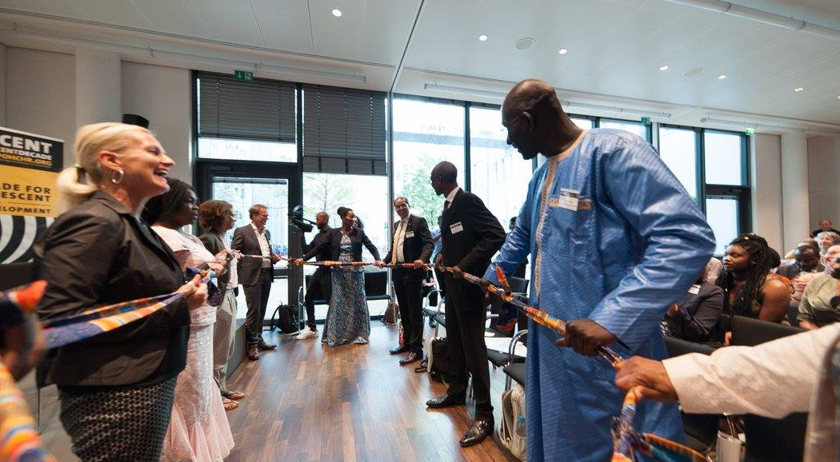
Implementation of the International Decade for People of African Descent: Good Practices from Multi-Stakeholder Cooperation in Germany
Elisabeth Kaneza | Kaneza Foundation for Dialogue and Empowerment
Web: www.kaneza.org | Twitter: @elisabethkaneza | E-mail: elisabeth@kaneza.org

Slide 6
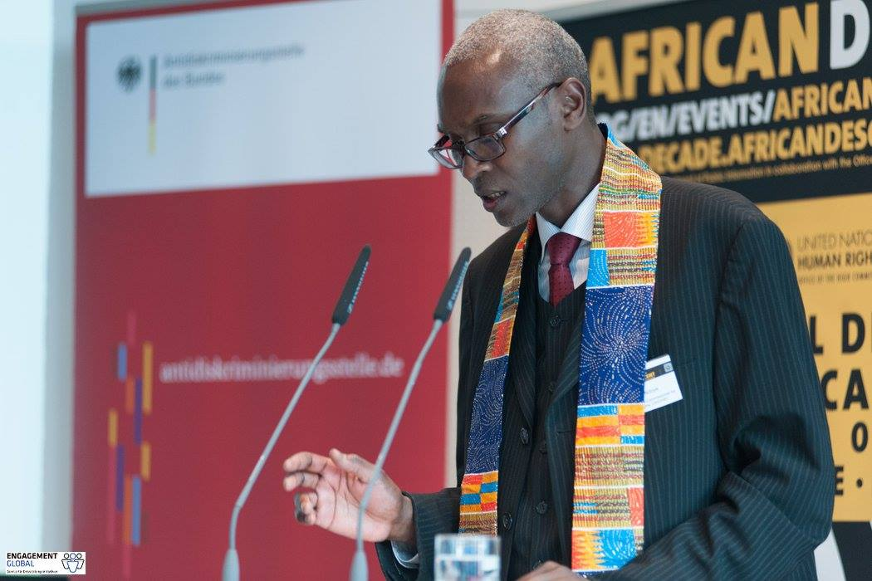

Slide 12
Implementation of the International Decade for People of African Descent: Good Practices from Multi-Stakeholder Cooperation in Germany
Elisabeth Kaneza | Kaneza Foundation for Dialogue and Empowerment
Web: www.kaneza.org | Twitter: @elisabethkaneza | E-mail: elisabeth@kaneza.org

