Slide 1
Youth at Risk: Racial Profiling
Mirjana Najchevska
Working Group of Experts on People of African Descent

Slide 2
DEFINITION OF RACIAL PROFILING
"Racial profiling" refers to the targeting of particular individuals by law enforcement authorities based not on their behavior, but rather their personal characteristics, or,
practice that targets people for suspicion of crime based on their race, ethnicity, religion or national origin, or,
the use of race or ethnicity as grounds for suspecting someone of having committed an offense

Slide 3
Racial profiling is a serious human rights problem affecting millions of people
“It’s unlikely but possible that you could get killed today. Or any day. I’m sorry, but that’s the truth. Black maleness is a potentially fatal condition.”
How to Talk to Young Black Boys About Trayvon Martin

Slide 4
What we learned during our country visits?
that, due to institutionalized racial discrimination, the rate of unemployment for people of African descent, particularly young people, is above the national average.
children and young people of African descent constitute one of the most vulnerable groups in the countries
they experience disproportionately low rates of access to quality education
they faced alarmingly high rates of violence, including on the part of law enforcement officers
they are too often target by the police breeding anger, frustration and a certain lack of faith in the police force

Slide 5
Some other countries (research in Australia)
Young African men are almost twice as likely to be stopped and questioned by police
Young African men reported feeling scared, angry and targeted and made to feel “small and dumb”
Many young African men felt they had been “cruelly treated” by police
47.6 per cent strong felt they had been stopped by the police because of their race
Almost 30 per cent said they were “not at all” able to walk down the street without worrying about being stopped by police when walking alone,

Slide 6
People of African descent are disproportionately policed, prosecuted, convicted, disenfranchised and imprisoned
The reliance on the criminal system provides the color-blind racist without ever referring to race.
There is no discussion of race and racism there is only public discourse about crime and criminals and gangs and drug-infested neighborhoods.
Are crime and criminals associated with blackness?

Slide 7
Youth of color are over-represented in arrest statistics
Labelled as gang members
Tracked via gang databases
Are arrest
Have contact with police

Slide 8
War on drugs and gangs

Slide 9
medicalization of deviance
the prison industrial complex

Slide 10
Recent development
rise of medical model of deviance which provides therapeutic alternatives for the middle and upper classes and the white;
shifts in educational practices that favor zero-tolerance policies and a correctional atmosphere that feeds the school-to prison pipeline;
philosophical and legal changes in the juvenile justice system:
maximize penalties,
widen the net of control,
directly and indirectly facilitate entry into the adult criminal justice system.

Slide 11
There is a choice:
addiction and a disease
disciplinary infraction or a crime
medical support
legal labeling
Informal and formal systems of social care with varying degrees of discretion
different types of deviant behavior warrant different types of social control
ljuvenile justice system
adult criminal justice system.

Slide 12
Institutional care

Slide 13
For youth of African descent it is very easy to come under some institutional care
Discrimination
Poverty
Economic and social disadvantages
Social exclusion

Slide 14
Institutional care
Institutional care -heightened risk of violence
Millions of girls and boys grow up for substantial periods under the control and supervision of care authorities
Children are institutionalised for a variety of reasons
(many of them based on poverty)

Slide 15
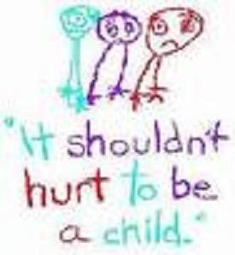

Slide 16
Detention

Slide 17
Perpetua mobile of racism
Zero tolerance in school policies
juvenile justice system rooted in racialized preoccupation
with gangs
growing ranks of the prison industrial complex
growing convergence with the adult system

Slide 18
Tricky justification

Slide 19
Some researches
while black drivers were subject to far more traffic stops and vehicle searches than whites, they were no more likely than whites to be found in possession of contraband..
28.4 percent of blacks and 28.8 percent of whites were found to possess
drugs
The study about the patterns of stops and searches conducted in airports showed that while Black and Hispanic air travelers were disproportionately stopped and searched in airports their “hit rates” for possession of contraband were actually lower than the hit rates for White air travelers.

Slide 20
Cultural differences
For many disadvantaged communities the distinction between public and private space is blurred.
Young people living in the public housing high-rise being subject to police interventions in their homes.
Legal definitions of what constitute a gang are often vague and subject to police interpretation.

Slide 21
* Fear of physical retribution or increased harassment
complaints will be investigated by police officers
Lack of faith in the complaint system
Inadequate police complaints mechanisms
Lack of legal support
Lack of faith in any institutional commitment to do something about
the police violence

Slide 22
Consequences

Slide 23
Racial targeting has both individual and collective effects
It takes a profound emotional toll on those subject to it.
It is degrading and intimidating.
It also has serious group effects.
It treats innocent, law-abiding people like criminals purely on the basis of their race or ethnicity.
It encourages youth of African descent to be mistrustful of and to avoid contact with the police

Slide 24
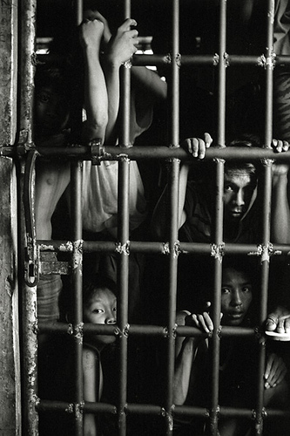
Enlargement of vulnerability
Many facilities fail to segregate vulnerable young from dangerous peers
Violence against children while in justice institutions or in the custody of the police is more common than violence against children placed in institutions solely for provision of care
All the prejudices and discriminations attached to unwanted or family-less children are reinforced where the child is seen as a social nuisance, or worse

Slide 25
Distortion of family
For example - African American youth are at increasing risk of out-of-home placement due the incarceration of parents.
They now account for more than 50% of the children in foster care.
Young black children are about 17 percent of the nation‘s youth

Slide 26
Collateral consequences
bar felons from ever holding public office,
place a lifetime ban on gun ownership for convicted felons,
driver‘s license suspension for convicted drug felons.
occupational bans for convicted felons, prohibiting them from teaching, childcare work, related work with children or law enforcement.
eased access to criminal records, an increase in all employers checking criminal backgrounds and new technology, which facilitates quick checks.
explosion in incarceration is negatively correlated with black male employment rates.

Slide 27
Specific drug felons consequences
Drug felons are permanently barred from receiving public assistance
Drug use, possession or sales are the only offenses other than welfare fraud that result in a ban on federal assistance
Drug felons are also permanently prohibited from receiving Federal financial aid for education.

Slide 28
What can be done?
To address the criminalisation od race
To take care about cultural differences
Strengthen international an national commitment and action based on recognition of the racial aspects of violence and incarceration
Prioritize prevention, deinstitutionalisation of the care (ensure institutionalisation is a last resort, and prioritise alternatives.)
Ensure quality staffing and training
Create accessible and youth friendly reporting systems and services

