Slide 1
Ramona Constantin

Slide 2
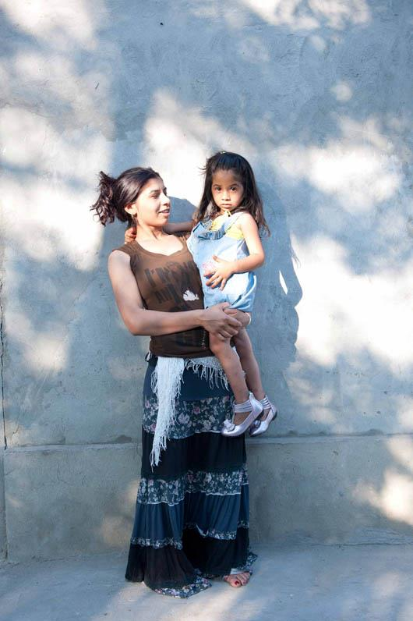
Notes:
Life in Romania – why you left Romania,
you wanted a fresh start after husband left, build a life in UK.
Arrived in Manchester in September 2009
Lived in shared house with 14 other people.
Challenges/ How it felt
How it felt - alone, disappointed, scared, lost. The strongest feeling was fear.
Didn’t know about the culture, if the way I was behaving was right in this country
Couldn’t speak the language
Had never worked in Romania and didn’t have and experience of work.
Employment rights – made it difficult to work

Slide 3
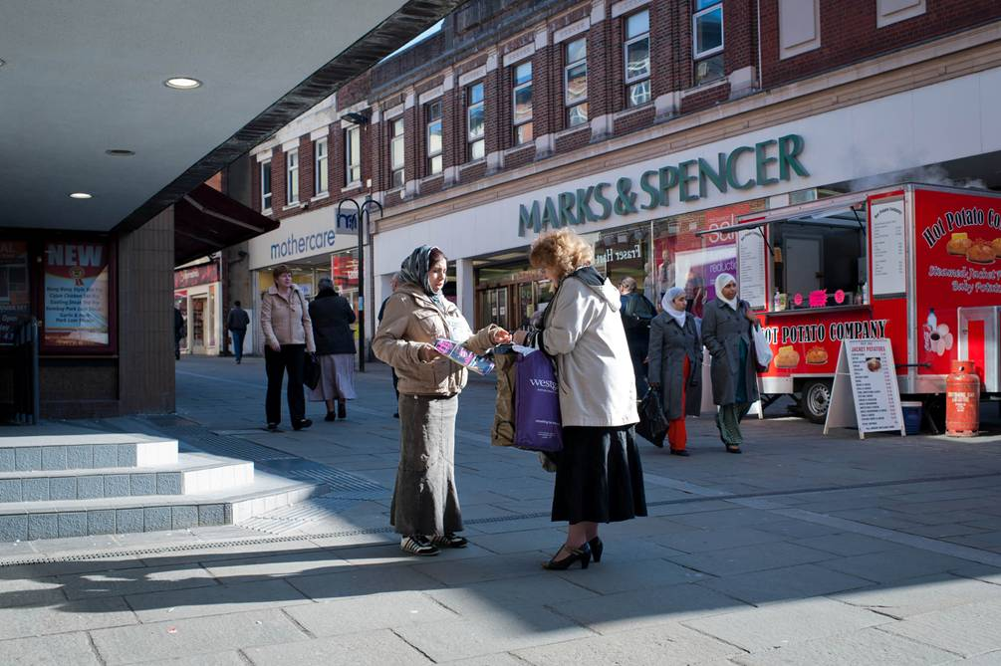
Notes:
How you overcame the challenges – how did you get support. How do others do this?
Started selling BITN first to earn money… then
Got to know people, gave me confidence in myself that people are nice no matter what country you come from.
Made me believe good people out there and made me trust people.
Gave me a purpose in the day and supported me with day to day things, money and longer term plans - I stopped crying in the day when I started selling the magazine
Magazine advertised training programme and I applied - I trained in key skills – learning English ( ESOL), citizens advice, housing benefits, healthy eating, confidentiality, safeguarding,
Doing the training courses made me have more belief in myself.
Started working as an outreach worker for children’s centre where large Roma population - building trust so families got access to services, helping them to getting children in school. Give hope.
Now - Work in 3 schools supporting all children, inc Roma, with homework and in classes to make sure they understand what they are being taught

Slide 4
Notes:
How I developed a support structure – what people can do to feel engaged/part of a community
I like talking and engaging with people, experiencing things so I took every chance I was offered to help myself. People feel more able to engage if communities engage with them. Eg – children’s birthday party
It can feel difficult as a stranger to access things in the community because of culture/background. Examples.
Challenges
Women mistrusting of me as I’m not following culture. They know that I wasn’t educated in Romania and hadn’t worked so didn’t understand why they should listen to me or believe what I was saying was right event though here I’d had training. Men were distrusting, took long time to get people to believe in me and what I was doing
Maintaining my culture and behaving as Roma women, is hard to balance with working. I have to be two people at the same time – one at work and one at home who behave very differently.
Its hard for people with young children to access training and get work experience without childcare – culturally people don’t trust other people to look after their children because in our communities that’s the role of the woman.

Slide 5
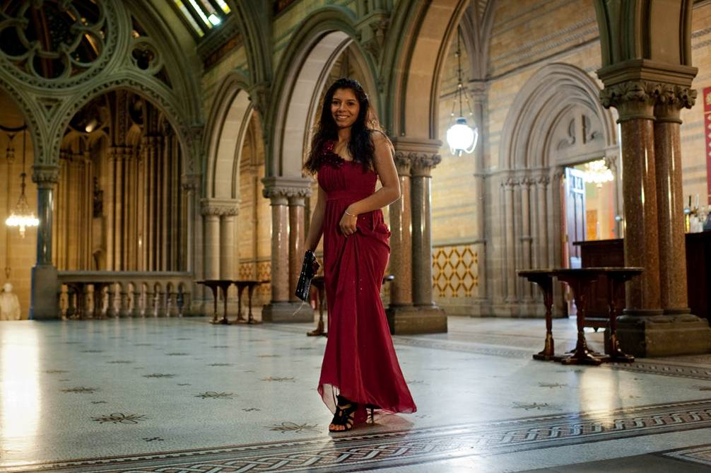
Notes:
How I changed my life
Family didn't know me, I was more confident in my attitude, in speaking and writing English
I earn an income
My work is Inspiring me to to do more,
Strength – I am stronger
I’ve met the queen, won awards for being inspiring in my neighbourhood, I’ve worked with a journalist to write a book ,
I’ve made a life for myself and my family here
Long term ambition - Social worker
Helping Roma communities to help themselves

