Slide 1

AARP
Long Term Care LTSS
Erica Dhar, Senior Advisor
AARP Office of International Affairs

Slide 2

AARP: Who Are We?
www.aarp.org
Non-profit, non-partisan, social welfare organization
38 million members
AARP.org
AARP Services, Inc.
AARP Foundation
            AARP International
Age Friendly Cities
Best Employers
UN Advocacy
Notes:
Thank you, and thank you to NYU and my colleagues on this panel for allowing me to be a part of this important panel. For those who may not be familiar, let me give you a little background as to AARP. AARP is a nonprofit, nonpartisan social welfare organization with a membership of more than 37 million that helps people turn their goals and dreams into real possibilities, strengthens communitities and fights for the issues that matter most to families– such as health care, employment security and retirement planning. AARP was founded in 1958 by Ethel Percy Andrus, a retired educator from
California. AARP has offices in all 50 states, the District of Columbia, Puerto Rico
and the U.S. Virgin Islands. AARP is governed by a 22-member volunteer Board
Of Directors.

Slide 3
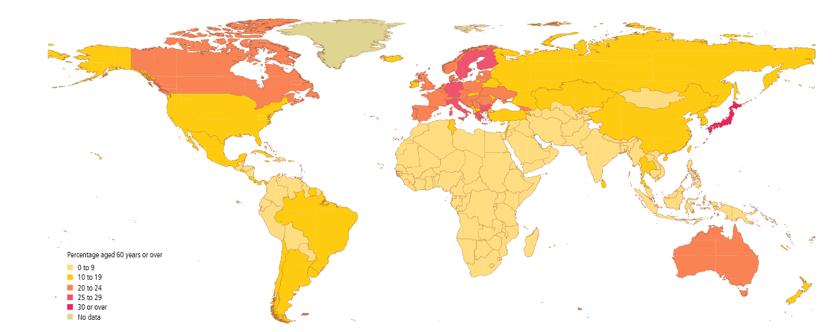

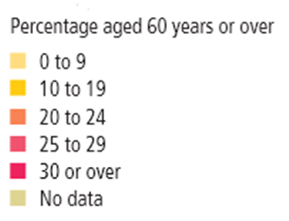
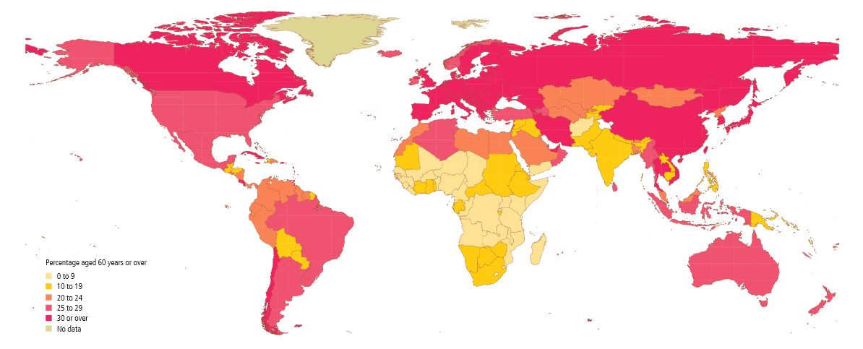
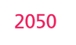
Number of Persons Aged 60
2012 810 million
2050 2 billion
2050 Older people will
outnumber children under 14
Source: UN DESA, Population Ageing and Development Wall Chart, 2012
Notes:
They say a picture tells a 1000 words, I hope this explains why we at AARP take our work so seriously.
Today one out of every nine persons in the world is aged 60 or over. There are two trends, driving this phenomena, lower birth rates and increased longevity. Although Europe, the US and Japan have aged, by 2040 Korea will be the oldest country in the world, to quote the Korean Times, South Korea will have the highest proportion of senior citizens in the world by 2050 – 37.3 percent. They project to beat Japan (36.5%), Italy (34.4%), and the U.S. (21.1%). The global elderly population is expected to be 15.9 percent in 2050, according to projections by the United Nations. There are 36 million senior citizens in the U.S. today but this will grow to 87 million by 2050. However, with longevity we have seen an increase in chronic disease, viz., cardiovascular, respiratory, cancer, tuberculosis and alzheimers.

Slide 4
Valuing the Invaluable
        AARP Public Policy Institute Report
42.1 million family caregivers in the U.S
61.6 million provided care at some point in the year
Caregiving reduces paid work for the typical caregiver by 41%
2004: Productivity losses to U.S. businesses related to informal caregiving was $33.6 billion
2009: Estimated economic value of caregiver unpaid contributions was $450 billion.
Notes:
So to emphasize how many individuals are involved in family caregiving AARP’s public policy institute has published reports. Valuing the Invaluable,
“Average” caregiver: 49 yr.old woman who works outside the home and spends 20 hrs./wk. providing unpaid care to her mother for nearly 5 yrs.
More than the cost of medicare and medicaid together.
42.1 million family caregivers in the U.S. provided care to an adult with limitations in daily activities at any given point in time
61.6 million provided care at some time during the year
Caregivers are likely to experience reduced pension and social security benefits and wages, along with limited access to 401(l) plans.
. This was related to: replacing employees, absenteeism, care crises, workday interruptions, unpaid leave, supervisory time, etc.
Estimated economic value of unpaid
contributions was about $450 billion
from an estimated $375 billion in 2007

Slide 5
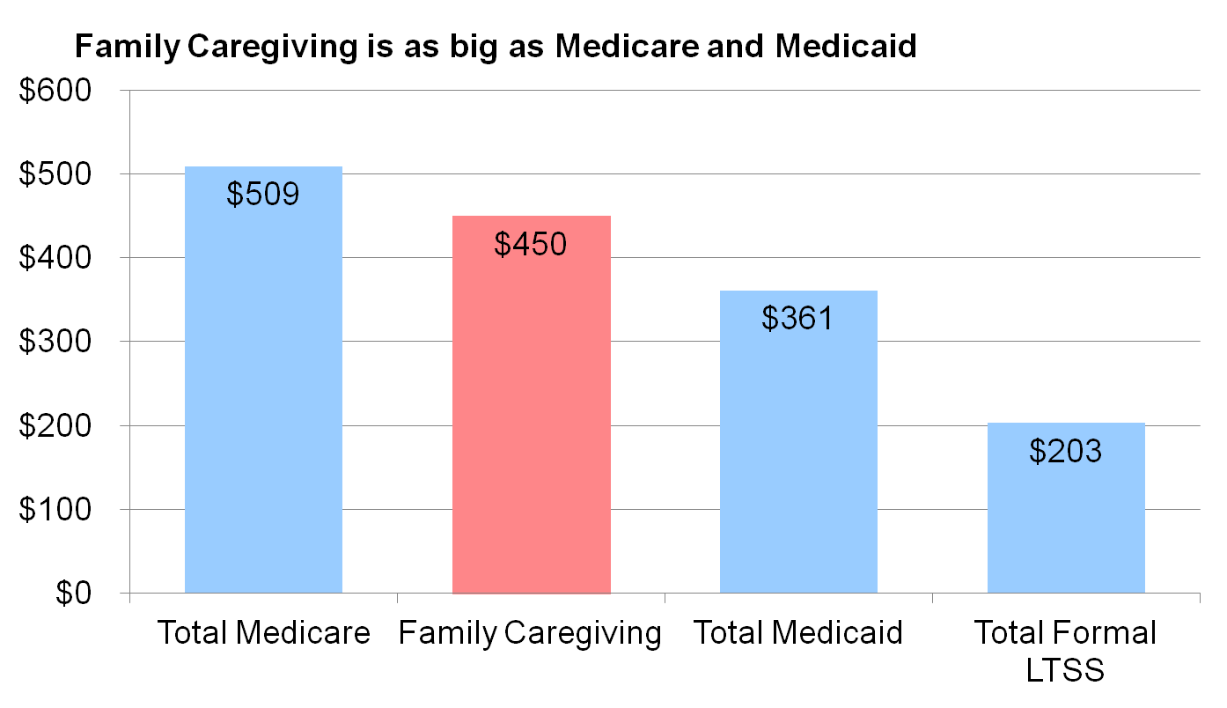
How Much is $450 Billion?

Slide 6
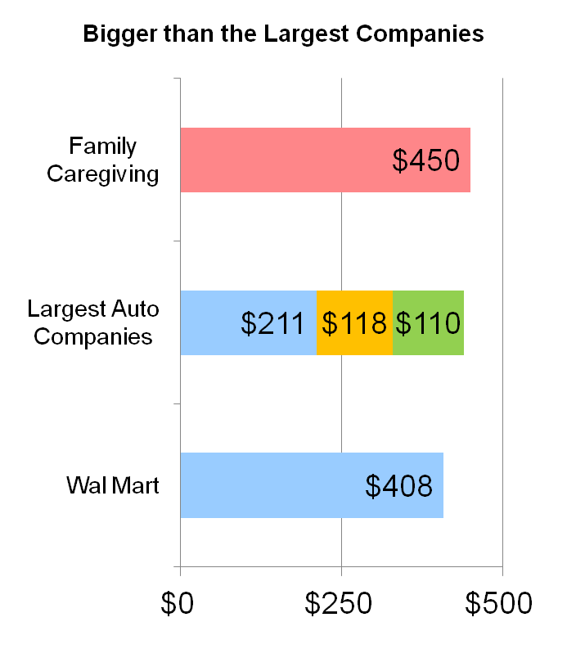
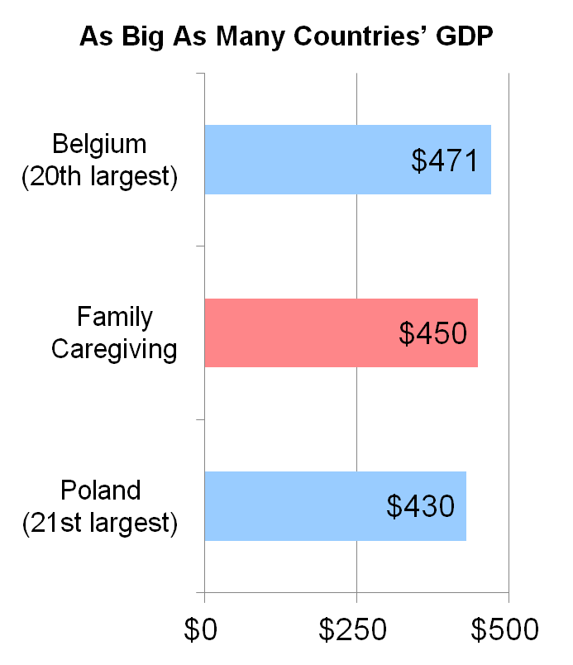
How Much is $450 Billion?
Notes:
As big as many country GDPs Belgium’s GDP 471 billion

Slide 7
Why Family Care Matters Today?
Caregivers are the backbone of long-term services and supports (LTSS)
Caregivers are key partners in health care
Family support is a key driver in remaining in one’s home and in the community
Caregiving is now more widespread and more difficult – a public issue
  Complexity in the coordination and delivery of care
  Poor care experiences are becoming increasingly shared concerns

Slide 8
Family Caregivers Fill Big Gaps in Health Care & LTSS
  Health care decisions, treatment, and outcome
  Serve as “continuity connectors” and the “eyes and ears,” especially for persons with dementia
  Assume a health management role in the home
  PPI analysis of 20-year trends in family caregiving and LTSS findings
  Family caregiving has been shown to delay or prevent the use of nursing home care
Notes:
Family members are part of the delivery of health care
Until the mid-1990s, family care was augmented by some paid help
That trend has reversed and more families are carrying the load alone
Family caregivers are assisting older relatives/friends with higher rates of disability than in the past
More likely to be providing hands-on and physically demanding and intimate personal help (bathing, using the toilet)

Slide 9
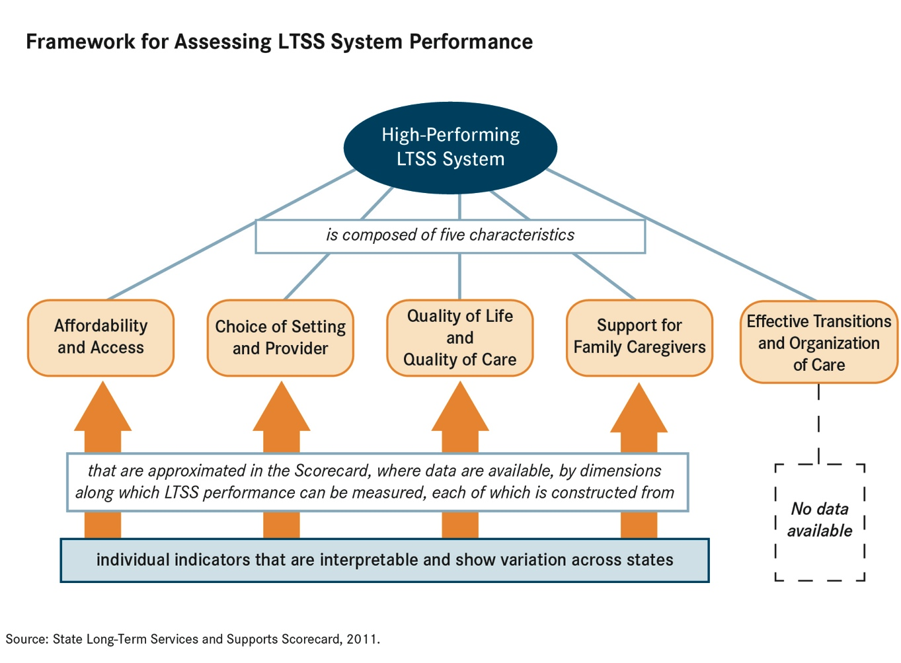

Slide 10
The 2014 LTSS State Scorecard
www.longtermscorecard.org
  Raise national level of performance
  Assess state LTSS system performance along key dimensions
Additional goals:
  Measure change in LTSS system performance over time
  Add/improve indicators to better measure LTSS performance
  Advocate for better measurement; needed for accountability
  Effectively communicate both point-in-time performance and change over time
Notes:
Repeat the main goals of the first Scorecard:

Slide 11
The 2014 LTSS State Scorecard
Major findings:
  Highest ranked states: Minnesota, Washington, Oregon
  Lowest ranked states: Mississippi, Alabama, W. Virginia Poverty and high rates of disability present challenges
  Wide variation exists within dimensions and indicators
  State Medicaid (primary source of public funding for LTSS) Support for family caregivers goes hand in hand with
    other dimensions of high performance
  Better data is needed to assess state LTSS system performance
  The cost of LTSS is unaffordable for middle-income families
Notes:
Hawaii, Wisconsin, Iowa, Colorado, Maine
Oklahoma, Indiana, Kentucky, Tennessee, Florida, Louisiana, Georgia, New York, Nevada
All states, even higher ranked ones, have areas of improvement
policies dramatically affect consumer choice and affordability

Slide 12
The 2014 LTSS State Scorecard
Key findings relating to select indicators and public policy to improve performance:
  Medicaid safety net
  LTSS “balancing”
  Maximizing consumer choice of LTSS options
  Consumer direction
  Nursing home residents with low care needs
  Pressure sores among nursing home residents
  Preventing hospitalizations
  Nurse delegation
Notes:
Medicaid safety net
Establishing financial eligibility standards for Medicaid coverage and determining level of disability needed to qualify for services
LTSS “balancing”
People who need LTSS can choose noninstitutional options for care
Maximizing consumer choice of LTSS options
“options counseling” and nursing home diversion programs that gear users toward Home and community based services (HCBS) rather than institutional settings
Consumer direction
Give people who use LTSS the option to direct their own services in publicly funded programs
Expand available workforce
Nursing home residents with low care needs
Federal grants to help states move nursing home residents who want to return to their community
Pressure sores among nursing home residents
Establish and enforce high standards for providers and monitor quality of care nursing home proves
Every state has a publicly funded nursing home ombudsman program
Preventing hospitalizations
Integrate primary, acute, chronic, and long-term services
Nurse delegation
Change nurse practice laws to save money b/c it broadens the type of workers who can perform specific tasks

Slide 13
The 2014 LTSS State Scorecard
Conclusions:
  The Affordable Care Act provides new incentives for states to improve their LTSS systems Care should be affordable and of the person’s choice
  CGs are the foundation of American LTSS
  As a nation, we are having fewer children and getting older.
Notes:
and, what is key, is that the lowest performing states have the most to gain by taking advantage of what the ACA is offering.
; they need somewhere where they can go for advice, information, answers to questions, respite, and support.
These two factors coupled together indicate that a more efficient and reliable LTSS needs to be available to older people and those with disabilities to make sure that they can receive high-quality care, maintain as much independence as they can, and overall, get the help they need.

Slide 14
The 2014 LTSS State Scorecard
5 Dimensions of a “high-performing” system:
  1) Affordability and access
  2) Choice of setting and provider
  3) Quality of life and quality of care maximize positive outcomes
  4) Support for family caregivers
  5) Effective transitions and organization of care

Slide 15
AARP, CSCS, NYSCRC Report: Caregivers in Crisis – Why NY Must Act Now (Nov. ‘13)
Major policy recommendations:
  Establish a community care navigator program
  Provide adequate funding to non-Medicaid programs
  Provide training and skill-building to caregivers
  Review paid and unpaid family leave policies to assist working CGs and the businesses that employ them
  Ensure access to competent legal assistance and legal protection to caregivers
  Promote and increase affordable housing options
  Support volunteer models
  Promote changes in the work environment that encourage direct-care staff recruitment and retention
Notes:
by pushing existing NY Connects Program to provide outreach and public education to caregivers and the public
that will keep seniors at home longer

Slide 16
Advocacy: Why now?
Federal and state budgets
Millions of caregivers in need of resources
Improving state resources
Advocacy cycle
  Identify issue/problem → Research cause & effect → Plan goals, methods, timeline → ACT → Monitor & evaluate actions and results

Slide 17
Advocacy (cont’d)
Know the leaders
Know the process
Track the legislation
Prioritize issues
Create justification
Raise awareness

