Slide 1
Fostering Cooperation between National Rapporteurs and Equivalent Mechanisms and Cooperation with International and Regional Organizations
Consultative Meeting on Strengthening Partnerships with National Rapporteurs on Trafficking in Persons and Equivalent Mechanisms
23-24 May 2013

Slide 2
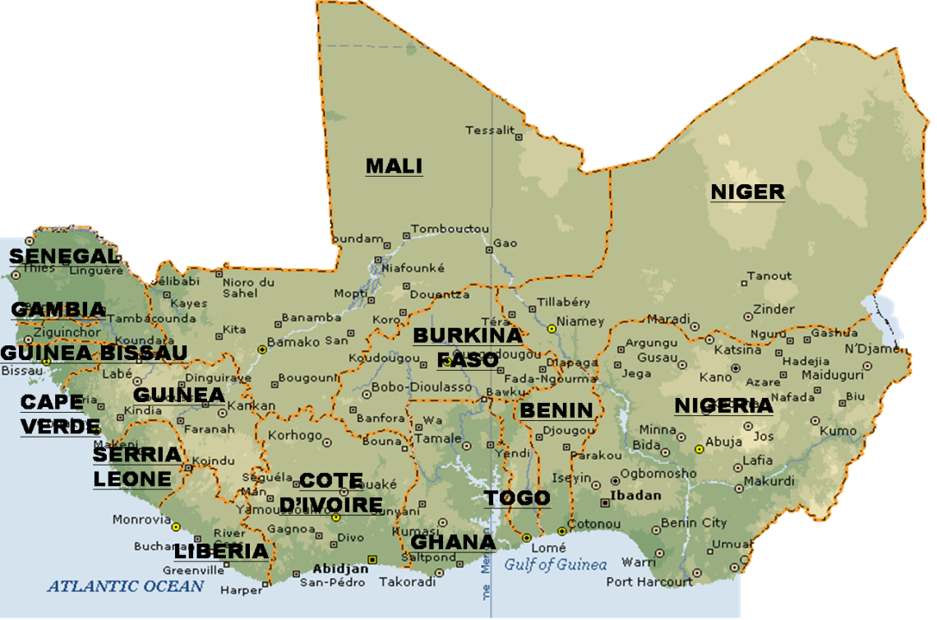
THE ECOWAS MAP

Slide 3
Context of TIP in West Africa
Human Trafficking as a Criminal Enterprise (the West African Context) – poverty, low human capital development , supply and demand factors, weak law enforcement, weak child protection systems, cottage type industry versus serious organized crime?
A human security problem with strategic consequences for the Region.
An obstacle to human development

Slide 4
Structure of Causation
Trafficking in persons
Social and structural vulnerabilities
Weak protective environment
Criminal groups acting as catalysts

Slide 5
The 3 P’s could be further elaborated within the specific contexts of:
Criminal law legislation and law enforcement;
Labor law, policies and practice
Social protection
Advocacy and Social Mobilization
Capacity Building ,partnerships and coordination are basic process strategies accompanying the above

Slide 6
Strategic matrix for combatting human trafficking; at national, regional and international levels
Contextual Strategies | Prevention | Protection | Prosecution
Criminal law legislation and law enforcement
Labor law, policy and practice
Advocacy and Social Mobilization
Social Protection
Process or support strategies: Capacity building ,partnerships and coordination

Slide 7
ECOWAS Normative and Institutional Framework

Slide 8
LEGAL FRAMEWORK /MANDATE OF THE DEPARTMENT OF HUMANITARIAN AND SOCIAL AFFAIRS
ECOWAS Revised Treaty
Protocol Relating to the Mechanism for Conflict Prevention, Management, Resolution, Peace-keeping and Security
ECOWAS Plan of Action to Combat trafficking in Persons, especially Women and Children
ECCAS/ECOWAS Plan of Action to Combat Trafficking in Persons, especially Women and Children
ECCAS/ECOWAS Multi-lateral Cooperation Agreement to Combat Trafficking in Persons, especially Women and Children
ECOWAS Policy on Protection and Assistance to Victims of Human Trafficking
ECOWAS Guidelines on Protection, Assistance and Support to Witnesses
ECOWAS Convention on Extradition
ECOWAS Convention on Mutual Assistance in Criminal Matters
ECOWAS Child Policy and Child Protection Framework
ECOWAS Regional Action Plan to Combat Child Labor

Slide 9
ECOWAS Approach to Counter TIP
Building Consensus on Standards
Exploration of linkages with related issues in the areas of criminal justice, social protection and child protection.
Capacity Building
Advocacy
Monitoring and Evaluation including fostering collective accountability

Slide 10
STRATEGIC GOALS OF THE PROGRAM
Ensuring development of appropriate Institutional, policy and legal frameworks for combating trafficking in persons and for child protection
Development of methodologies and approaches in measuring and ensuring sustainable progress in the combat of trafficking in persons and child protection,
Development of linkages between Member States and stake-holding agencies and development of Member States Capacities for effective combat of trafficking in persons,
Ensuring adequate public sensitization on the subjects of trafficking in persons and child protection.

Slide 11
Collaboration with the AU
In 2010 the AU Commission in collaboration launched the AU COMMIT based on the Ouagadougou Plan of Action in ECOWAS as the first REC
This was in recognition of the far reaching steps already taken by ECOWAS in combatting TIP.

Slide 12
Going forward
ECOWAS is commissioning and Impact Assessment of the implementation of its plan of action
Developing a Media and Communication Strategy and a Network of Media institutions to strengthen advocacy and prevention.
Support capacity building of law enforcement and assistance measures.
Engaging Civil Society in combatting TIP.
Advocating for a “whole of the State” and “whole of society” approach.

