Slide 1
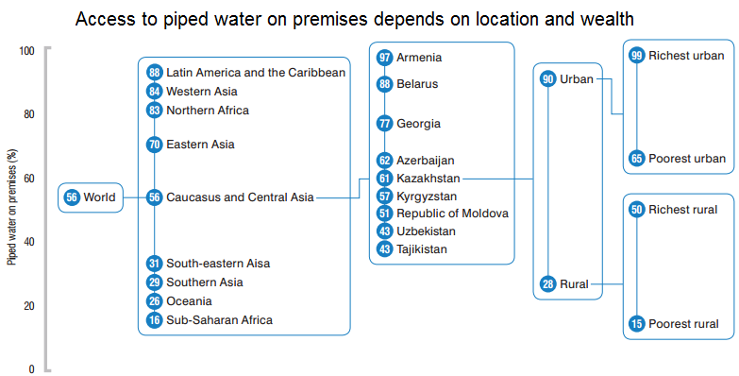
Illustrating inequality in access to water and sanitation
“We envisage a world of universal respect for human rights and human dignity, the rule of law, justice, equality and non-discrimination… A world where we reaffirm our commitments regarding the human right to safe drinking water and sanitation and where there is improved hygiene…”
Transforming our World: the 2030 Agenda for Sustainable Development,
A/RES/70/1, United Nations General Assembly, 25/09/2015.
WHO/JMP, Progress Report on Sanitation and Drinking Water: 2015 Update and MDG Assessment, p.18
General statistics in almost all countries can hide important inequalities in access to water and sanitation services. An observation of trends reveals, for example, that the poorest inhabitants of rural areas are often by far the most disadvantaged in this respect.
Léo Heller
Special Rapporteur on the human right to safe drinking water and sanitation
ENDING INEQUALITIES
A priority for accomplishing Sustainable Development Goal 6, and many others.
@SRWatSan
srwatsan@ohchr.org

Slide 2
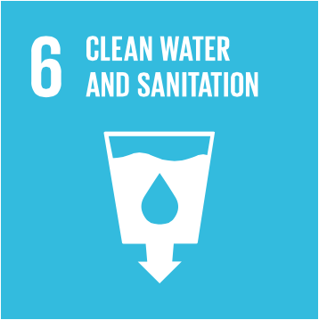
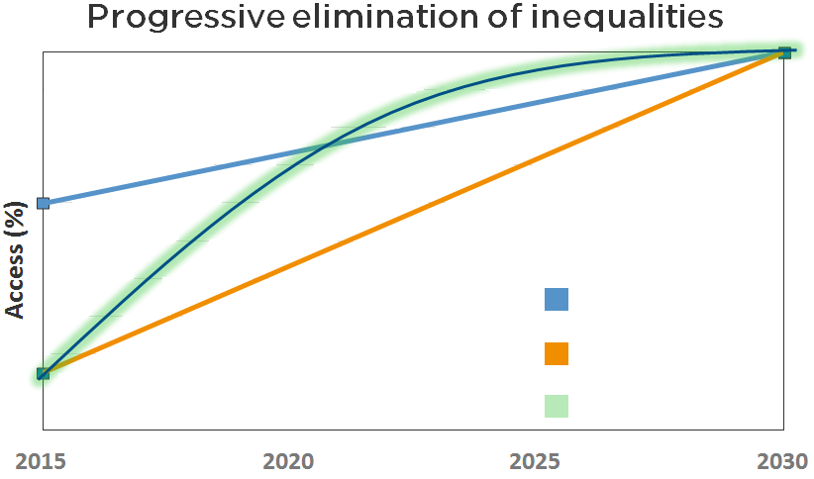
What is Goal 6 of the Agenda for Sustainable Development?
"Transforming our World: The 2030 Agenda for Sustainable Development", which details the 17 Sustainable Development Goals (SDGs) and 169 goal-specific targets, was formally adopted by all 193 Member States of the United Nations at the UN Summit in 2015.
It is a 15-year plan of action “for people, planet and prosperity”. It aims to strengthen universal peace, eradicate poverty in all its forms and dimensions, and promote prosperity and people’s well-being while protecting the environment.
Ensuring the availability and sustainable management of water and sanitation for all is the aim of Sustainable Development Goal 6. It includes the following targets:
Human rights on the agenda
Whereas the Millennium Development Goals (MDGs) did not possess a clear human rights approach, the SDGs are now unequivocally anchored in respect for human rights.
It is of great importance that the human rights to safe drinking water and sanitation are now specifically recognised in the SDGs, as it gives the 2030 development agenda a new framework to critically address the work that still remains after the MDGs. If we take a closer look at those who have achieved access to improved services in the past fifteen years and those who are still left behind, we notice some stark inequalities. For example, among those people who still do not have access to improved sanitation, 70 per cent live in rural areas.
Promoting equality in water and sanitation helps to attain all SDGs
The richest portions of some countries’ populations experienced a much faster increase in access to improved water and sanitation services in comparison with their poorest portions. Other important inequalities concern access in informal vs. formal settlements and the general differential conditions that characterise many countries from the global North and South. In some world regions, disproportionate levels of access are also observed between disadvantaged groups (e.g. minorities, women, persons with disabilities, persons with HIV, ethnic groups) vs. the “general” population.
The SDG agenda recognises the importance of
eliminating such inequalities and is tackling it
head-on. It is even the core objective of
Sustainable Development Goal 10, whose aim
is to “Reduce inequality within and among countries”. Emphasizing equality underscores both the need to eliminate discrimination and to adopt special measures to address the needs of those who are currently unserved. In the same fashion as human rights are interrelated and interdependent, so too are the SDGs. Providing all people with safely managed water, sanitation and hygiene services (achieving Goal 6) would necessarily reduce inequalities, thereby contributing to accomplish Goal 10.
Given the essential nature of drinking water, sanitation and hygiene for an adequate standard of living, the speedy elimination of inequalities in access to these services will strongly contribute to the achievement of several other goals. Notably, SDG Goal 6 is closely linked to:
Goal 3 : Ensure healthy lives and promote well-being for all at all ages;
Goal 4 : Ensure inclusive and equitable quality education and promote lifelong learning opportunities for all;
Goal 5 : Achieve gender equality and empower all women and girls;
Goal 11 : Make cities and human settlements inclusive, safe, resilient and sustainable;
Goal 13 : Take urgent action to combat climate change and its impacts;
Goal 14 : Conserve and sustainably use the oceans, seas, and marine resources for sustainable development.
Where should States start?
So how should the UN Member States start to accomplish Goal 6 concretely? States must consider all of their inhabitants that still do not have access, or have inadequate access, to sufficient water and sanitation services. Designating, in relative terms, the most “advantaged” and “disadvantaged” among these individuals, States must plan how each group will be addressed to improve or surpass an acceptable level of access to water and sanitation services by 2030, and work to make groups progress at the necessary rates.
We defend that the most disadvantaged populations of all States, such as those who lack the enjoyment of these and other human rights (e.g. to health, housing, education), must receive preferential attention. If this were the case, States would be able to accelerate the rate of progress at which their most disadvantaged will attain a similar level of access as the most advantaged, as shown below.
The link between water, sanitation and community health cannot be understated: each year, 1.6 million people (mostly children under the age of 5) die from water and sanitation-related diseases. The SDG agenda has clearly stated that progress is a matter of human rights. Indeed, it is time for all States to adopt a human rights-based approach in shaping world development.
Sustainable Development Targets:
6.1 – By 2030, achieve universal and equitable access to safe and affordable drinking water for all
6.2 – By 2030, achieve access to adequate and equitable sanitation and hygiene for all and end open defecation, paying special attention to the needs of women and girls and those in vulnerable situations
Advantaged group
Expected progress
Disadvantaged group
Expected progress
Disadvantaged group
Ideal progress

