Slide 1
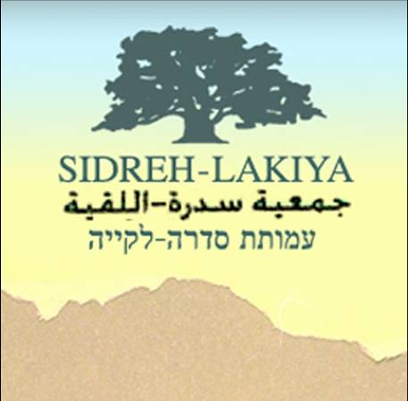
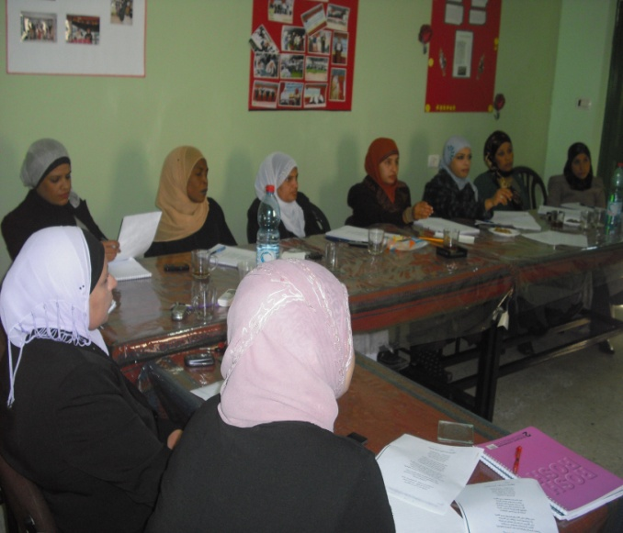
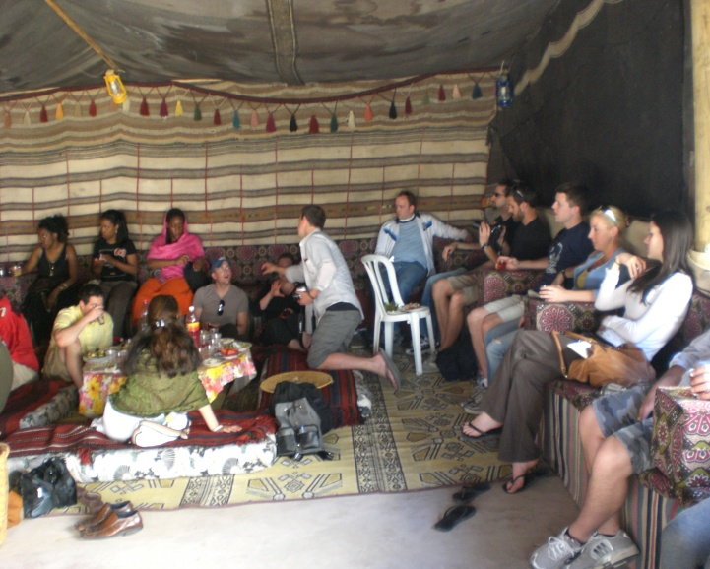
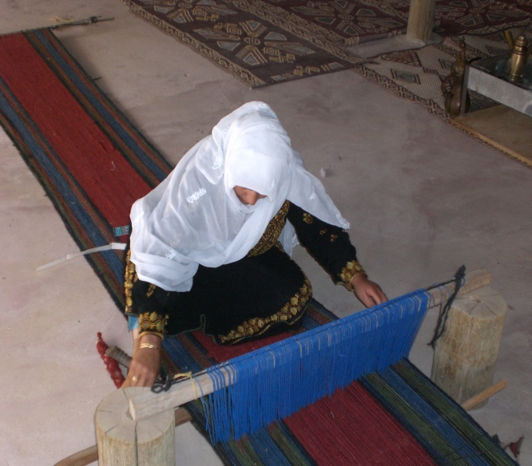
SIDREH
The case of Sidreh and the situation of Bedouin Women in the Negev

Slide 2
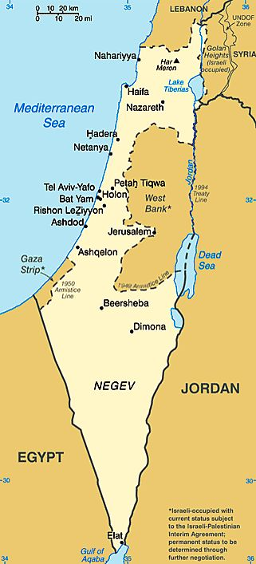
The Bedouin population of the Negev Desert suffers from harsh socio-economic conditions
There are almost 190,000 Bedouin people in the Negev Desert, making more than 25% of its population. However, they control less than 3% of the area.
They are organized as follows
Permanent settlements (7)
Urban Settlements with a total population of about 100,000
Among the largest concentrations of poverty and unemployment in Israel
About 77% of Rahat’s residents (the largest Bedouin city in Israel) are supported by National Insurance Institute allowances.
The rates of crime and drug use among the Bedouins in the Negev are constantly increasing and the offenders’ age is constantly decreasing.
Over 60% are children under the age of 17, while the elderly population (over 65) constitutes no more than 1.5%
Its growth rate of 5% a year is one of the highest in the world.
2. Unrecognized settlements (55)
More than 40,000 people
Not considered legal settlements by the Israeli Government
Subject to demolition by the authorities
Ineligible for basic municipal services such as connection to the electrical grid, water mains or garbage services
Between 8 – 10 are in the process of being recognized

Slide 3
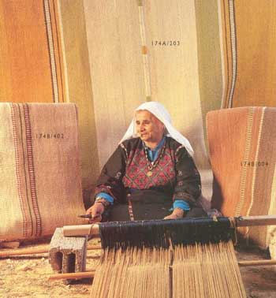
Bedouin Women are one of the most vulnerable groups as a result of the difficult external conditions, as well as the harsh patriarchal tradition within the community
General situation of Bedouin Women in the Negev
Only 6.3% of Arab-Bedouin women have an academic degree according to the numbers from 2007.
Only one woman was elected to the Israeli Parliament (Knesset) by an Arab party over the last sixty years, since state independence.
There are no women in a position of leadership in the local government
90% of the Bedouin women are unemployed
Women are confined to the domestic and private domain and traditions such as polygamy are still common (in 2007, only 18.9% of Bedouin women worked outside the home, compared with 78.9% of Jewish women).
Highest illiteracy rate in Israel (between the ages 55-64, the illiteracy rate reaches 35%, and above that age it reaches 68%).

Slide 4
Main issues affecting the Bedouin Community and its Women
The accelerated modernization and urbanization process threatens Bedouin’s traditional way of life and livelihood, and causes a continuous marginalization
Accelerated modernization and urbanization processes threatens Bedouin’s traditional way of life and livelihood
High Illiteracy Rates
Poor Access to Health Services
Harsh Patriarchal traditions and conservatism
Lack of organized community efforts and Internal Tribal conflicts
Limited economic development
Geographically remote
Poor transportation
Lack of trained human resources

Slide 5
Major Recommendations – Government Level
There are several strategies that could be implemented on a government level to improve the situation
Increase access to Health Services with a focus on women
Provision of sustainable of basic infrastructural services such as electricity and water supply to health services.
Increase logistical access to health services by constructing roads
Support grassroots NGOs in joint efforts to combat illiteracy
Increase access to early childhood education for young boys and girls in villages
Increase access to high school education by adding high school classrooms at the elementary schools in villages or build high schools in the villages.
Provide vocational training targeting women 40+ years. Women have demanded training in areas of work including hairdressing, general and bridal clothing design.
Support organizations engaged in enhancing opportunities for the preservation of its cultural heritage and traditional crafts such as weaving and spinning.

Slide 6
Sidreh is a nonprofit organization established in 1998 to empower, represent and improve the socio-economic situation of Bedouin women in Negev
Women Empowerment & Representation
Goals
Improve women’s employment opportunities and economic development
Overcome the various types of illiteracy, ensuring access to continuing education for adult women
Increase woman's visibility, equality and participation in all aspects of community life, while improving their self confidence and leadership skills
Represent Bedouin women in different national and international scenarios, while enhancing their capacity to advocate for their rights

Slide 7
Sidreh seeks to enable Bedouin women to become independent and active members of their community
Support the Arab women in the Negev in their pursuit of the full realization of themselves and of their rights, as well as of those of their own community
Mission
Arab women in the Negev will have full ownership over themselves and their decisions. They will fully benefit from their rights, while enjoying safety and stability. They will be active members in their society, always proud of their cultural heritage
Vision

Slide 8
Sidreh seeks to provide integral services in order to empower local women and generate prosperity in the communities
Areas of Intervention
Education
Literacy and high school completion
Economic Development
Social Empowerment & Community Development
Women leadership training and promotion
Communtiy reselinece and emergency respons projects
Educational Models & curriculum
Empowerment and Civil Education (health, environment, maternity, rights, etc)
Women in the Media
Weaving project as source of income and empowerment
Develop/support other local entrepreneurial endeavors
Strengthen Alternative Tourism in the region
Advocacy and Awarness Strategies

Slide 9
Lakiya negev weaving
Sidreh is one of the Negev's leading NGO’s, and the first organization of its kind to promote a sustainable income generating project by transforming women’s traditional weaving skills into a professional manufacturing business that empowers women both socially and economically.
Over 100 women participate in the production of rugs, bags and pillow cases; from spinning, dyeing, twining, weaving and quality control, as a unique process that is hardly seen anywhere else in the world.

Slide 10
Sidreh has a successful and widely recognized track record of more than ten years of experience
Major Achievements
Sidreh developed a successful model that empowers women, by becoming local leaders and advocators of their own rights. This model has proved effective in working with challenging communities, while gaining support from local organizations.
More than 1,400 adult women can read and write thanks to our literacy program
More than 60 adult women have completed high school and Israeli university preparation exams (bagrut) through our Adult Education Program.
More than 1,600 women have participated in our leadership and rights (Education, Health, Housing and Employment) awareness programs.
Sidreh is the only organization that works with the communities of the “unrecognized villages”, which present alarming needs and high levels of vulnerabilities
Built the first Women’s Center in an Unrecognized Village, and supported the consolidation of local Women’s Committee, which develops activities for more than 90 women. This was the first time that men were also involved in a women association, creating a sense of trust and harmony between men and women.
Developed the first women’s newspaper in the Negev, with 11,000 copies per month; distributed to more than 50 villages.
Represented Bedouin women in various scenarios, participating in the Palestinian Women’s Network, and CEDAW’s regional meetings in Cyprus and New York, among others.
“Lakiya Negev Weaving” is close to become 100% self-sustainable. Many fair-trade retailers around the world are already recognizing its quality and design as one of the best in the region, and it has surpassed the stringent quality rules required by Western buyers.

Slide 11
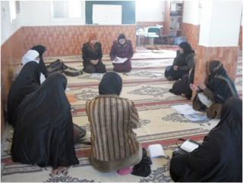
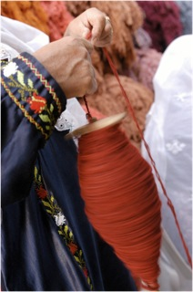
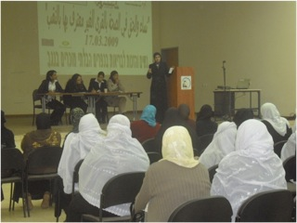
For more information please contact us at: sidreh@gmail.com
Or visit our website: www.lakiya.org

