Slide 1
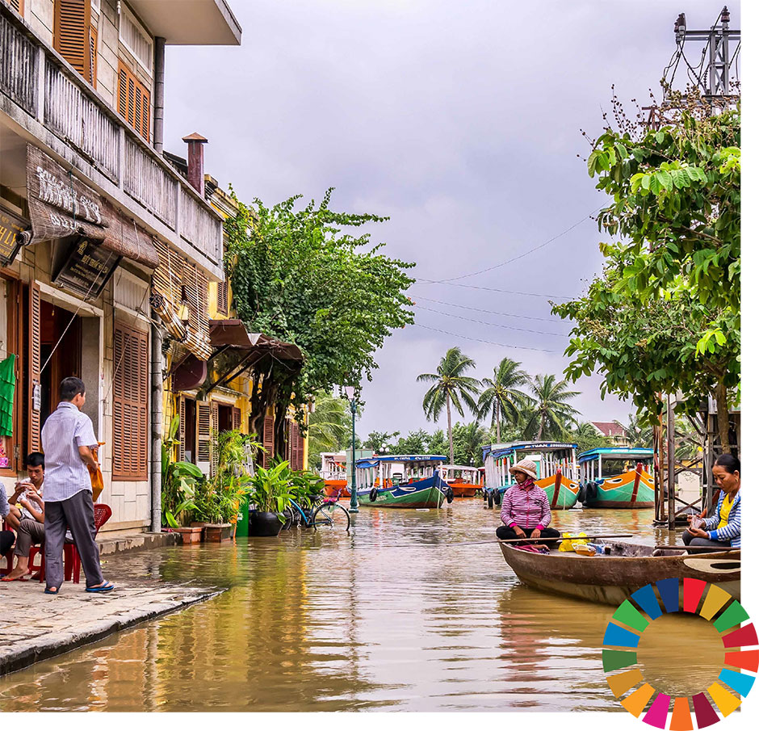
Implementing Human Rights and the 2030 Agenda
Gaynel Curry
Sustainable Development Section
Marc Titus D. Cebreros
Human Rights Indicators and Data Unit
Notes:
Difference between MDGs and SDGs
Building the bridge between human rights and development, including with regard to reporting
How can the UPR reporting feed into the implementation and the reporting on the SDGs/VNRs?
How can States ensure that the VNRs reflect recommendations coming out of the UPR?
And why do we try to build these bridges between development and Human rights

Slide 2
The SDGs as a Rights-Based Agenda
Explicitly grounded in HR instruments
Important substantive convergence of goals and targets with HR obligations
Endorses HR cross-cutting principles: people-centered, universality, equality and non-discrimination, interdependence & indivisibility, accountability, participation
Great majority of agreed SDG indicators are directly relevant to implementation and measurement of human rights, including the right to development
Notes:
2030 Agenda is grounded in Human rights
Preamble
The SDGs seek “seek to realize the human rights of all”
Para 8
We envisage a world of universal respect for human rights and human dignity, the rule of law, justice, equality and non-discrimination; of respect for race, ethnicity and cultural diversity; and of equal opportunity
Para 10
The new Agenda is guided by the purposes and principles of the Charter of the United Nations, including full respect for international law. It is grounded in the Universal Declaration of Human Rights, international human rights treaties…..
Para 19
We emphasize the responsibilities of all States, in conformity with the Charter of the United Nations, to respect, protect and promote human rights and fundamental freedoms for all, without distinction of any kind as to race, colour, sex, language, religion, political or other opinion, national or social origin, property, birth, disability or other status.
Para 18
We reaffirm our commitment to international law and emphasize that the Agenda is to be implemented in a manner that is consistent with the rights and obligations of states under international law.

Slide 3
Linking SDGs and HR work
Many of the SDGs mirror human rights
  ESCR - Goals 1,2,3,4,6,8,11
  CPR – Goal 16
  R to Devt- Goal 17, 13
  Equality– Goal 5, 10, 16

Slide 4
Human rights priorities for SDG implementation
Alignment with international human rights standards
Leaving no one behind
Active and meaningful participation
Robust accountability
Partnerships for development
Notes:
1. Alignment with IHR standards
Implementation of the 2030 Agenda should be fully aligned with international human rights norms and standards
Recommendations from international human rights mechanisms should guide implementation of the SDGS
SDG reporting should include and link to human rights reporting
An integrated, non-selective approach to SDG implementation; indivisibility of rights throughout the process
National SDG priorities should be consistent with HR standards
SDG implementation does no harm + contributes to HR realization
2. LNOB
While some groups are not explicitly mentioned in the Agenda 2030 such as migrants and LGBTIQ, LNOB is grounded in normative principles and standards of non-discrimination and equality and therefore applies to everyone
Programmes identify and address inequalities, discrimination and root causes, taking a rights-based approach
Address gender inequalities
Move beyond assessing average and aggregate progress towards ensuring progress for all population groups and individuals: use of disaggregated data to identify who is left behind & why
Requires legal, policy, institutional and other measures to promote equality and reverse the trend of rising inequalities
Disaggregated data is key to finding out who is being left-behind and why. However it must be collected and used in accordance with IHRL. This means ensuring the following:
Participation “Nothing about us without us”
Do no harm
Self-identification: freedom to self-identify or not
Transparency: people’s right to (statistical) information (freedom of expression, International Covenant on Civil and Political Rights, Art. 19 ; Principle 1 of Fundamental Principles for Official Statistics) and transparency in methods
Privacy: data protection and confidentiality (ICCPR, Art. 17)
Accountability: accountability in data collection, and data collection for accountability
3. Active and meaningful participation
Ensure participation of all critical stakeholders, including affected communities, i.e. women, children, marginalized groups and civil society in all phases of the design, implementation, monitoring of the 2030 Agenda
SDG reviews (VNRs) should draw on contributions from indigenous peoples, civil society, the private sector and other stakeholders, in line with national circumstances, policies and priorities”.
Civil society space: rights of freedom of expression, access to information, freedom of association and assembly are fundamental pre-requisites for meaningful participation
4. Robust accountability
Governments commit to establishing a “robust, voluntary, effective, participatory, transparent and integrated follow-up and review framework” @ national, regional and global levels
Establishment of national follow-up mechanisms, including providing remedies to individuals and groups
Regional review process/economic commissions
High Level Political Forum/presentation of voluntary national reviews – assessment of implementation
5. Partnerships for development
Multistakeholder partnerships, particularly the private sector, respect HR safeguards and due diligence
Use of normative standards to assess partnerships (UN Guiding Principles on Business & HR)

Slide 5
Looking forward
Source: 2019 SDG Progress Report
Notes:
SDGs are an important tool for eradicating inequalities but States are lagging behind in implementation across the board.
At the recent intersessional meeting, participants and panellists noted that while there has been some progress, implementation of the 2030 Development Agenda is lagging. The HC and other distinguished panellists, including Mary Robinson, SGD Advocates Professor Jeffrey Sachs and Dr. Alaa Murabit, ASG for UNDP Asako Okai, and Michael O’Flaherty reiterated that to achieve the Goals within the timeframe, greater efforts were needed to:
overcome issues of financing, resource mobilization and spending allocations
address poor governance, the lack of accountability and corruption in some States;
adopt a human rights-based approach which puts people at the centre of implementation;
strengthen engagement with human rights mechanisms and recommendations to facilitate SDG implementation, particularly at the national and local levels but also at the global level feeding into the Voluntary National Reviews (VNR) by States.
accept a more collaborative role with civil society, National Human Rights Institutions, business and other non-traditional development partners, at all levels and including at the High Level Political Forum, where more space should be made.
the need to preserve civic space at national level so that civil society can make its essential contribution to the implementation of the SDGs;
encourage, with the participation of NHRIs and national statistical bodies, better data collection, disaggregation and analysis in SDG implementation, to address challenges faced by the most vulnerable and marginalised in society;
promote better coherence between political commitments and legal obligations; and
OHCHR is exploring how to bridge the divide between the development community in New York and the human rights community in Geneva. Recognizing that this divide also exists at national level, we are working to:
Improve coordination between the different reporting structures;
Create tools and strategies to help States track the implementation of UPR recommendations and prepare their VNRs and vis-versa.

Slide 6
Looking forward
SDGs are an important tool for eradicating inequalities but States are lagging behind in implementation across the board.
Using a HRBA in implementing the SDGs would facilitate implementation and help in addressing inequalities.
UN SDG Fund
OHCHR tools and resources
Notes:
At the recent intersessional meeting, participants and panellists noted that while there has been some progress, implementation of the 2030 Development Agenda is lagging. The HC and other distinguished panellists, including Mary Robinson, SGD Advocates Professor Jeffrey Sachs and Dr. Alaa Murabit, ASG for UNDP Asako Okai, and Michael O’Flaherty reiterated that to achieve the Goals within the timeframe, greater efforts were needed to:
overcome issues of financing, resource mobilization and spending allocations
address poor governance, the lack of accountability and corruption in some States;
adopt a human rights-based approach which puts people at the centre of implementation;
strengthen engagement with human rights mechanisms and recommendations to facilitate SDG implementation, particularly at the national and local levels but also at the global level feeding into the Voluntary National Reviews (VNR) by States.
accept a more collaborative role with civil society, National Human Rights Institutions, business and other non-traditional development partners, at all levels and including at the High Level Political Forum, where more space should be made.
the need to preserve civic space at national level so that civil society can make its essential contribution to the implementation of the SDGs;
encourage, with the participation of NHRIs and national statistical bodies, better data collection, disaggregation and analysis in SDG implementation, to address challenges faced by the most vulnerable and marginalised in society;
promote better coherence between political commitments and legal obligations; and
OHCHR is exploring how to bridge the divide between the development community in New York and the human rights community in Geneva. Recognizing that this divide also exists at national level, we are working to:
Improve coordination between the different reporting structures;
Create tools and strategies to help States track the implementation of UPR recommendations and prepare their VNRs and vis-versa.

Slide 7
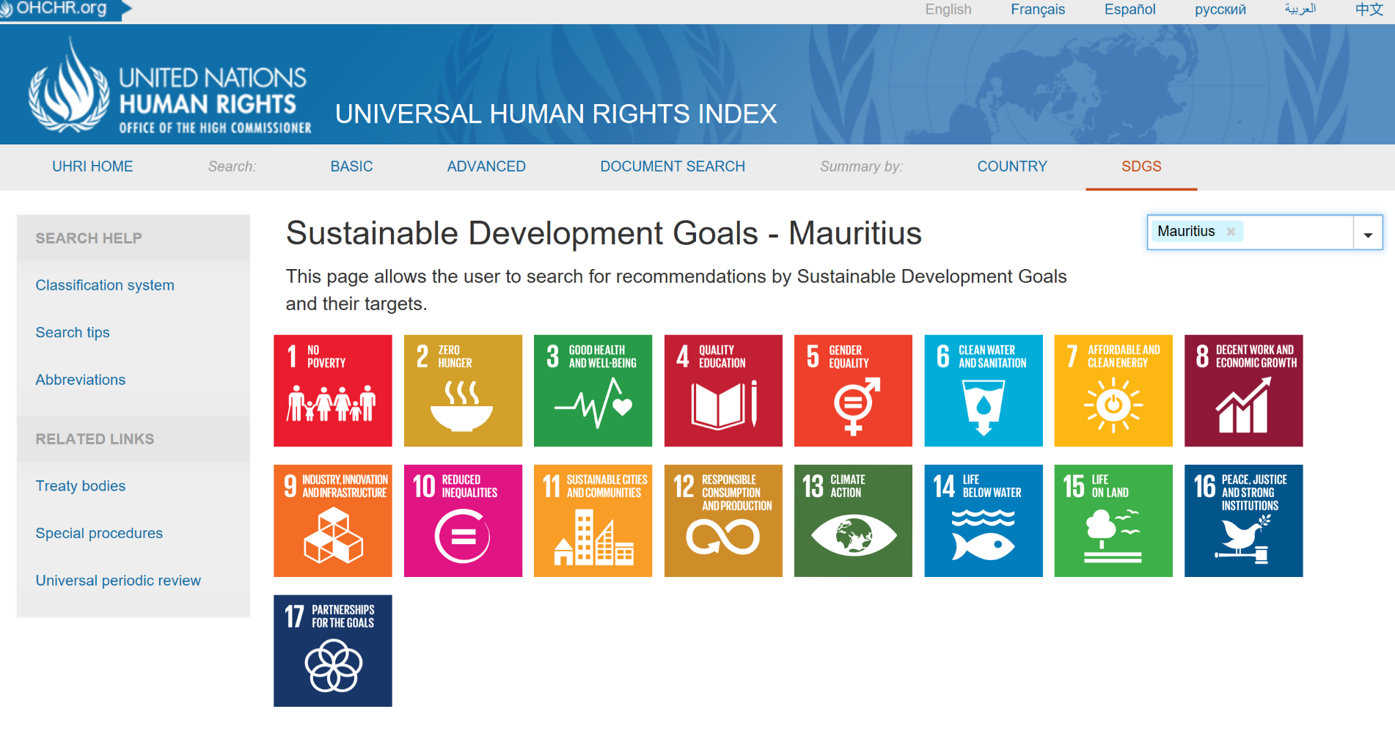
RESOURCES
Universal Human Rights Index
Notes:
TPs:
All three mechanisms make recommendations aiming towards short- and long-term changes in laws, policies and/or practices to improve the realization of human rights.
OHCHR online database entitled “Universal Human Rights Index” (UHRI) compiles those recommendations, see www.ohchr.uhri.org and allows for searching against specific themes, Sustainable Development Goal targets and/or groups of persons affected.
The UHRI can assist you in analysing who may be at risk of being left behind in their country, as well as mapping systemic, recurring und unresolved human rights issues that may impede the realization of the SDGs.

Slide 8
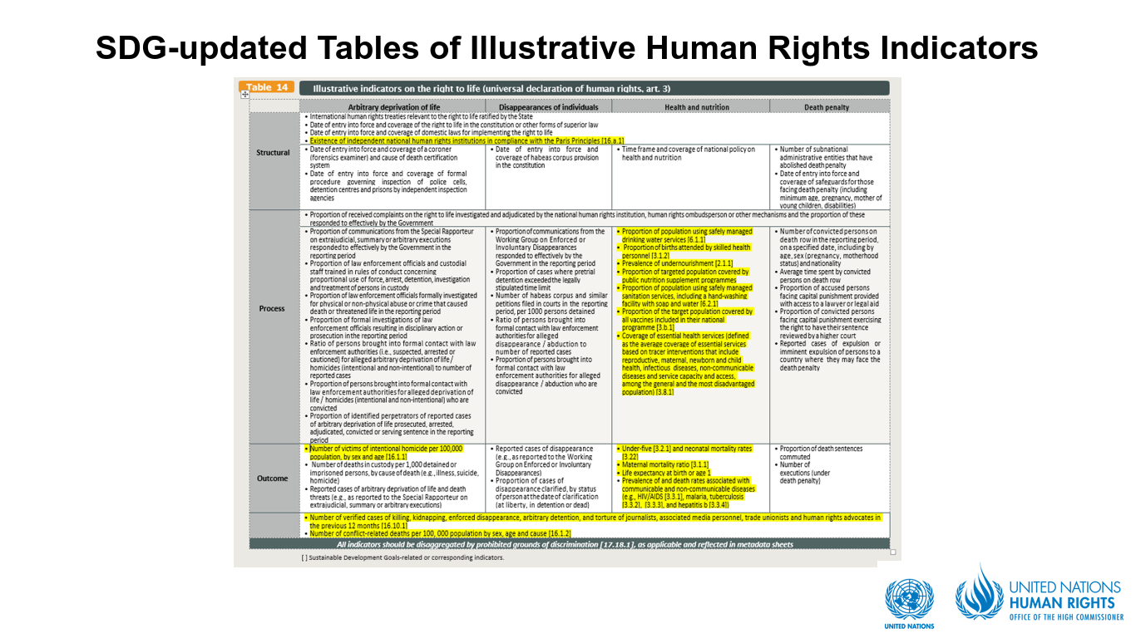
Other resources:

Slide 9
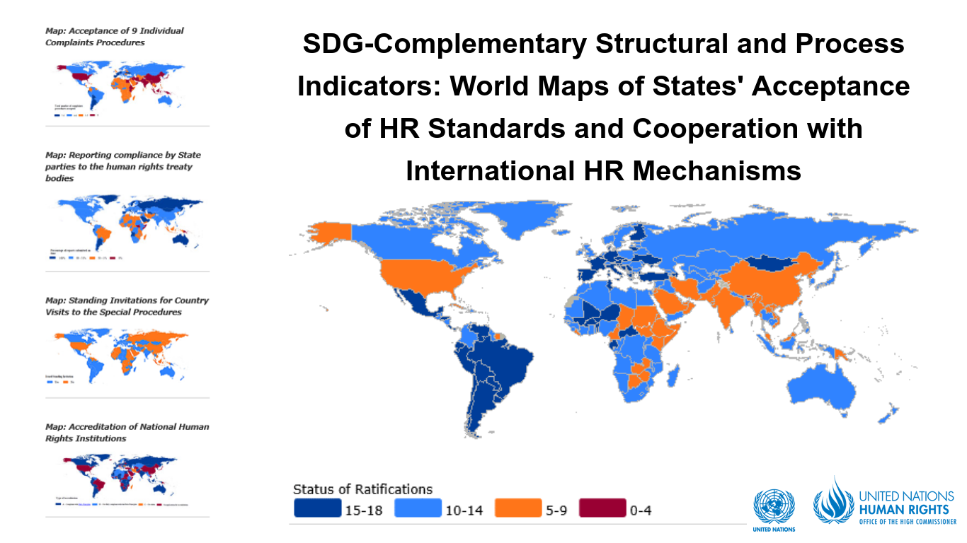
Other resources:

Slide 10
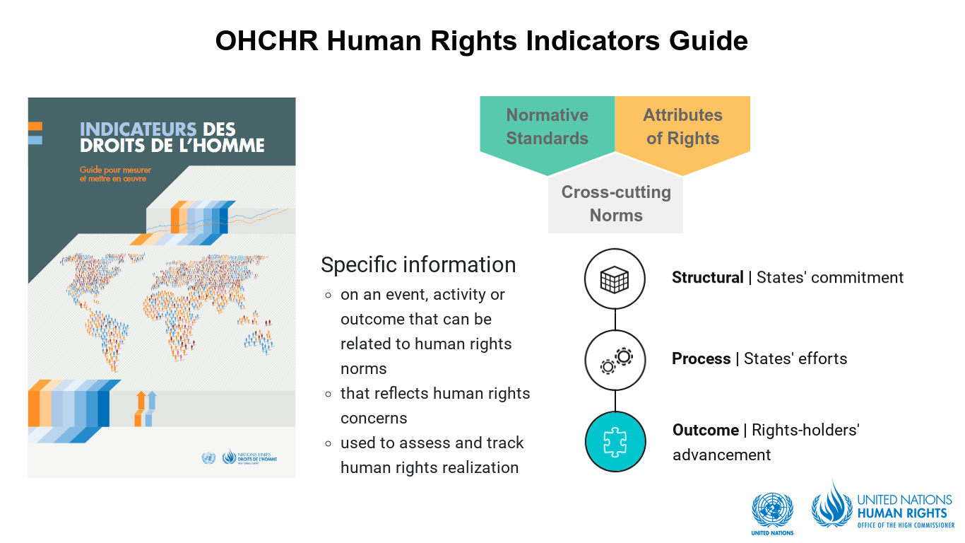
Other resources:

Slide 11
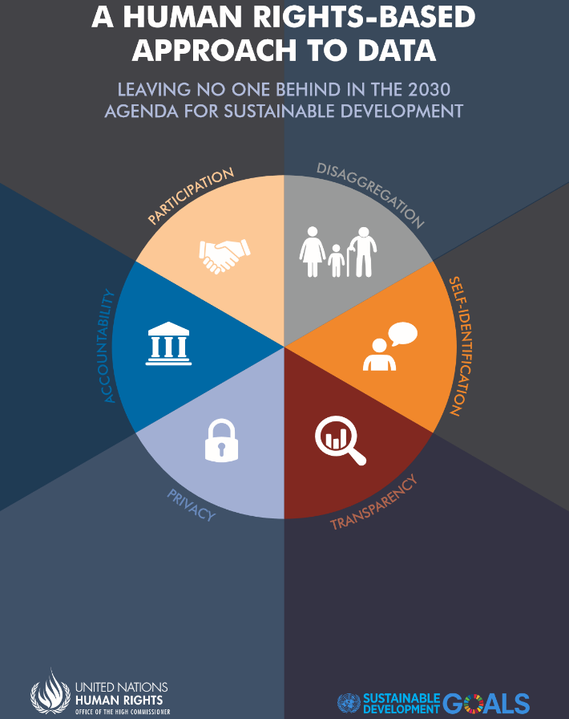


Other resources:
Notes:
Together with the Human Rights Index, there are other resources that are relevant for integrating human rights into the implementation of the SDGs.
(CLICK) For instance, OHCHR has provide guidance on the collection and use of indicators, and has developed specific methodologies for date collection in relation to some of the SDG indicators.
(CLICK) OHCHR has also supported National Mechanisms for Reporting and Follow-Up in relation to human rights, which can play a role in the preparation of VNRs.
We would also like to hear from you what sort of things is useful to your work

Slide 12
THANK YOU
Notes:
Announce: Second Intersessional Meeting – 3 December 2019 – on ‘Decade of Action and Delivery on SDG’ - - encourage participation.

