Slide 1

Immigration detention in Australia & the right to challenge the lawfulness of detention
UN Working Group on Arbitrary Detention
Professor Gillian Triggs
President
2 September 2014

Slide 2
Working Group on Arbitrary Detention- Day 1
International law reasonably well developed and articulated re Art 9(4)
Right to challenge detention not well integrated in domestic law
Practical barriers impede ability to challenge lawfulness of detention
What role can national human rights institutions play?

Slide 3
National Human Rights Institutions
Unique link between governments, civil society, and UN
Capacity to act within the UN system
Independence under UN Paris Principles
Advocacy-can “speak truth to power”
Provide access to justice through complaints function ( AHRC:18-20,000 inquiries and complaints a year, 70% conciliated)
Conduct formal inquiries with compulsion powers

Slide 4
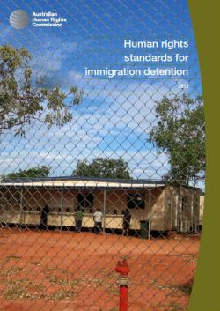
AHRC Human rights standards for immigration detention
Sets out benchmarks for the humane treatment of people held in immigration detention

Slide 5
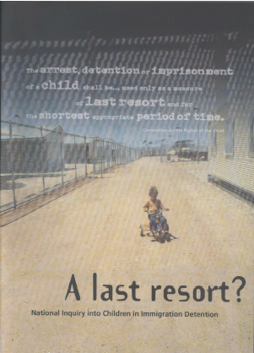
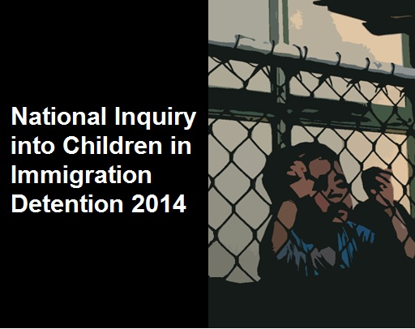
National Inquiry into Children in Immigration Detention

Slide 6
AHRC Inquiry into Children in Immigration Detention 2014
Political risks in holding Inquiry
Media is vital but potentially risky to impartiality and independence
Past inquiries:
2004 - Last Resort: National Inquiry into Children in Immigration Detention
2012 - Age assessment in people smuggling cases

Slide 7
Older children draw conceptual pieces – the world as it should be and the world in detention

Slide 8
Australia’s “exceptionalist” protection of human rights
Few express Constitutional protections of fundamental freedoms (religion, right to vote)
No Charter of Human Rights -only common law country without one
No regional human rights regime to develop jurisprudence
Australia party to almost all human rights treaties
Legislation on Race, Sex, Disability, Age

Slide 9
Australia protects human rights in diverse ways
Judiciary, common law and principles of statutory interpretation eg: presumption that Parliament does not intend to breach international law
But, fatal flaw, legislation ‘trumps’ common law if law is clear and unambiguous eg: Migration Act
Administrative law: natural justice and due process
Parliamentary scrutiny for human rights
Australian Human Rights Commission

Slide 10
Migration Act (Cth)
3,600 in mandatory ‘closed’ detention on Australian mainland and Christmas lsland
2,500 on Manus Island, PNG and Nauru
700 children currently detained, most for well over a year, no education on Christmas island until last month; those arriving after 19 July 2013 “never to be settled in Australia”
No assessment of refugee status: 33,000 in legal black hole no visas or settlement

Slide 11
Habeas Corpus: in effect suspended for asylum seekers
High Court approved administrative detention eg: mandatory detention of asylum seekers arriving by boat without visas
Few legal hooks for appeal to Courts in absence of a Charter of Rights and unambiguous laws
No access to judicial review for negative security assessments; findings Human Rights Committee that this is arbitrary detention/cruel punishment

Slide 12
Detainees on remote islands no practical access to lawyers- four hours flight from Australia
No charge or trial by judicial courts

Slide 13
Australian Human Rights Commission
Mandate to assess ‘acts and practices’ of the Commonwealth
Benchmarks for “human rights” are ICCPR, CROC, and other Declarations
But…not legislated part of Australian law, except re Sex, Race and Disability
Disconnect between Australian law and international law

Slide 14
AHRC Inquiry
Methodology
Team visits to detention centers-medical experts, pediatricians
Data: 500 interviews of 1500 detainees, 250 submissions
4 public hearings, including Minister of Immigration
Power to compel information from service suppliers and Government

Slide 15
AHRC Inquiry
Report to Parliament October 2014

Slide 16
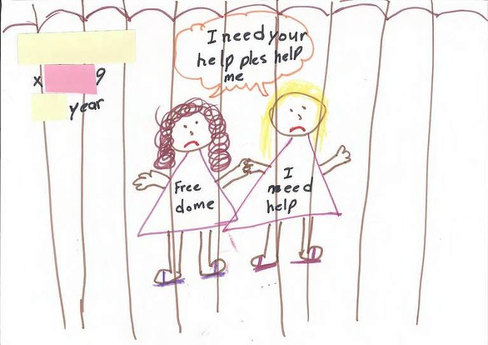

Slide 18
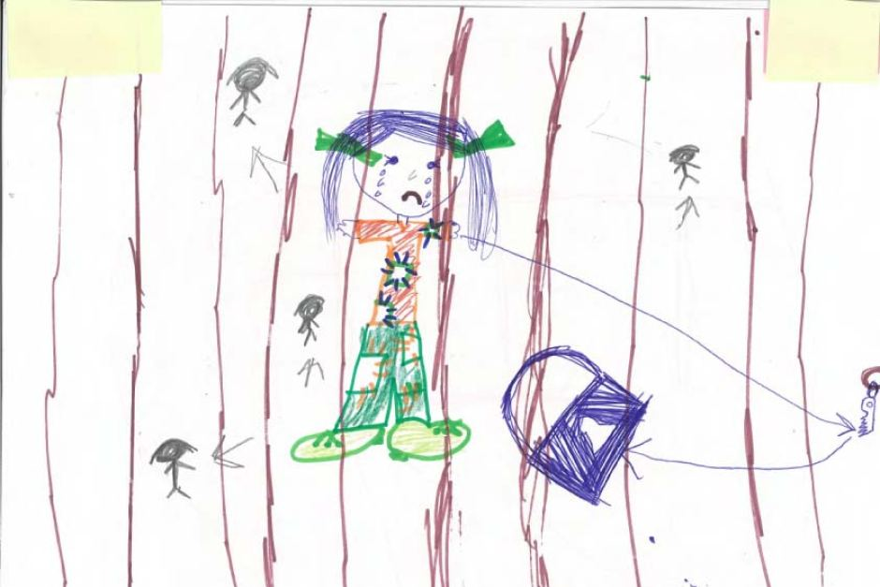

Slide 19
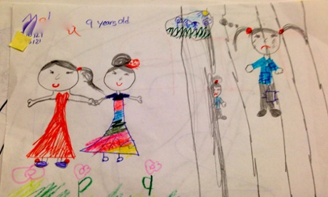

Slide 20


Slide 21
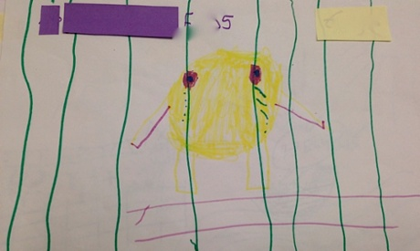

Slide 22
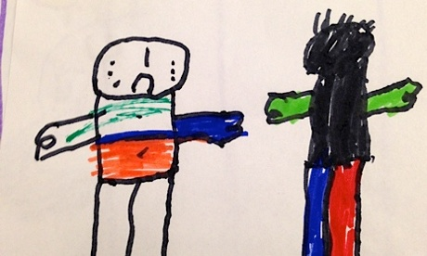

Slide 23
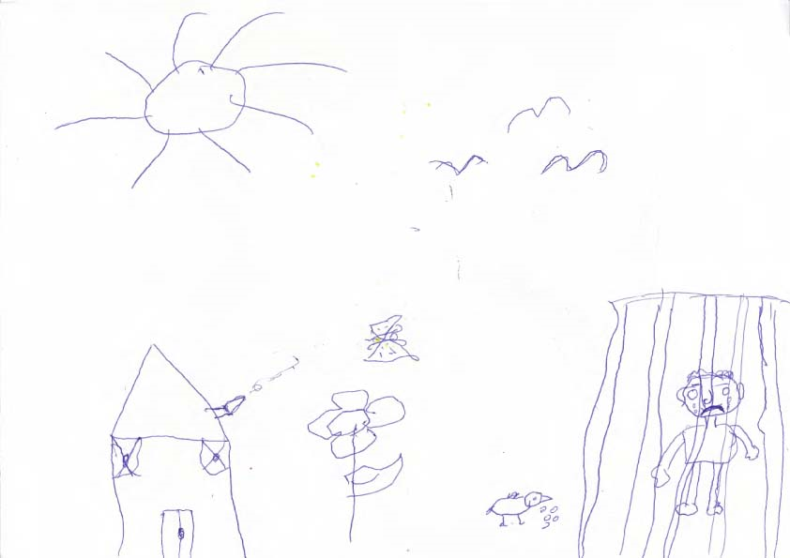

Slide 24


