Slide 1
Policy Guideline on inclusive employment - SDG 8
In-Person Training Module
Presenter's name
Event or meeting title Location, (Date)

Slide 2
Welcome!
You each have one minute to come to the front of the room, introduce yourself and share: What is something you’re good at?

Slide 3
Objectives of the module
Become familiar with the SDG-CRPD resource package and its components.
Gain a better understanding of the situation of persons with disabilities with regards to employment.
Identify concrete actions that policymakers can take to implement SDG 8 in their own contexts.
Learn how to obtain additional information for supporting the process of implementation of SDG8.

Slide 4
What’s in the SDG-CRPD resource package?
Policy Guidelines
Human Rights Indicators for the CRPD
Data Sources Guidance
Training Materials
Videos

Slide 5
Agenda
Start time: 00:00
Disability & Ableism (if applicable)
Data contest!
Stereotypes
Meal time: 00:00
Video Viewing
Employment Barriers
Let’s go on a work journey!
Next Steps
Closing time: 00:00

Slide 6
Disability and Ableism:
What did you think about disability when you were 8-12 years old?

Slide 7
In trios:
Share what you remembered
What do you notice in common between the stories?
Come up with a list of words that you associated with disability during that time of your life.

Slide 8
Ableism
“a value system that considers certain typical characteristics of body and mind as essential for living a life of value. Based on strict standards of appearance, functioning and behaviour, ableist ways of thinking consider the disability experience as a misfortune that leads to suffering and disadvantage and invariably devalues human life”.
Special Rapporteur on the rights of persons with disabilities, Report on the impact of ableism in medical and scientific practice, A/HRC/43/41, 2019

Slide 9
WELCOME TO THE DATA CONTEST!
The team with most points will win a prize!

Slide 10
Question 1 - What is the average employment rate for persons with disabilities across 8 regions? (5 points)
15 per cent
36 per cent
67 per cent

Slide 11
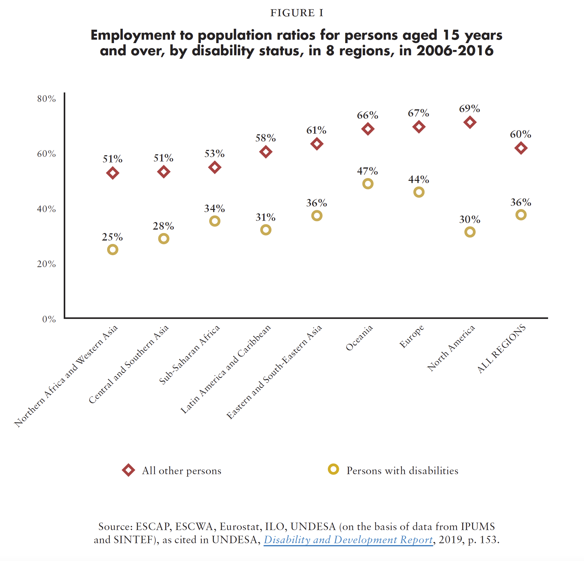
Question 1 - What is the average employment rate for persons with disabilities across 8 regions? (5 points)
Source: ESCAP, ESCWA, Eurostat, ILO, UNDESA (on the basis of data from IPUMS and SINTEF), as cited in UNDESA, Disability and Development Report, 2019, p. 153.

Slide 12
Question 2: true or false - In many countries, restrictions to legal capacity prevent some persons with disabilities from opening bank accounts (5 points)

Slide 13
Question 2: true or false - In many countries, restrictions to legal capacity prevent some persons with disabilities from opening bank accounts (5 points)
Correct answer: True
Expanded answer: persons with intellectual disabilities may be requested to have a guardian appointed to authorize transactions. Women with intellectual disabilities may face additional barriers which restrict their legal capacity, either in law or in practice. Substitute decision-making regimes may prevent signing an employment contract, and result in employers’ unwillingness to hire anyone under guardianship, to avoid legal hurdles.

Slide 14
Question 3 - What is the proportion of persons with disabilities who are economically inactive in comparison to persons without disabilities? (5 points)

Slide 15
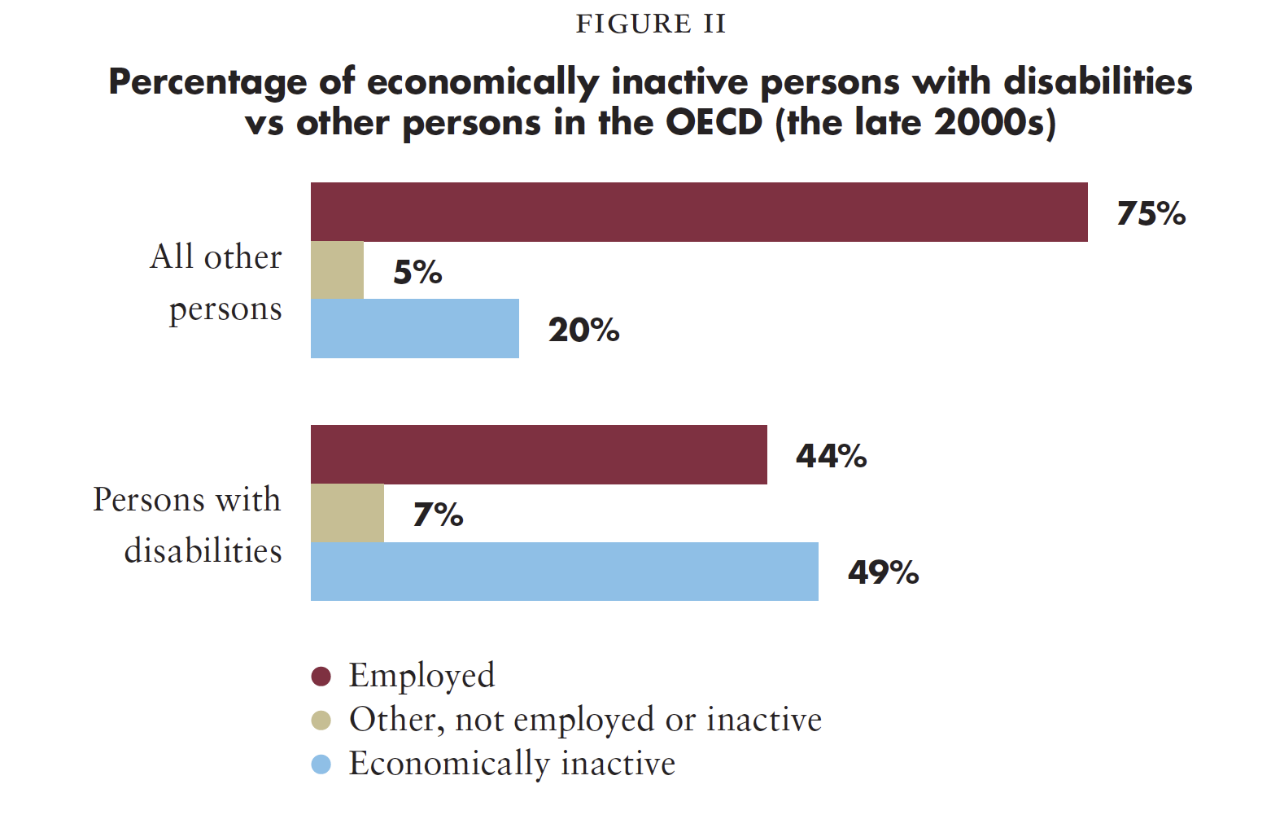
Question 3 - What is the proportion of persons with disabilities who are economically inactive in comparison to persons without disabilities? (5 points)
Source: OECD, Sickness, Disability and Work: Breaking the Barriers: A Synthesis of Findings across OECD Countries, 2010.

Slide 16
Question 4 - What is the wage gap range for persons with disabilities? (7 points)

Slide 17
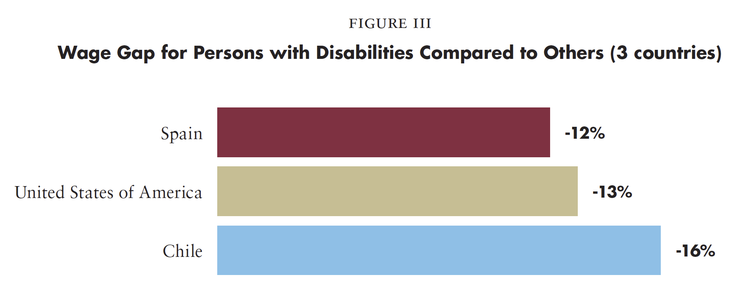
Question 4 - What is the wage gap range for persons with disabilities? (7 points)
Source: National Statistical Institute of Spain, Erickson et al (2014) and Ministry of Social Development of Chile, as cited in UNDESA, Disability and Development Report, 2019, p. 159.

Slide 18
Question 5: Challenge! (10 points)
Two members of your team have to share policies or practices in their countries that are aimed at guaranteeing sustained, inclusive and sustainable economic growth, full and productive employment and decent work for persons with disabilities.

Slide 19
In pairs, discuss:
Something you learned or that surprised you in this activity.

Slide 20
BREAK! Come back at :00

Slide 21
Stereotypes - In Trios
List the stereotypes you know, have heard, or believe about persons with disabilities and employment.
When thinking about these stereotypes also consider the type of employment or if someone is self-employed.

Slide 22
Debates: One group argues in favor and another against the following statements
G1 (in favor), G2 (against):
“Occupational health assessments are a necessary tool to determine whether a person is capable of working.”
G3 (in favor), G4 (against):
“Hiring people with disabilities is good for business”
G5 (in favor), G6 (against):
“Because of their impairment, people with disabilities can only do certain kinds of jobs.”

Slide 23
Debates: One group argues in favor and another against the following statements
G1 (in favor), G2 (against):
“Occupational health assessments are a necessary tool to determine whether a person is capable of working.”

Slide 24
Debates: One group argues in favor and another against the following statements
G3 (in favor), G4 (against):
“Hiring people with disabilities is good for business”

Slide 25
Debates: One group argues in favor and another against the following statements
G5 (in favor), G6 (against):
“Because of their impairment, people with disabilities can only do certain kinds of jobs.”

Slide 26
Short Video
As you watch and listen, pay attention to the different situations highlighted and the issues shared and proposed.

Slide 27
Map the actors in your country:
Individually: draft a map of actors in the employment system for your country. Keep it with you.

Slide 28
LUNCH BREAK!
Come back at :00

Slide 29
Team work: Employment Barriers
Clara
Raj
Noah
Ana
Visit each station, read through the character card and write down specific barriers they and the actors in charge of making decisions might face.

Slide 30
Employment Barriers - Stations
Barriers faced by character
Barriers faced by actors

Slide 31
Maximize Employment
What helps to have a good working experience?

Slide 32
Maximize Employment
Full and productive employment of persons with disabilities
8.5 By 2030, achieve full and productive employment and decent work for all women and men, including for young people and persons with disabilities, and equal pay for work of equal value
Include the rights of persons with disabilities in labour law, including the prohibition of discrimination, the provision of reasonable accommodation and the right to return to work | Adopt an action plan/strategy for the promotion of employment of persons with disabilities in both the private and public sector | Carry out awareness-raising campaigns on the labour rights of persons with disabilities | Measure and reduce the disability pay gap
Related CRPD indicators:5.7, 5.11, 5.12, 13.14, 27.1, 27.4, 27.13, 27.16, 27.25

Slide 33
Maximize Employment
Self-employment of persons with disabilities
8.3 Promote development-oriented policies that support productive activities, decent job creation, entrepreneurship, creativity and innovation, and encourage the formalization and growth of micro-, small- and medium-sized enterprises, including through access to financial services 8.10 Strengthen the capacity of domestic financial institutions to encourage and expand access to banking, insurance and financial services for all
Ensure that mainstream vocational and entrepreneurship training are inclusive of persons with disabilities and that supportive targeted training is available to them | Adopt legal and regulatory measures to ensure the equal participation of persons with disabilities in business organizations and equal access to financial services, including micro-finance and credit schemes | Make business development services available for persons with disabilities
Related CRPD indicators: 9.3, 9.4, 12.1, 12.2, 12.15, 19.12, 19.13, 19.26, 24.5, 24.20, 24.27, 27.1, 27.4, 27.12, 27.15, 27.19, 28.3, 28.4, 28.5, 28.14

Slide 34
Maximize Employment
Protection of labour rights of persons with disabilities
8.8 Protect labour rights and promote safe and secure working environments for all workers, including migrant workers, in particular women migrants, and those in precarious employment 8.7 Take immediate and effective measures to eradicate forced labour, end modern slavery and human trafficking and secure the prohibition and elimination of the worst forms of child labour, including recruitment and use of child soldiers, and by 2025 end child labour in all its forms
Ensure freedom of association to persons with disabilities to create and participate in trade unions | Ensure that occupational health assessments do not prevent access to employment, based on impairments | Incorporate accessibility in all its dimensions as a key element of occupational health and safety | Adopt disability inclusive strategies against forced labour, including measures to end forced begging and other forms of exploitation
Related CRPD indicators:16.1, 16.3, 16.13, 27.1, 27.2, 27.5, 27.7, 29.9, 29.11, 29.23

Slide 35
Let’s Go On A Work Journey
What policies or practices should be in place to ensure that this character has a good working experience, and that the character’s job is accessible?
What policies or practices should be in place to prevent this situation from happening again?
Who, in your country, would have the power to put these in place?
What would be needed - to ensure consultation with people with disabilities - to have these policies in place?

Slide 36
BREAK! Come back at :00

Slide 37
Gallery round in pairs
Find one other person from a different team, go around the room and review the flipcharts.
Share: What new thing did you learn? What’s one thing that grabbed your attention? What feels doable in your country? What might be most difficult to accomplish?

Slide 38
Wrap up and next steps

Slide 39
Closing circle
One thing I commit to do in the next three months to advance inclusive employment in my context.

Slide 40
Thank you!
For further information,
please visit:
www.ohchr.org

