Slide 1
Domestic Workers in Thailand – Breaking the Isolation
Brahm Press
MAP Foundation - Thailand

Slide 2
MAP Foundation
19 years working on migrants’ rights and health in Thailand
CBO/NGO – most staff are migrants from Burma themselves
Chiang Mai main office, sub-office in Mae Sot at the border, and networks along border, in the South, and in Bangkok and Mahachai area
Programs:
Labour Rights including organizing, OSH and Domestic Workers; Women’s empowerment; Youth SRHR; Access to education; HIV and TB prevention; Crisis support; Print and multi media in migrant languages as well as two radio stations – one in Shan and the other in Burmese

Slide 3
Domestic work – Not recognized
Thailand has not ratified C189
Domestic workers are excluded from certain labour standards including:
No minimum wage coverage
No specified limitations on working hours / No overtime compensation
No social security coverage (still considered informal sector)
No maternity leave / No protection from dismissal for pregnancy
No labour inspection to access private residence “intrusion of privacy”
No controls on charges for documents by agents or employers no punishment for withholding documents

Slide 4
Domestic work – small protections
Government Ministerial Regulation no. 14 (Nov. 2012) includes domestic workers under certain parts of the Labour Protection Act 1998 by giving the right to:
Weekly rest day
Traditional public holidays (13 days a year) - or else proper remuneration (which is commonly the option)
Sick leave and payment of unused leave days in case of termination (rare)
Monthly payment of wages
Sets a minimum age of 15 for employment as a domestic worker (C138)

Slide 5
Brief survey
The number of domestic workers in Thailand is estimated at 250,000 - most are migrants
83,000 migrant domestic workers were registered in 2011 - the last official registration by work category (highest number was 129,267 registered in 2009)
MAP did a survey of migrant workers (end of 2013) included 20 domestic workers:
Half were undocumented
14 were being paid monthly: the majority of the domestic workers being paid monthly were receiving only 4,300-5,000 THB (a full time worker should be receiving a monthly salary of at least 7200 THB or 221 USD); all but one were working 13-14 hours per day.
6 were being paid daily: most reported working 8-9 hours a day and received 200-300 THB; one person received 400 THB.

Slide 6
Reaching the isolated
MAP first identified migrant domestic workers through word of mouth and by visiting temples
Started bringing women together in groups to talk – main topic usually migrant policy and documentation
Domestic workers meet in groups similar to MAP’s Women Exchange activity which creates a women-only space to learn, share, exchange and encourage each other
DW Groups in Chiang Mai and Bangkok: 20-30 people attend each time; new members attend every time; develop peer educators; 3 – 12 x a year (depending on funding); usually held on a Sunday
200 members in Bangkok (Pa-o, Burma, Shan) / 200 members in Chiang Mai
Now able to communicate and share more quickly with use of “Line” and social apps

Slide 7
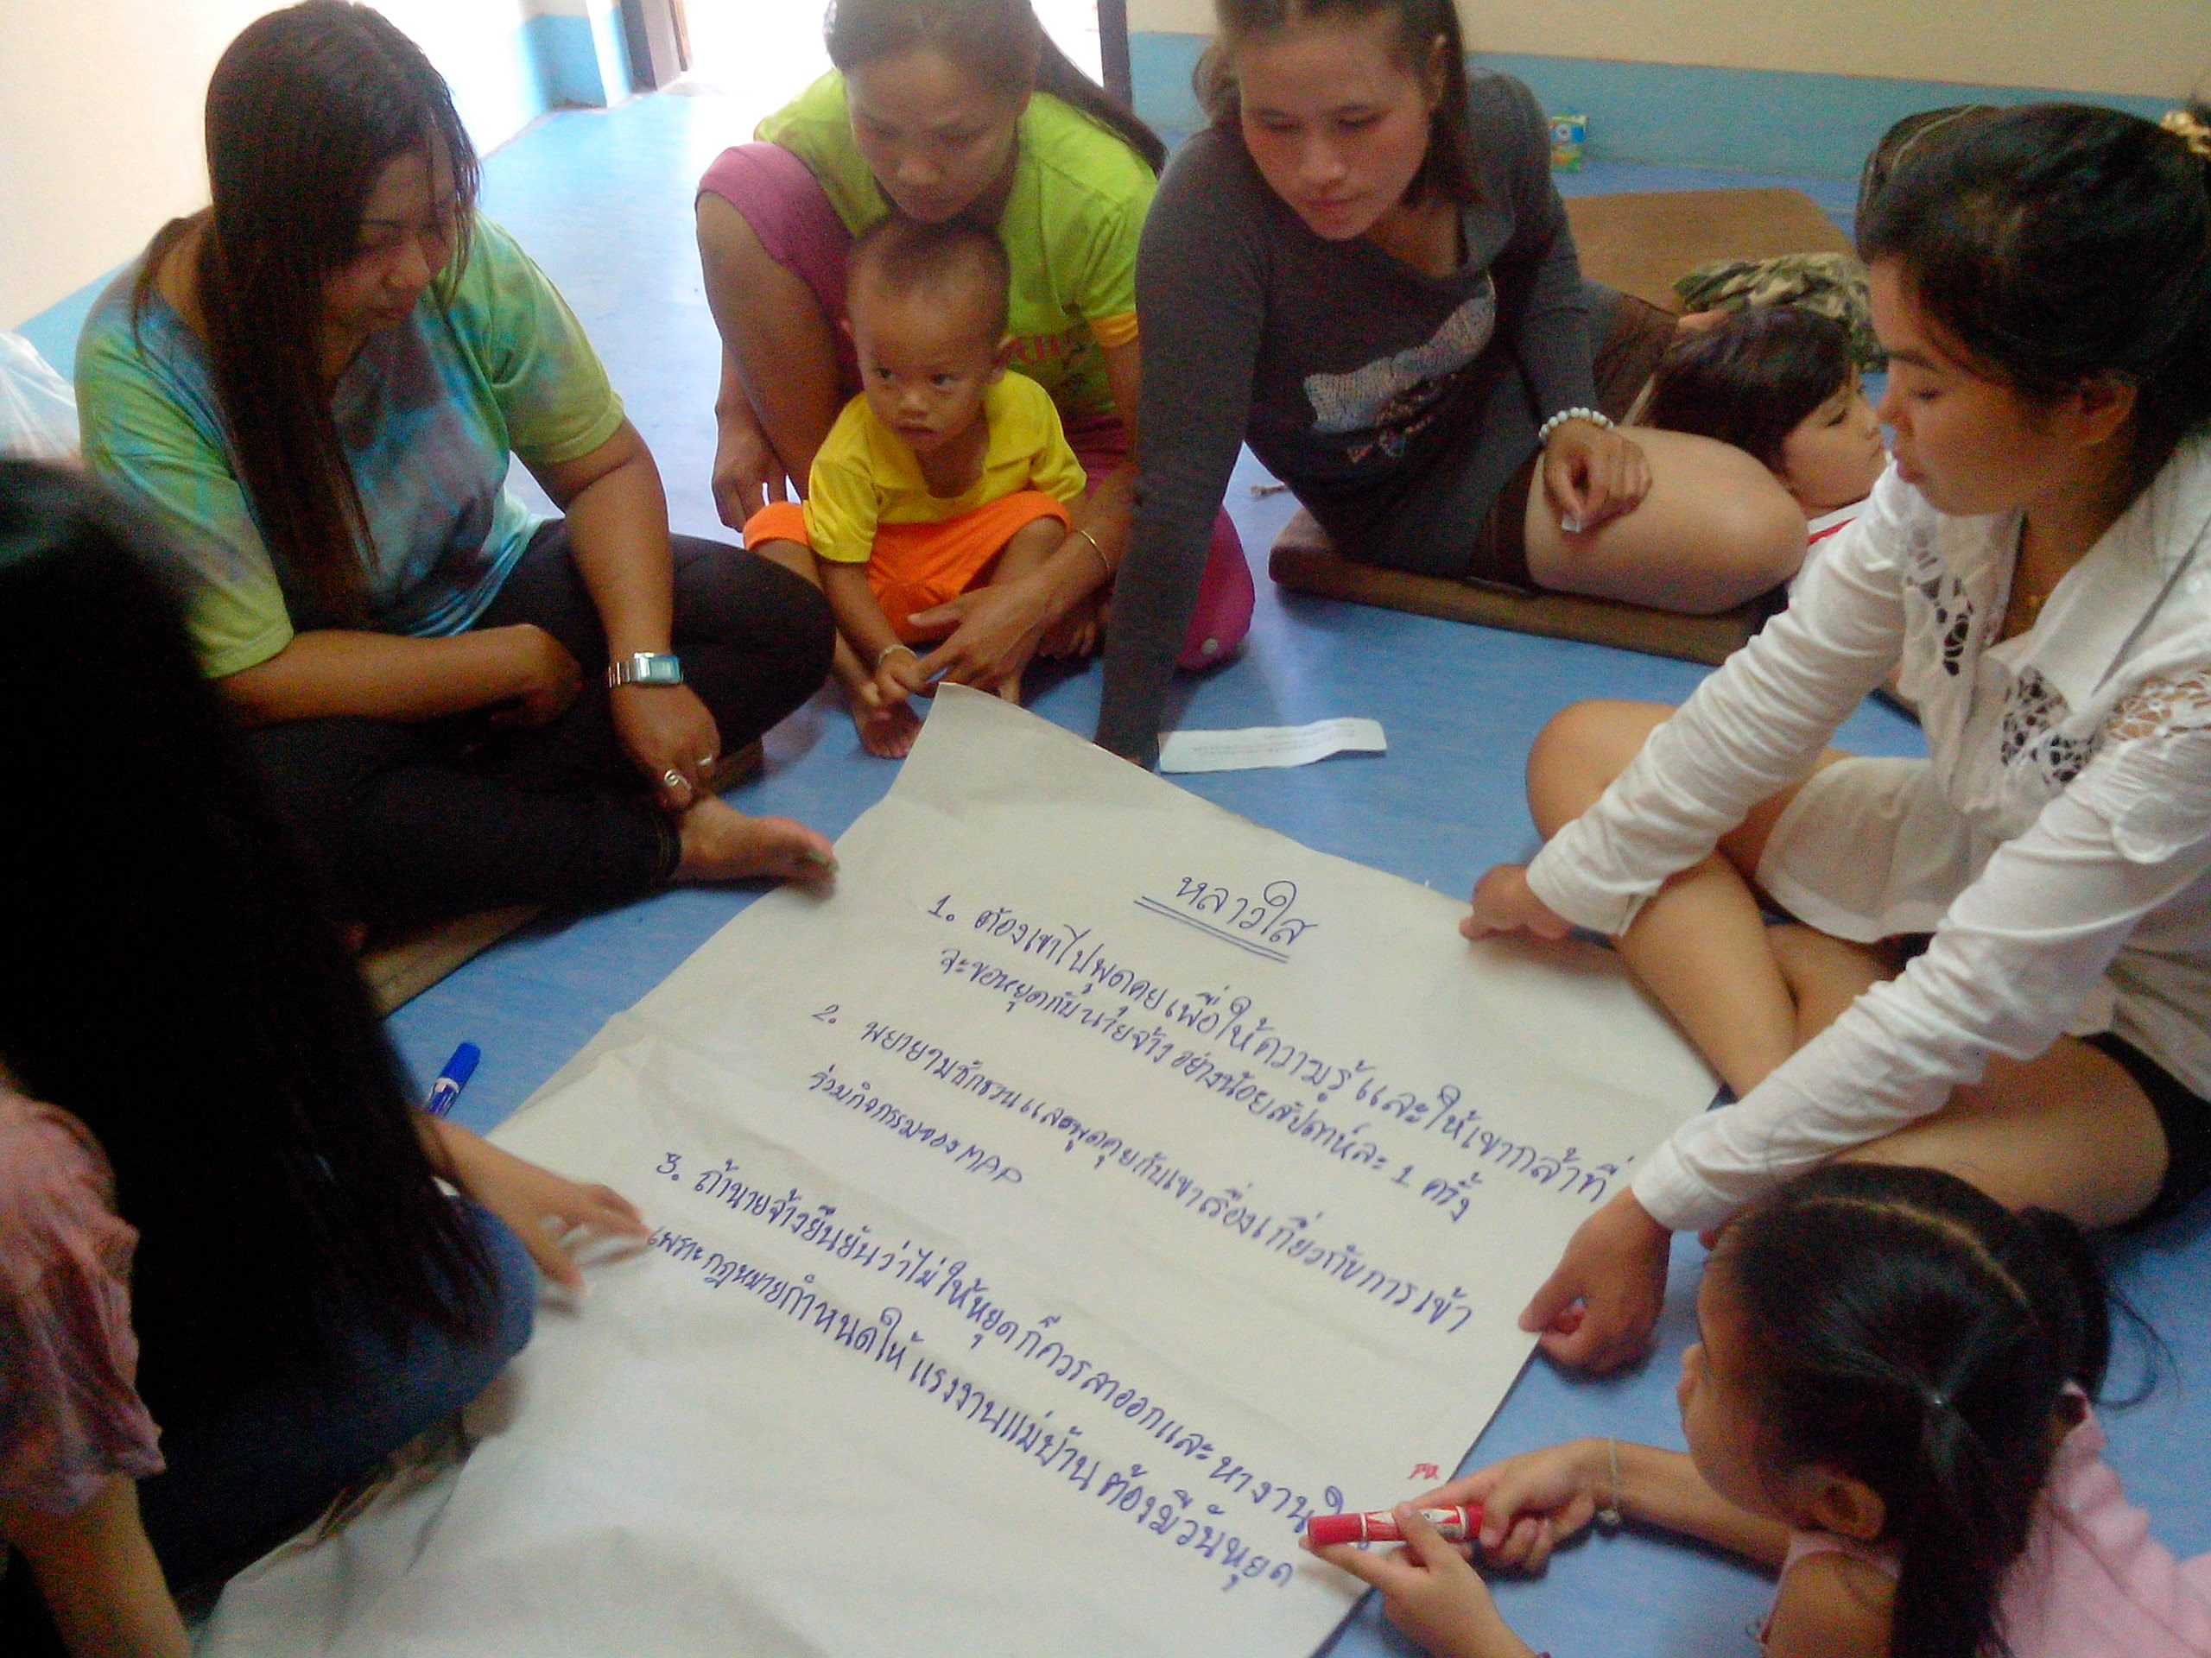
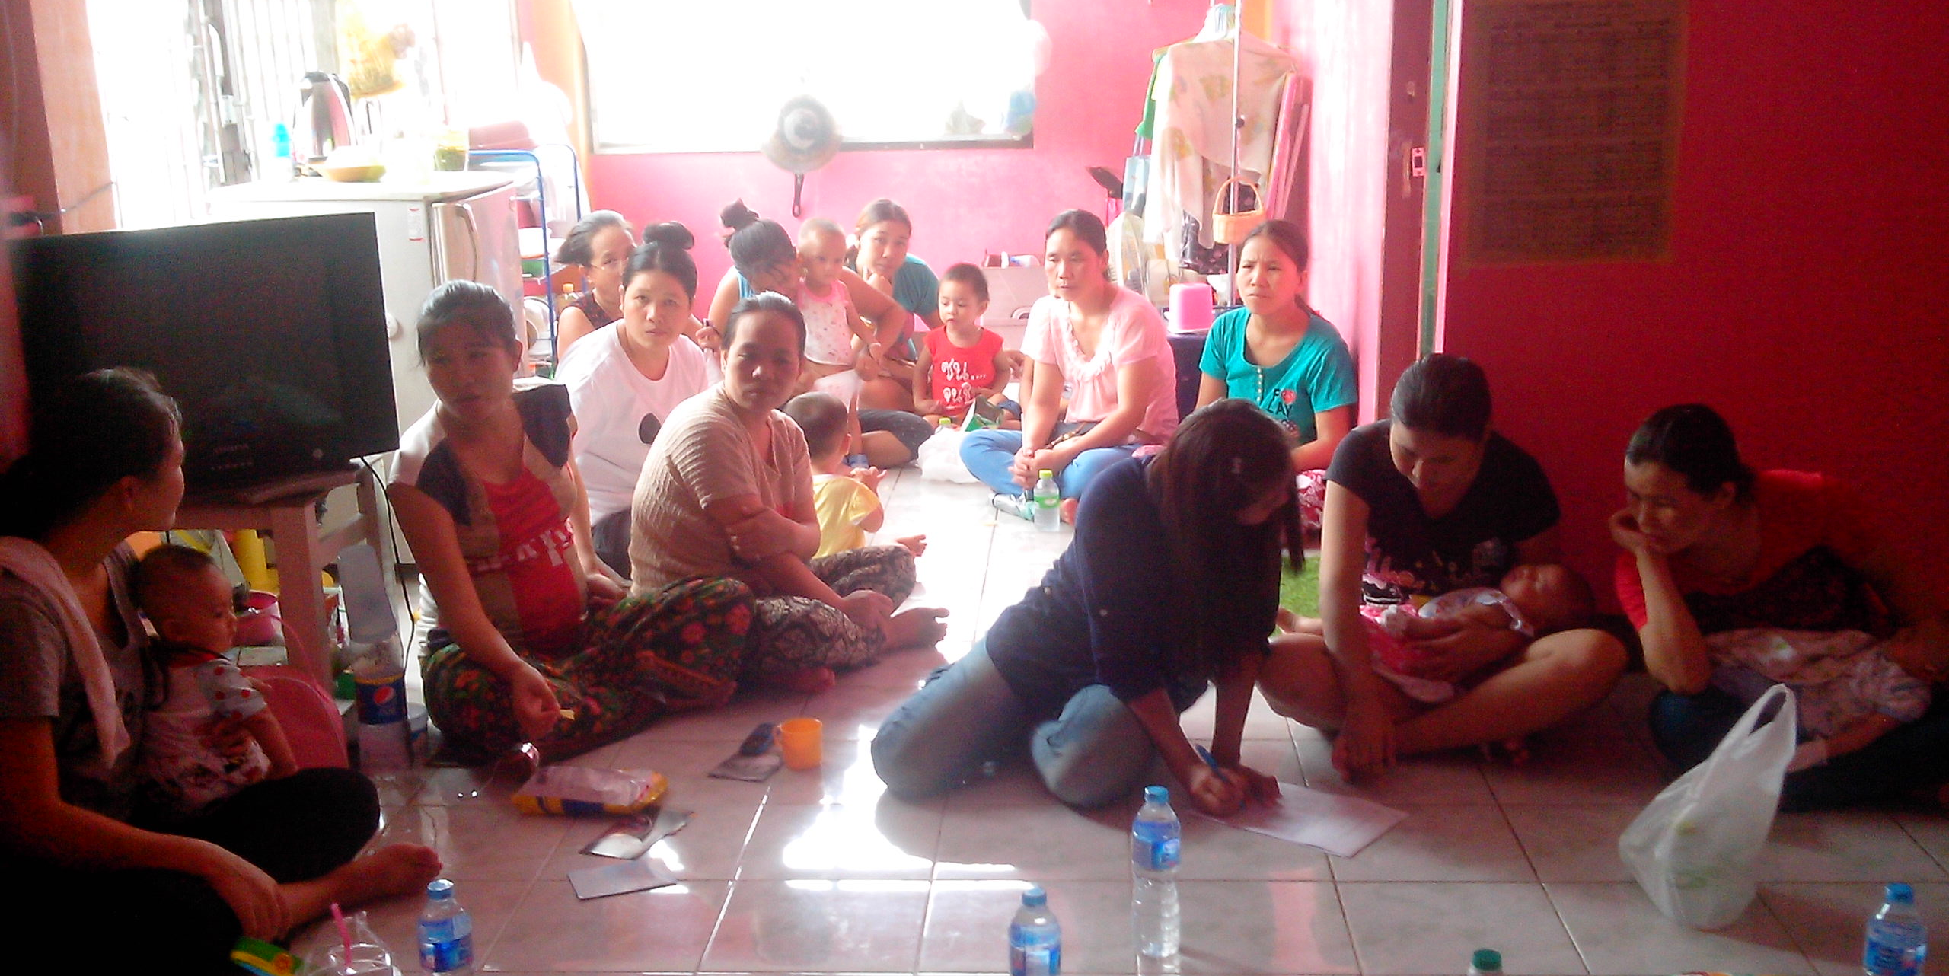
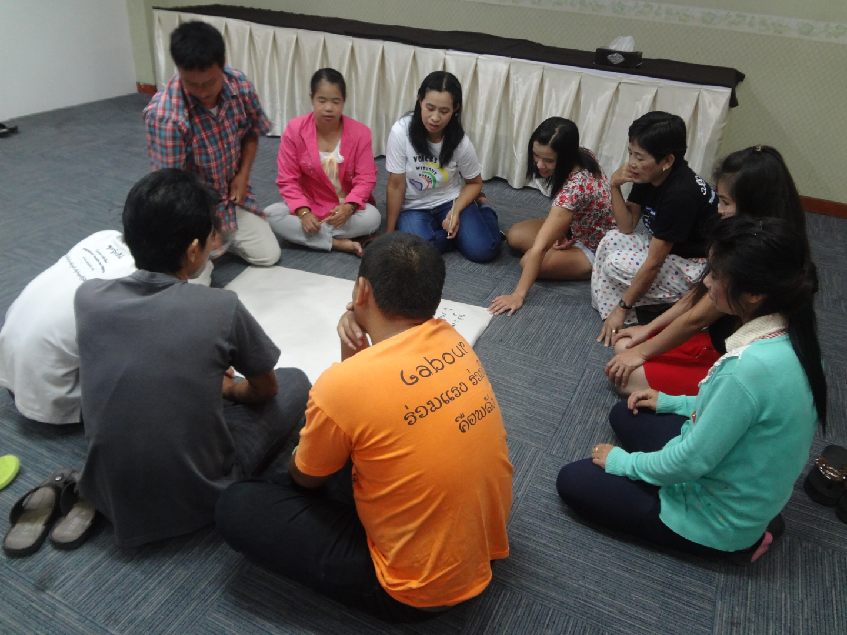
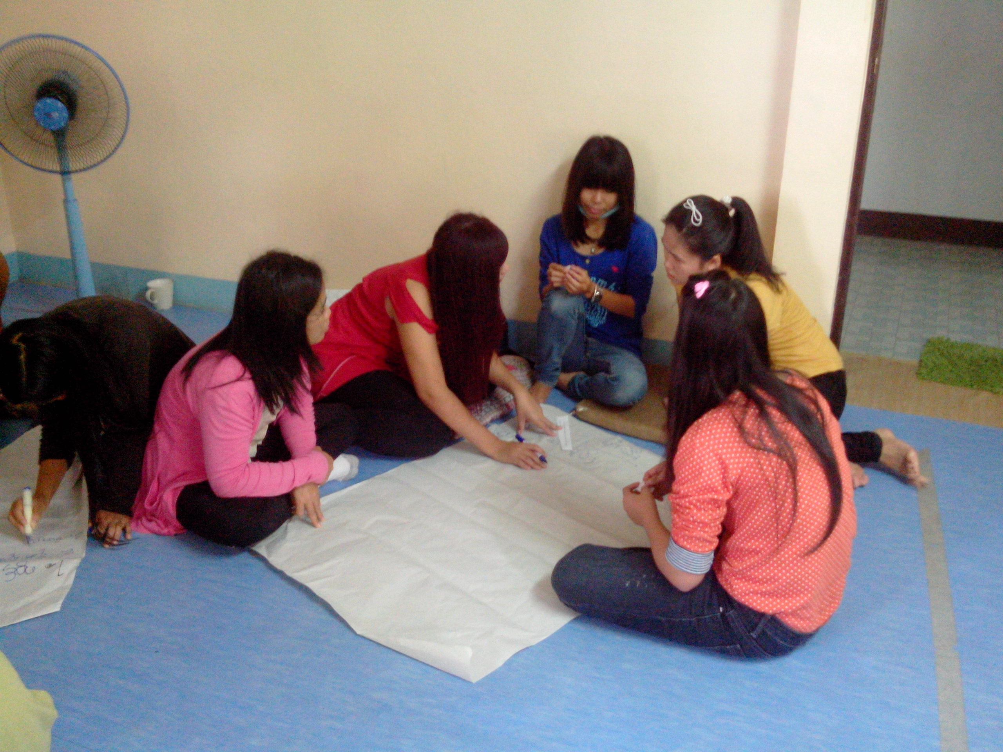

Slide 8
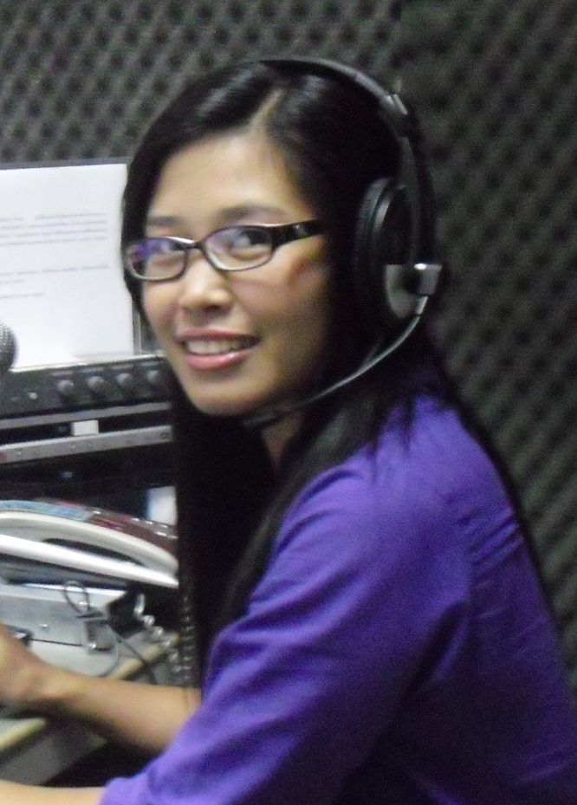
MAP Radio FM 99 just celebrated 11th anniversary as a community radio station
MAP Radio broadcasts in Shan language daily with a program schedule including Domestic Workers program live 11:00am-1:00pm every Friday (Pim – pictured)
13 call-ins avg.: how to change employers, what to do if not paid, how to negotiate with employer, minimum wage, new registration, and discuss working conditions
MAP Radio broadcasts over the internet as well
App allows migrant workers to listen over their smart phone - 289 downloads - Domestic workers the largest audience

Slide 9
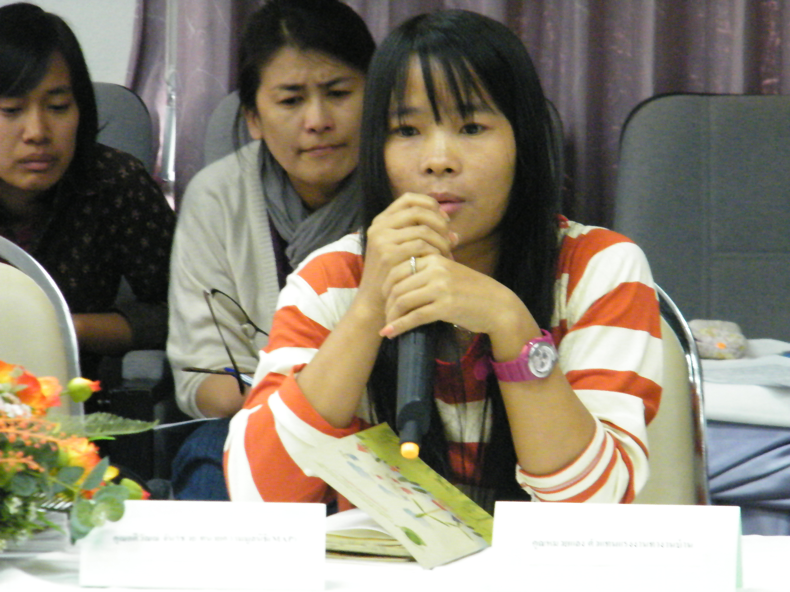
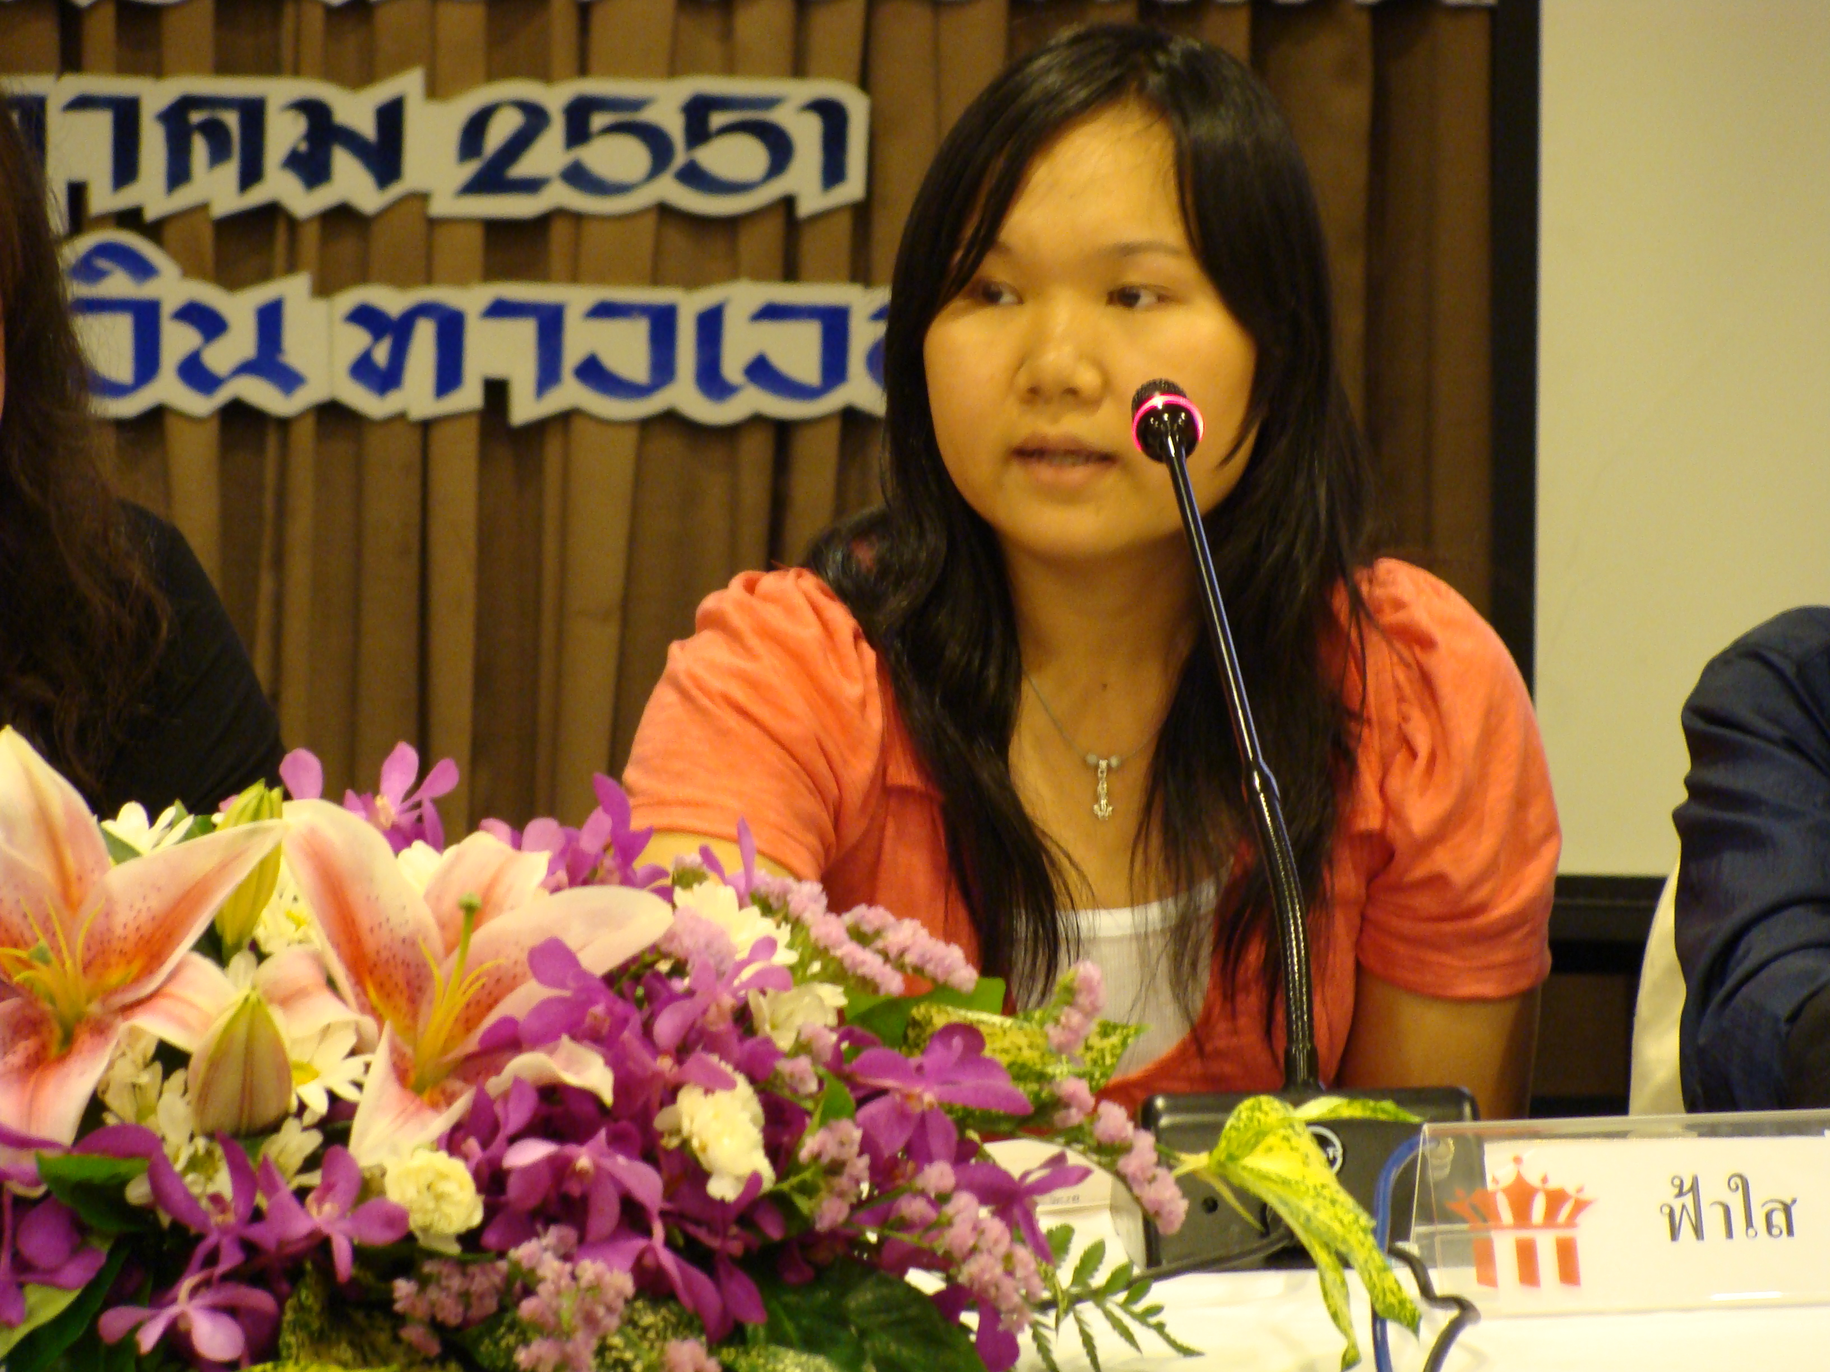
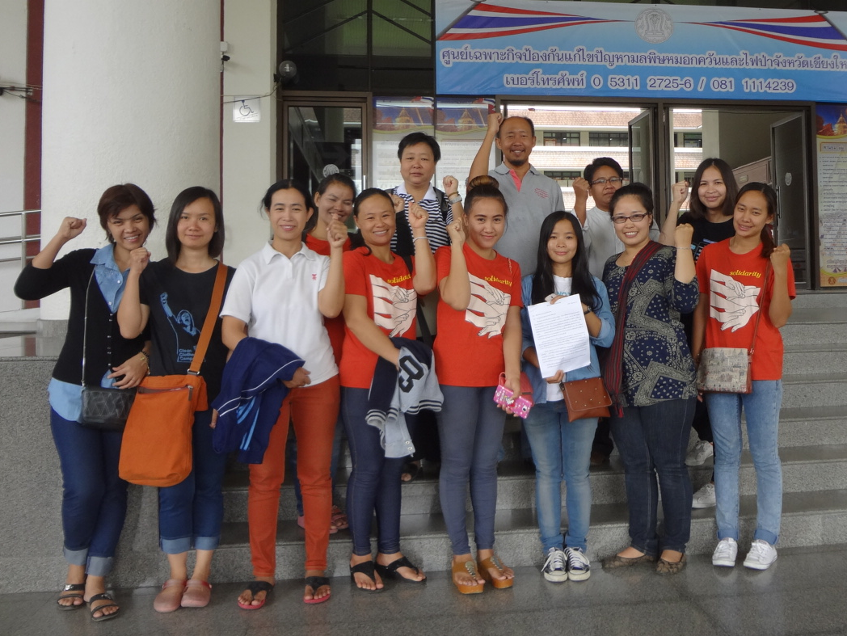
Solidarity
In Chiang Mai, domestic workers were encouraged to become members of a local Shan group called Workers Solidarity Association (WSA) in order to be part of a labour organization
Now she is one of the leaders (top)
Injects domestic workers issues into advocacy events such as Labour Day and International Migrants Day
International Domestic Workers Day

Slide 10
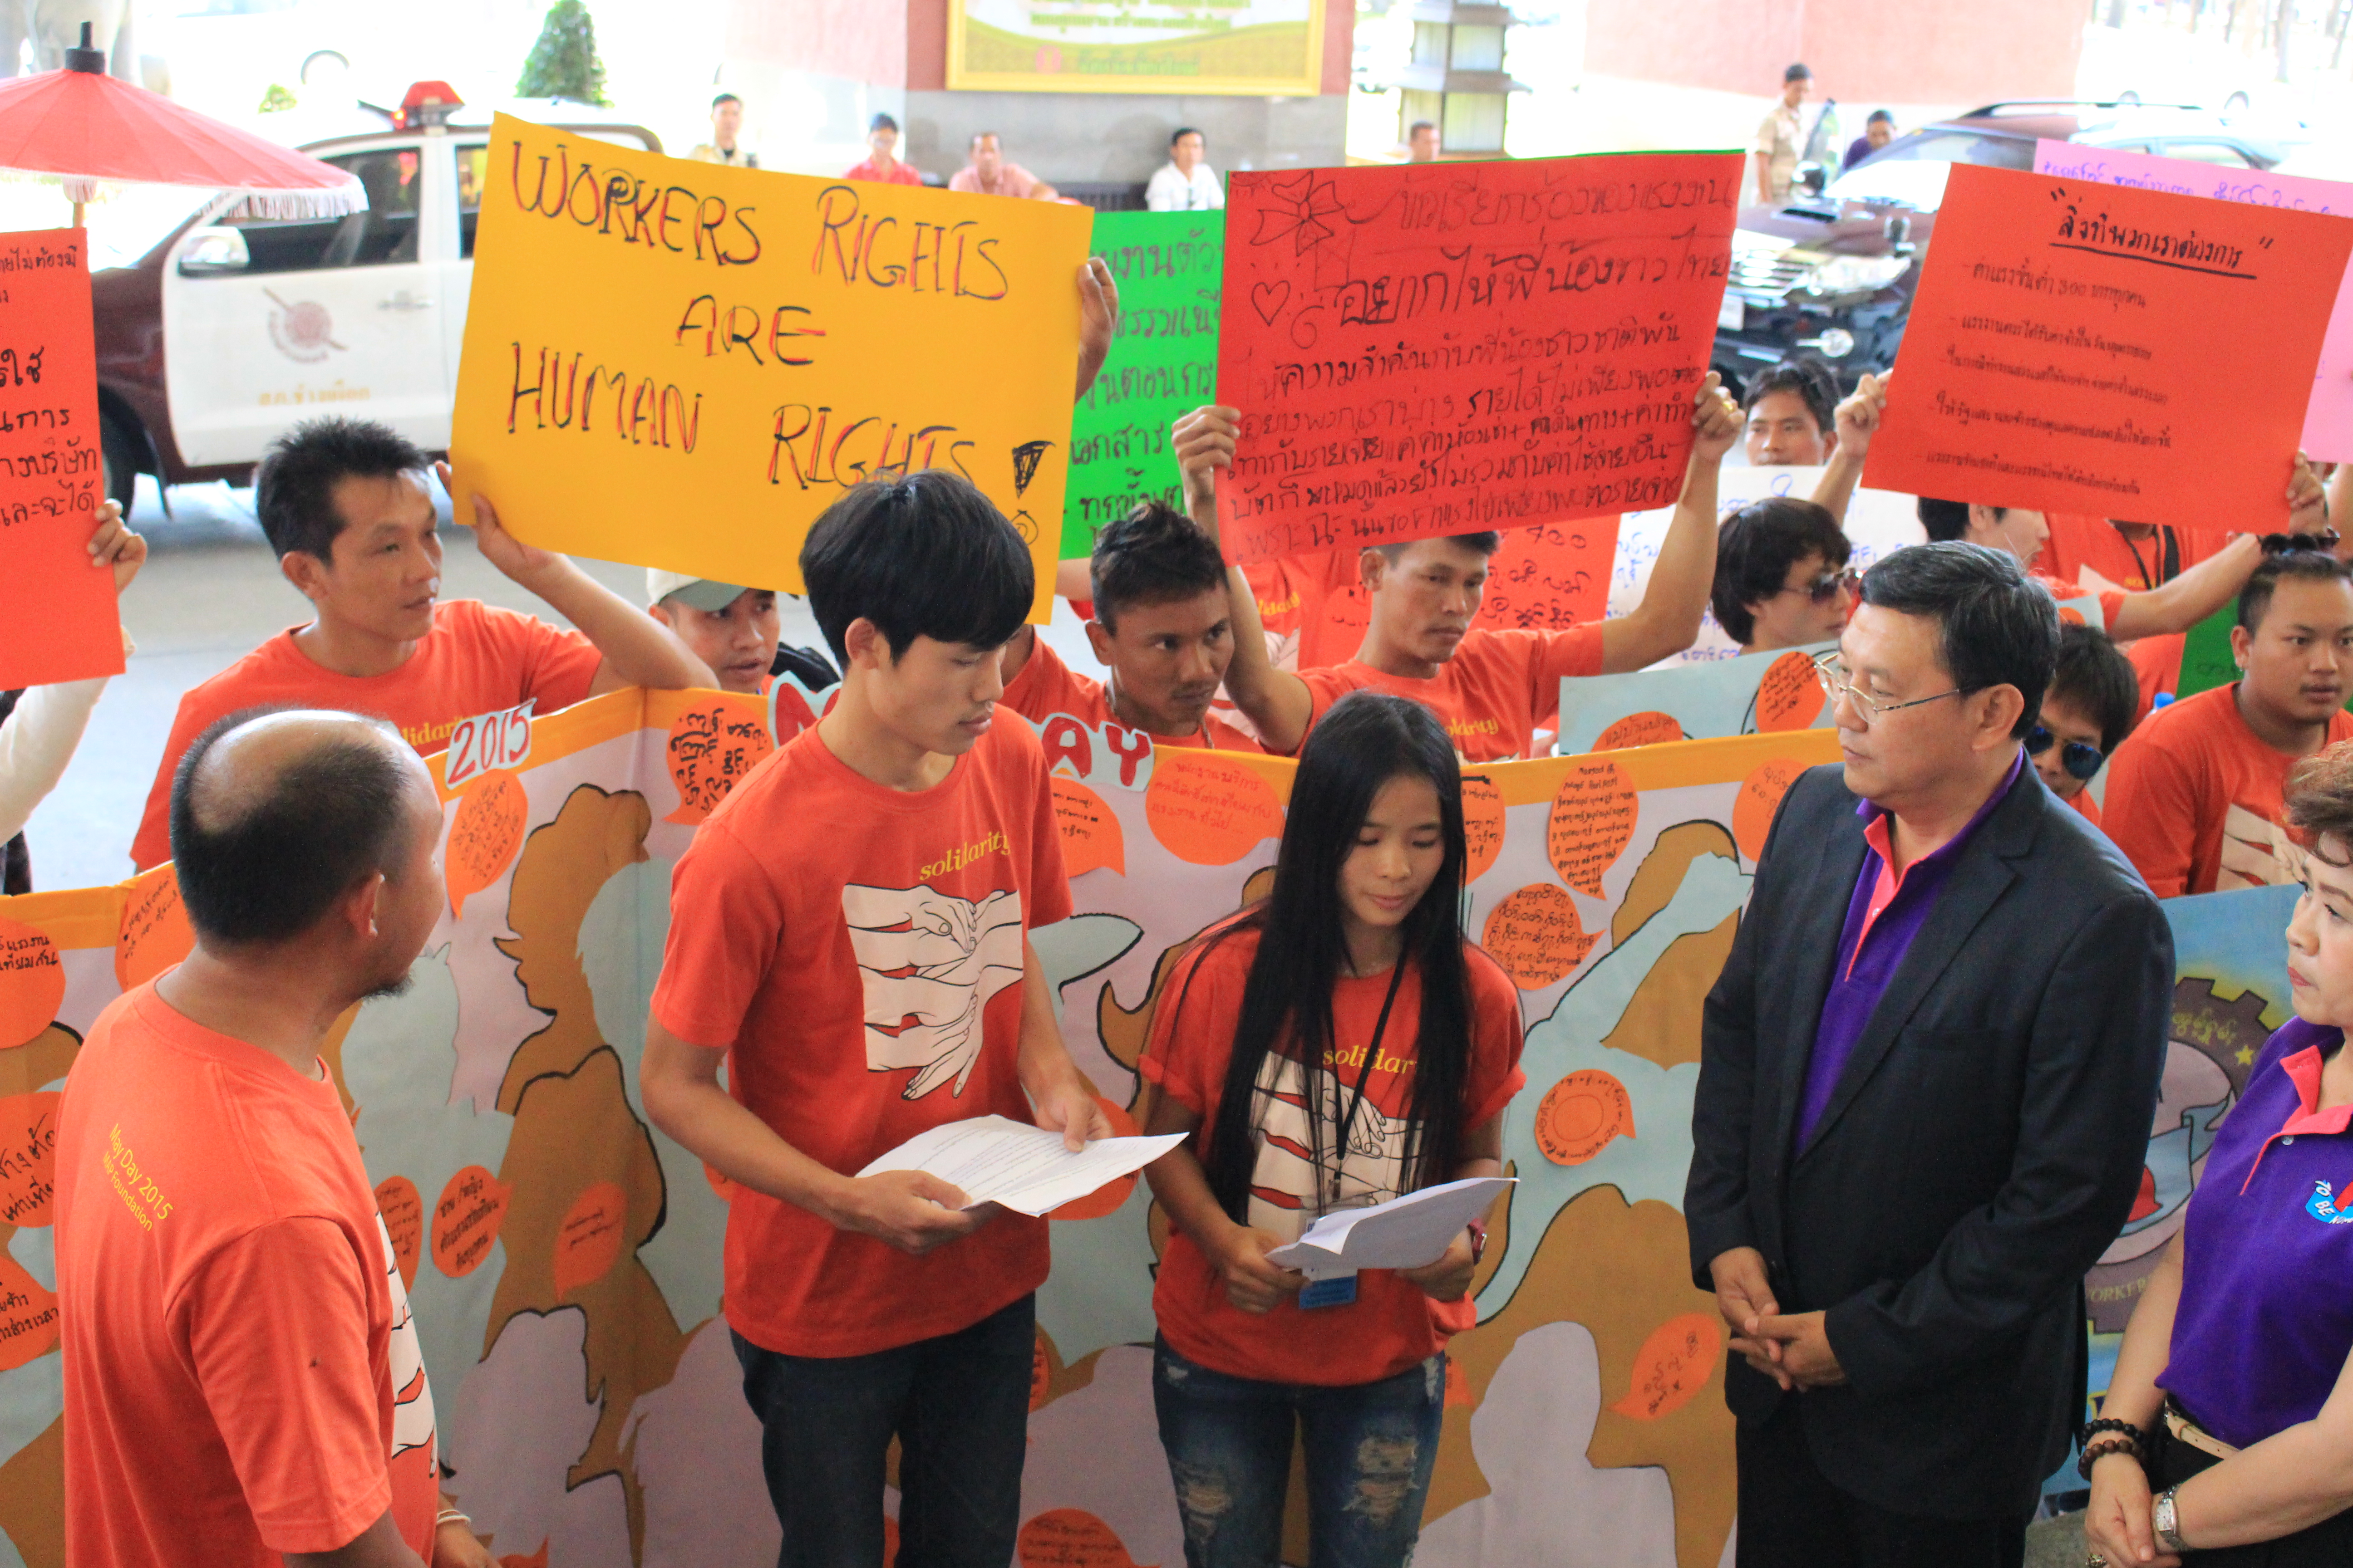
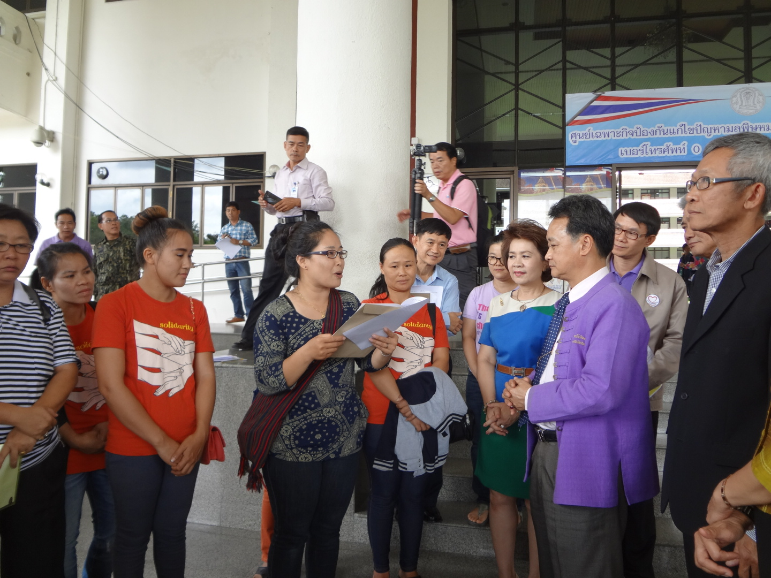
“May day” and “International Domestic Workers Day” – presented a letter with recommendations to the Provincial Governor chiang mai 2014-15

Slide 11
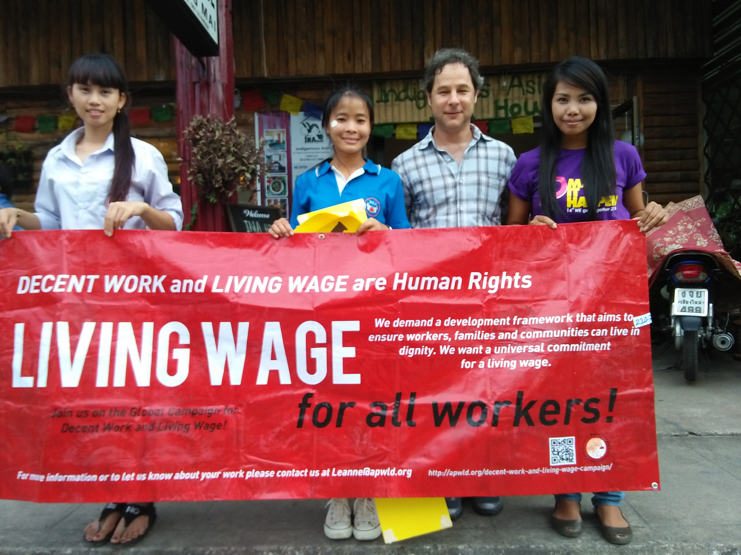
Thank you

