Slide 1
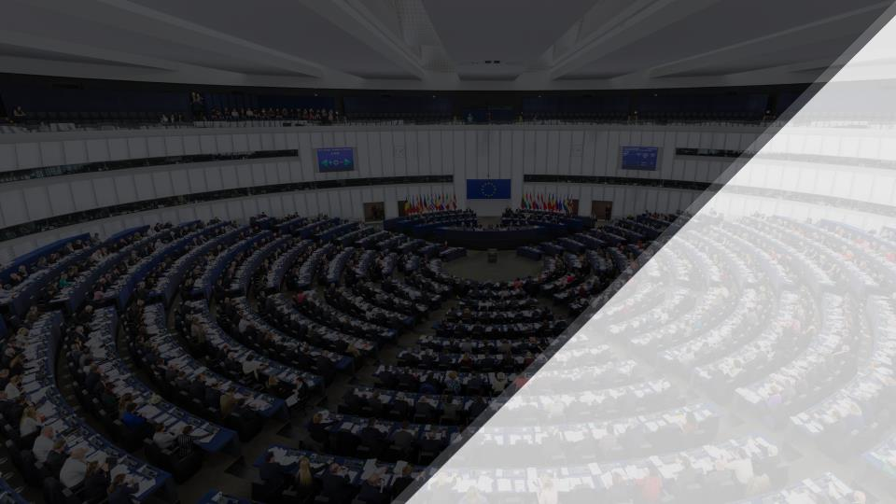
Social Forum
Implementing health related SDGs through a human rights perspective
in the context of the HIV Epidemic
2nd October 2017 | Geneva, Switzerland
Ricardo Baptista Leite, MP, MD, PhD(c)
Medical Doctor and Member of the Portuguese Parliament
Member of the Parliamentary Health Committee | Foreign Affairs Committee
Founder & President of UNITE – Parliamentarians Network to End HIV/AIDS, Viral Hepatitis and Tuberculosis
Head of Public Health | Católica University of Portugal
Guest Lecturer | NOVA Medical School and NOVA Information Management School
City Councilor of Cascais
ricardo.baptistaleite@gmail.com | @RBaptistaLeite

Slide 2



Portugal: Cascais – Sintra – Estoril Coast
@RBaptistaLeite

Slide 3


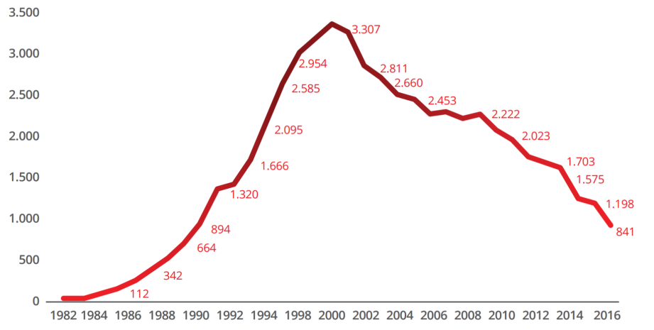

HIV in Portugal
Number of New HIV Infections 1983-2016
1979
1983
1996
2000
2011-2014
TROIKA
1st Dx HIV
in Portugal
HAART
Drug Addiction as
Health Problem
@RBaptistaLeite

Slide 4


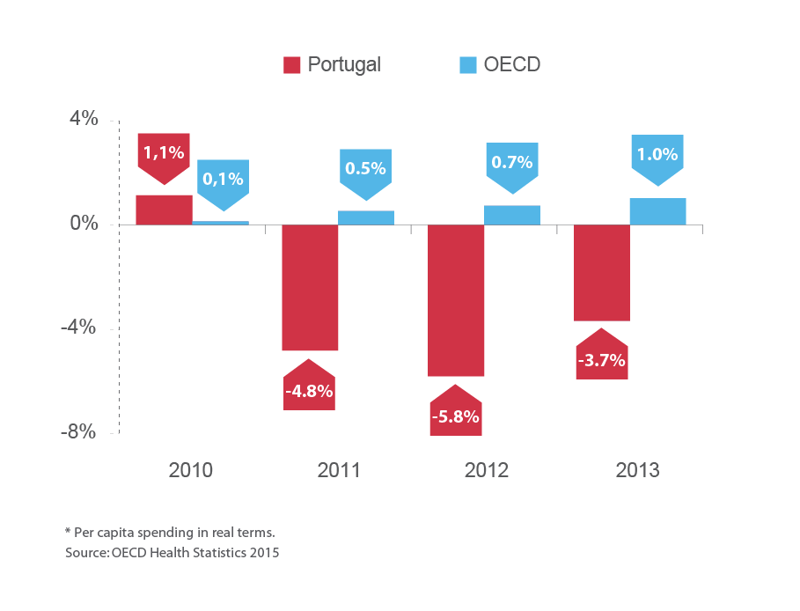
HIV in Portugal
2011 | TROIKA@Portugal
@RBaptistaLeite

Slide 5
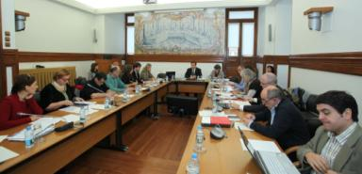
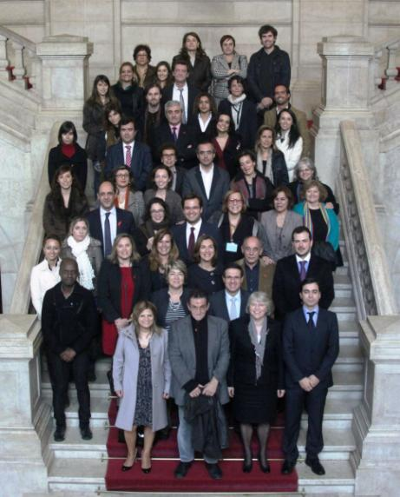
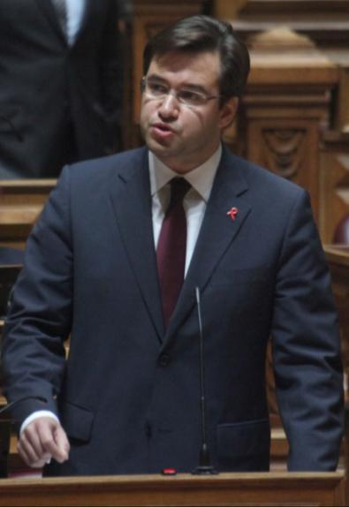
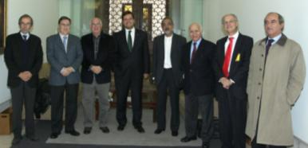
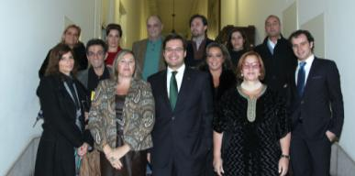
HIV in Portugal
2011 | HIV Resolution
@RBaptistaLeite

Slide 6

HIV in Portugal
Number of New HIV Infections 1983-2016
2015
1979
1983
1996
2000
2011-2014
2016
HEP C
TROIKA
1st Dx HIV
in Portugal
HAART
Drug Addiction as
Health Problem
T&T
Fast Track Cities
PrEP
@RBaptistaLeite

Slide 7

Cascais, Lisbon and Oporto on the Fast Track to end AIDS
Lisbon, 29th May 2017
@RBaptistaLeite

Slide 8

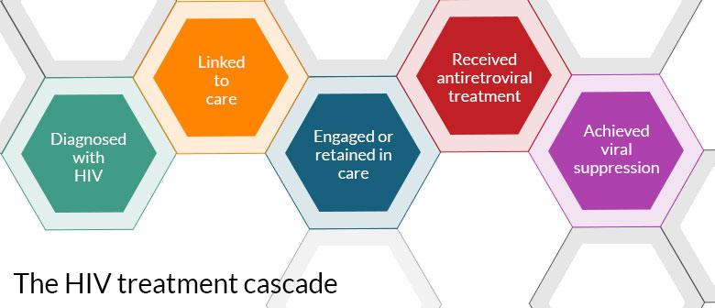
90 – 90 – 90
Biomedical approach to HIV
@RBaptistaLeite

Slide 9

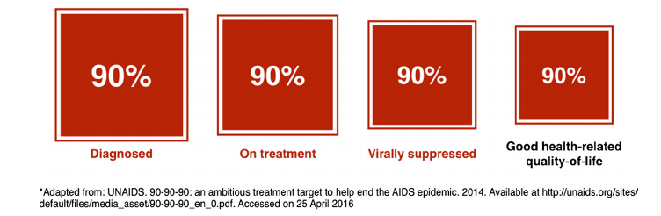
4th ‘90’
Good Health-related Quality-of-Life
HIV as a social and life-long condition
Lazarus et al. BMC Medicine (2016) 14:94
@RBaptistaLeite

Slide 10
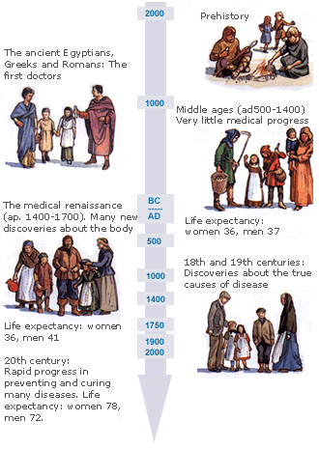
The Evolution of Healthcare
Goals of Medicine
Promote health
Preserve health
Restore health, when compromised
Minimize suffering and malaise
Nutbeam D. Health Promotion Glossary. Health Promotion International, 13(4): 349-364. 1999; http://ww2.ecclesbourne.derbyshire.sch.uk/
@RBaptistaLeite

Slide 11




The Evolution of Healthcare
Industrial Revolution
@RBaptistaLeite

Slide 12
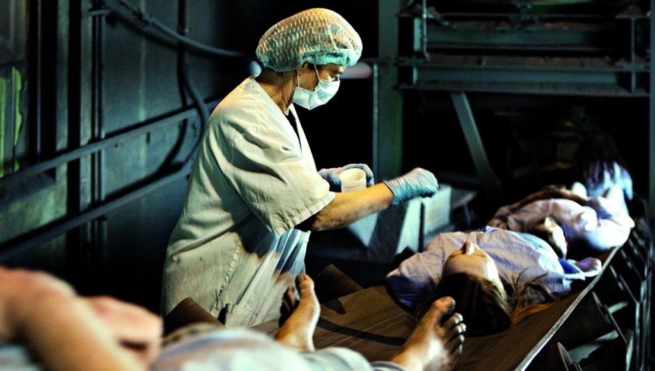
‘Industrialization’ of Healthcare
Health Factory, Norway, 2010
@RBaptistaLeite

Slide 13
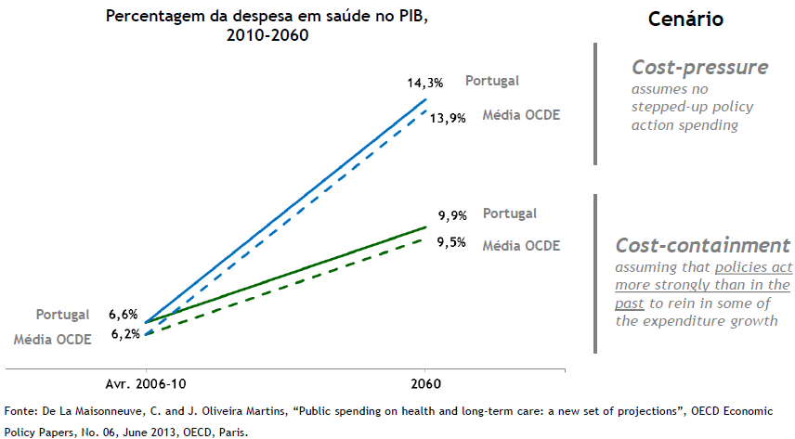
The Evolution of Healthcare
Rising Costs of Healthcare
Rising Expenditure in healthcare (projection)
+
Failure to Reduce Burden of Disease
Expenses in healthcare (in % of GDP)
2010-2060
@RBaptistaLeite

Slide 14




The Evolution of Healthcare
Outcomes Matter
@RBaptistaLeite

Slide 15


The Evolution of Healthcare
Outcomes Matter
Community
Value-based Healthcare
@RBaptistaLeite

Slide 16

Cascais 2030
DIGITAL PORTAL
@RBaptistaLeite

Slide 17
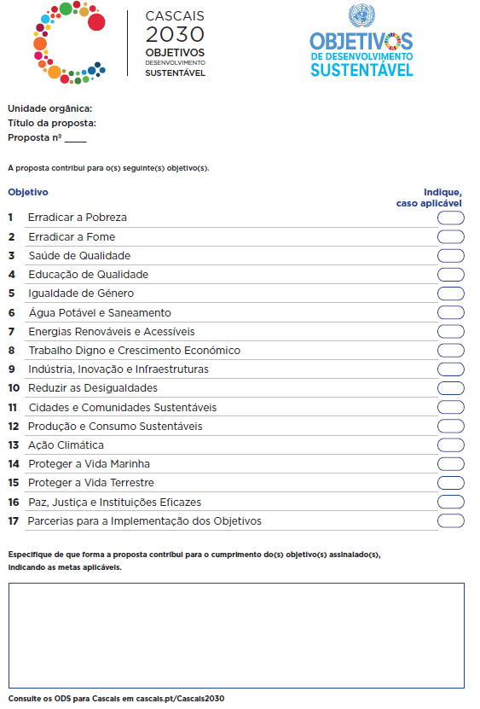
The commitment:
Cascais 2030
SDG Checklist
@RBaptistaLeite

Slide 18

Cascais 2030
DIGITAL PORTAL
Cascais 2030
LOCAL NETWORK
@RBaptistaLeite

Slide 19
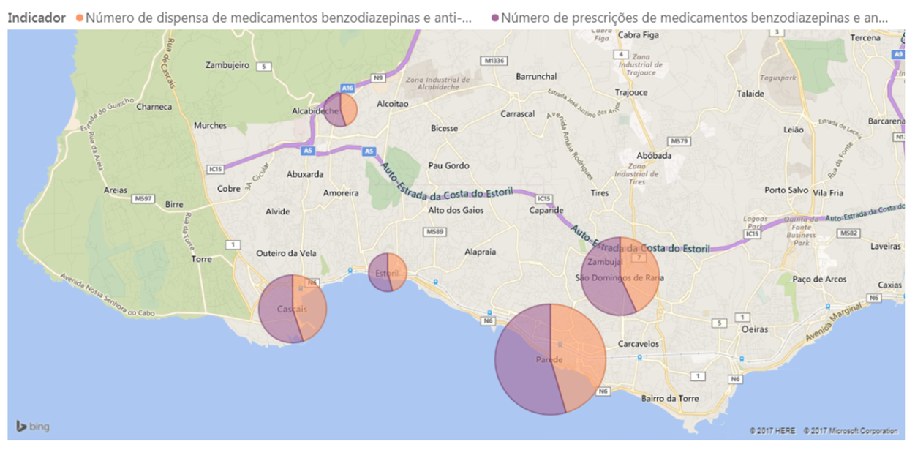
SMART HEALTH CASCAIS
SDG3: Achieve universal health coverage, including financial risk protection, access to quality essential health-care services and access to safe, effective, quality and affordable essential medicines and vaccines for all
@RBaptistaLeite

Slide 20
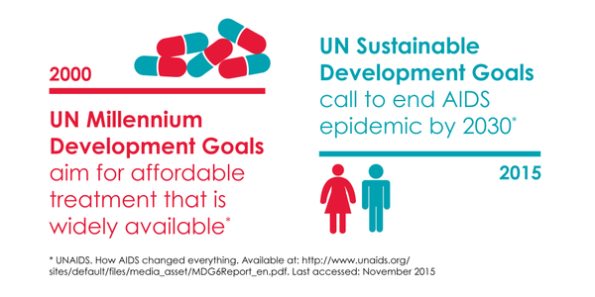

Leave no one behind…
@RBaptistaLeite

Slide 21

@RBaptistaLeite

Slide 22

Taking action to deliver on global policy goals
Members of Parliament
Approve national budgets
Directly change local and national policies
Interface between Governments and the People
@RBaptistaLeite
Notes:
Revisit the Dublin Declaration on Partnership to Fight HIV/AIDS1, and ensure that its monitoring adopts a ‘life-long’ approach to the health and social inclusion of PLHIV.

Slide 23

Taking action to deliver on global policy goals
Still MP’s are excluded from International - Multilateral workgroups and decision processes
@RBaptistaLeite

Slide 24





TAKING ACTION TO DELIVER ON GLOBAL POLICY GOALS
There is a need to foster an organized network of Parliamentarians to fight HIV/AIDS, Viral Hepatitis and Tuberculosis to:
Keep these diseases high on the political agenda
Address life-long quality of life, inequality, exclusion and changing epidemiological trends
Generate synergies in action by approaching the 3 interrelated epidemics together
Focus responses and expand testing in key populations
Ensure access to treatment
Promote research & innovation
@RBaptistaLeite

Slide 25
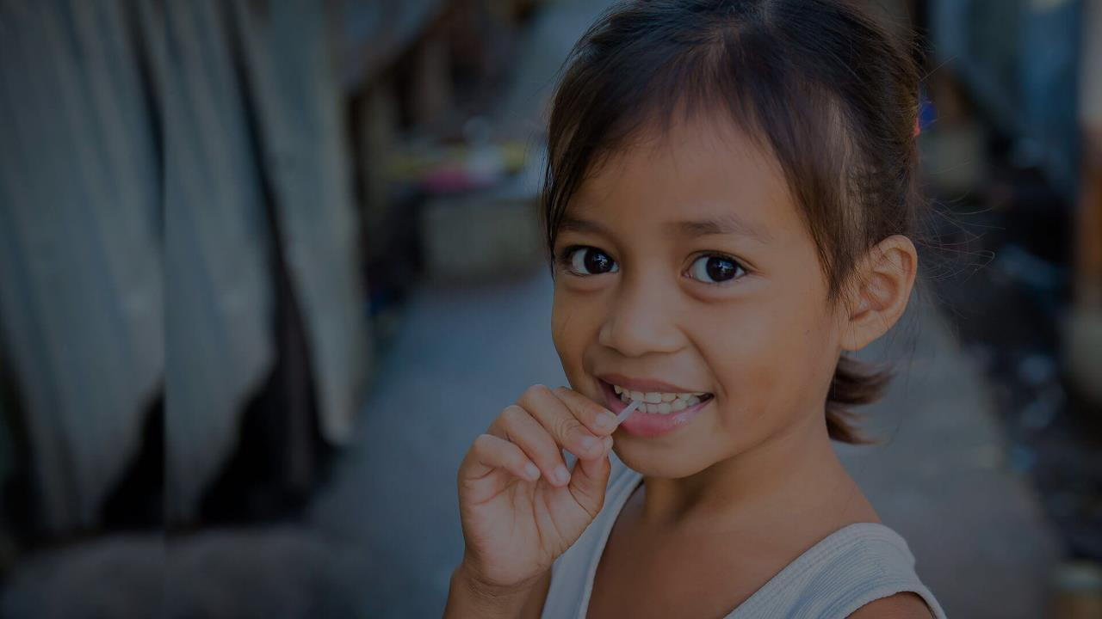

It’s time to end HIV/AIDS,
Viral Hepatitis and Tuberculosis.
It’s time to UNITE.
www.unitenetwork.org
With the support and under the auspices of
ricardo.baptistaleite@gmail.com | @RBaptistaLeite

