Slide 1
Photo from Pixabay
Innovation in education: overcoming barriers to learning for street children
Lizet Vlamings, Advocacy and Research Manager, Consortium for Street Children

Slide 2
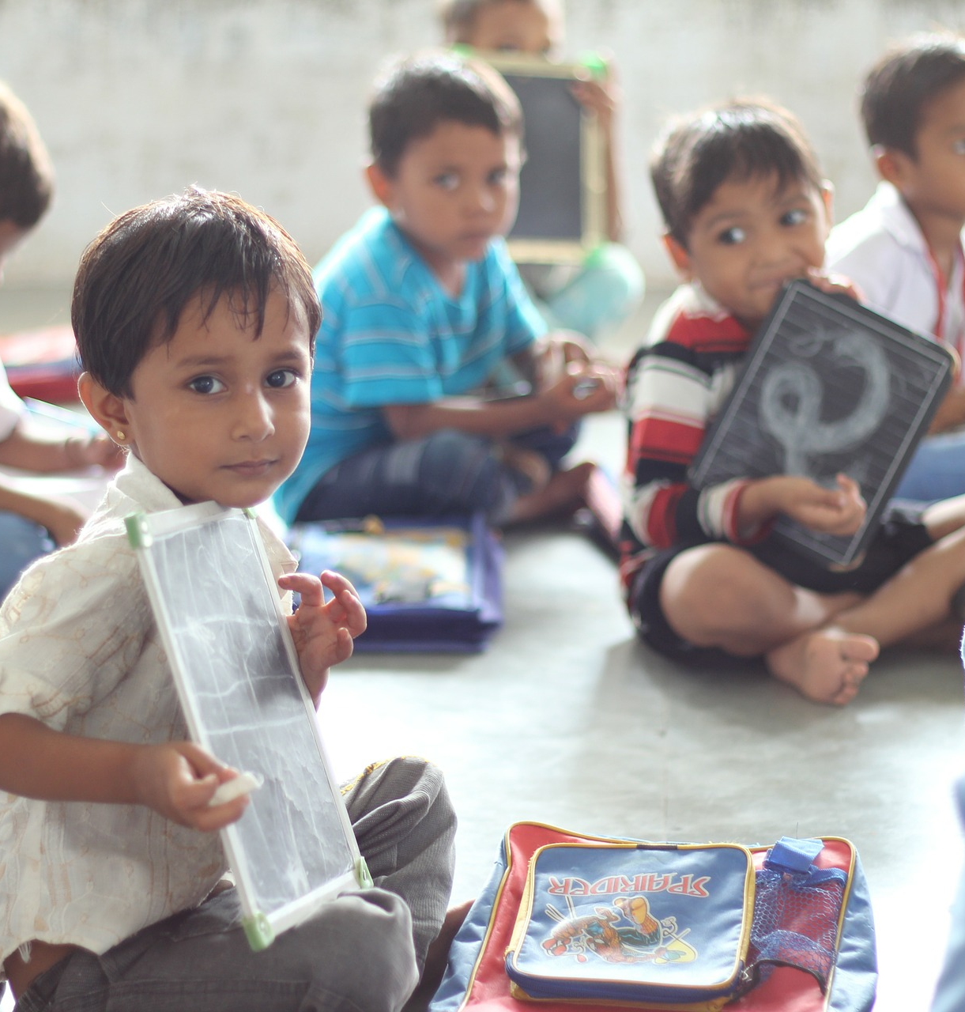
STREET CHILDREN INVISIBLE FROM DATA
Data is typically collected through household surveys that do not include most street children.
They are therefore not among the children counted as going to school or not going to school. They are invisible altogether.
Without data we are unable to plan for them, and their unique educational needs.
Photo from Pixabay

Slide 3
STREET CHILDREN’S VOICES
video

Slide 4
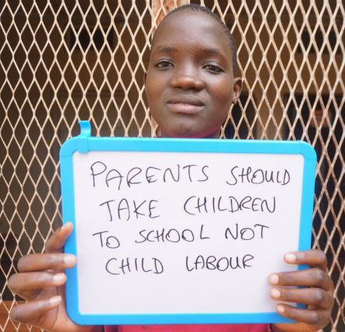
BARRIERS TO EDUCATION
Poverty
Lack of birth registration
Discrimination / stigmatisation
And many more
© Photo from Salve International, Uganda

Slide 5
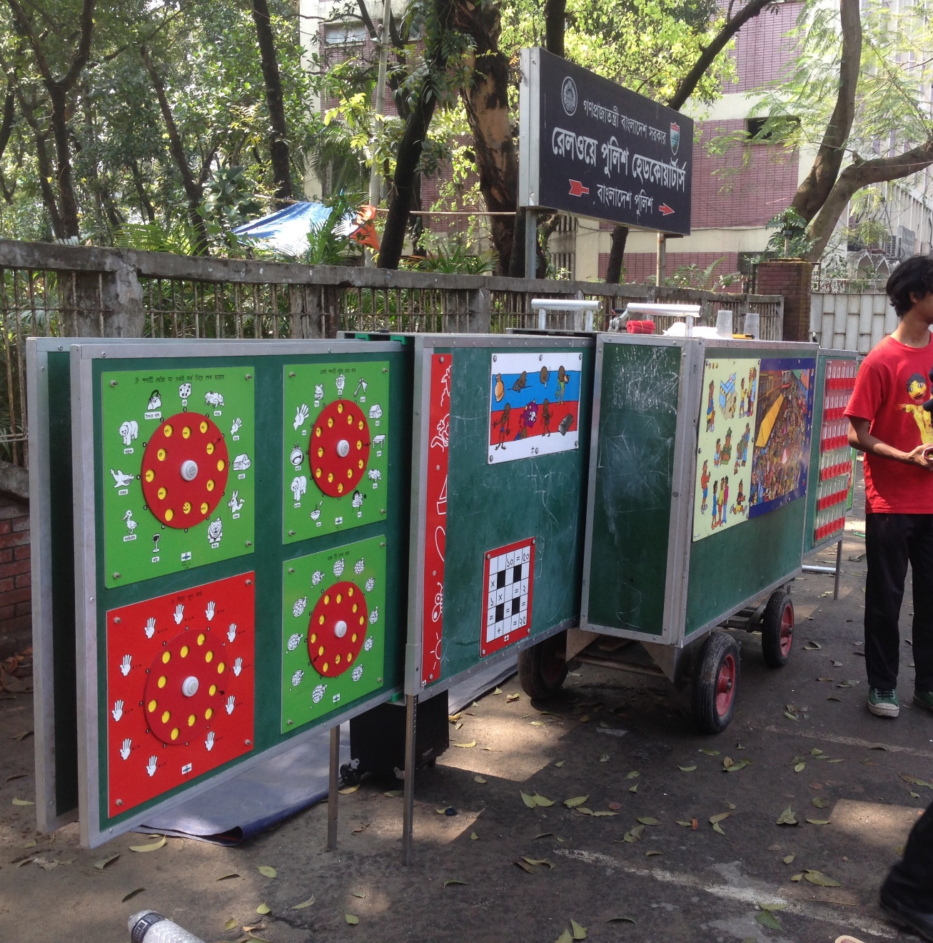
TARGETED EDUCATION SOLUTIONS
Mobile school in Dhaka, Bangladesh
Mobile Schools
Art mentoring programmes
Schools near places of work
Formal apprenticeships
© Consortium for Street Children

Slide 6
CONCLUSION
Achieving SDG 4 means access to education for all children.
This includes street children.
It is time to understand and capture their realities, to create specialised, targeted education solutions.
Photo from Pexel

Slide 7
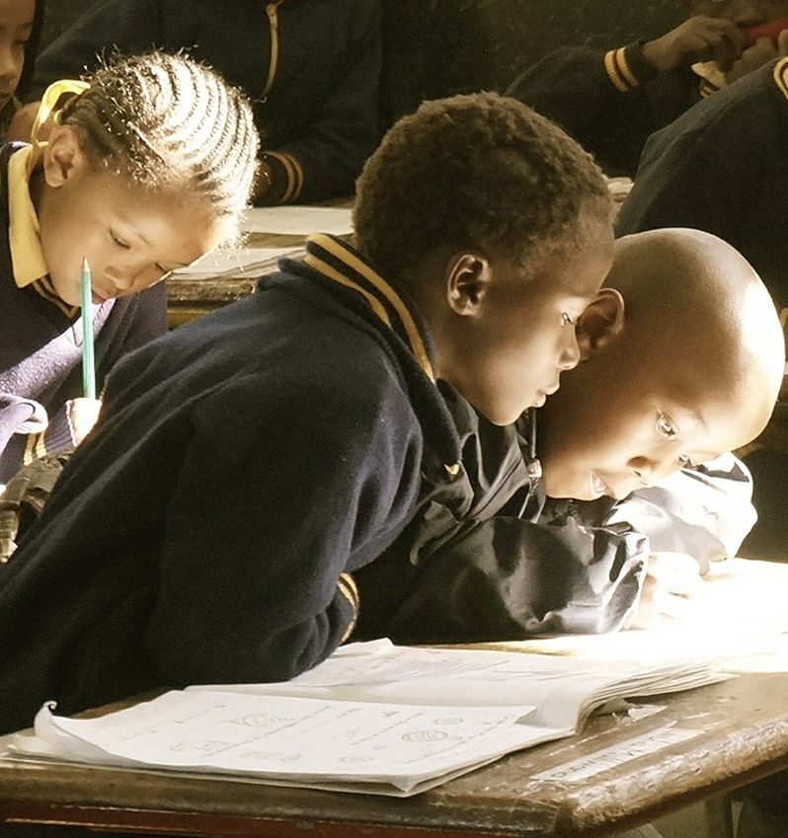
THANK YOU FOR LISTENING
For more information:
www.streetchildren.org
lizet@streetchildren.org
Photo from Pixabay

