Slide 1
Education for Justice (E4J)
Anti-Corruption Modules

Slide 2
Education for Justice (E4J)
Ultimate Aim: Build a culture of lawfulness among children and youth
How?: By improving education on crime prevention, criminal justice and rule of law.
Broad mandate:
Promote education on numerous UNODC mandate areas
At all levels of education: primary, secondary, tertiary

Slide 3
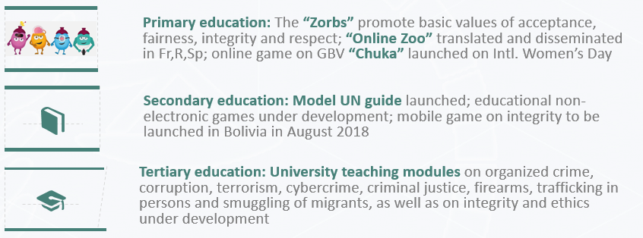
Education for Justice (E4J)
http://www.unodc.org/e4j

Slide 4
Education for Justice (E4J)
Tertiary education: university teaching modules
Over 100 modules on topics related to crime prevention and rule of law:
Anti-Corruption Integrity & Ethics Counter-Terrorism | Organized Crime (TIP/SOM, firearms, cybercrime, wildlife crime) Crime Prevention & Criminal Justice
http://www.unodc.org/e4j

Slide 5
14 University Modules: Anti-Corruption
Module 1: What Is Corruption and Why Should We Care? Module 2: Corruption and Good Governance Module 3: Corruption and Comparative Politics Module 4: Public Sector Corruption Module 5: Private Sector Corruption Module 6: Detecting and Investigating Corruption Module 7: Corruption and Human Rights | Module 8: Corruption and Gender Module 9: Corruption in Education Module 10: Citizen Participation in Anti-Corruption Module 11: Corruption, Peace and Security Module 12: National Anti-Corruption Frameworks Module 13: International Anti-Corruption Frameworks Module 14: Corruption and Organized Crime

Slide 6
14 University Modules: Integrity & Ethics
Module 1: Introduction and Conceptual Framework Module 2: Ethics and Universal Values Module 3: Ethics and Society Module 4: Ethical Leadership Module 5: Ethics, Diversity and Pluralism Module 6: Challenges to Ethical Living Module 7: Strategies for Ethical Action | Module 8: Behavioural Ethics Module 9: Gender Dimensions of Ethics Module 10: Media Integrity and Ethics Module 11: Business Integrity and Ethics Module 12: Integrity, Ethics and Law Module 13: Public Integrity and Ethics Module 14: Professional Ethics
http://www.unodc.org/e4j

Slide 7
E4J Educational Approach
To promote a global culture of lawfulness, E4J modules seek to:
Prepare students for value-driven effective action | Connect theory to practice Emphasize the importance of integrity to everyday life Encourage critical thinking Teach not only what is the right thing to do, but also how to do it
Keep students engaged | Use innovative teaching approaches Balance general ethics with applied ethics Draw on good practices from practitioners Link integrity and ethics to other global issues
http://www.unodc.org/e4j

Slide 8
E4J Educational Approach (cont.)
To promote a global culture of lawfulness, E4J modules seek to:
Be adaptable to different regional and disciplinary contexts | Multi-disciplinary / Multi-level Focus on global ethics and universal values but leave room for diverse regional/cultural perspectives
Be relevant for non-ethics lecturers / courses | Non-technical clear terminology User-friendly
http://www.unodc.org/e4j

Slide 9
E4J: The way forward
Promote the modules across the globe
Adapt the modules to primary and secondary schools
Foster ethical learning environments
Support educators in championing integrity
Seek continuous feedback and improvement
Conduct an impact evaluation
http://www.unodc.org/e4j

Slide 10
More information:
@DohaDeclaration
e4j@unodc.org
unodc.org/dohadeclaration
unodc.org/e4j

Slide 11
Thank you for your attention !
Thank you for your attention !
Sigall Horovitz
sigall.horovitz@un.org
Corruption and Economic Crime Branch
United Nations Office on Drugs and Crime
Vienna, Austria

