Slide 1
Promoting women's rights in Saudi Arabia through social media
Panel 4: Social movements and women’s rights
Social Forum, Geneva
2nd of Oct 2012
Manal al-Sharif

Slide 2
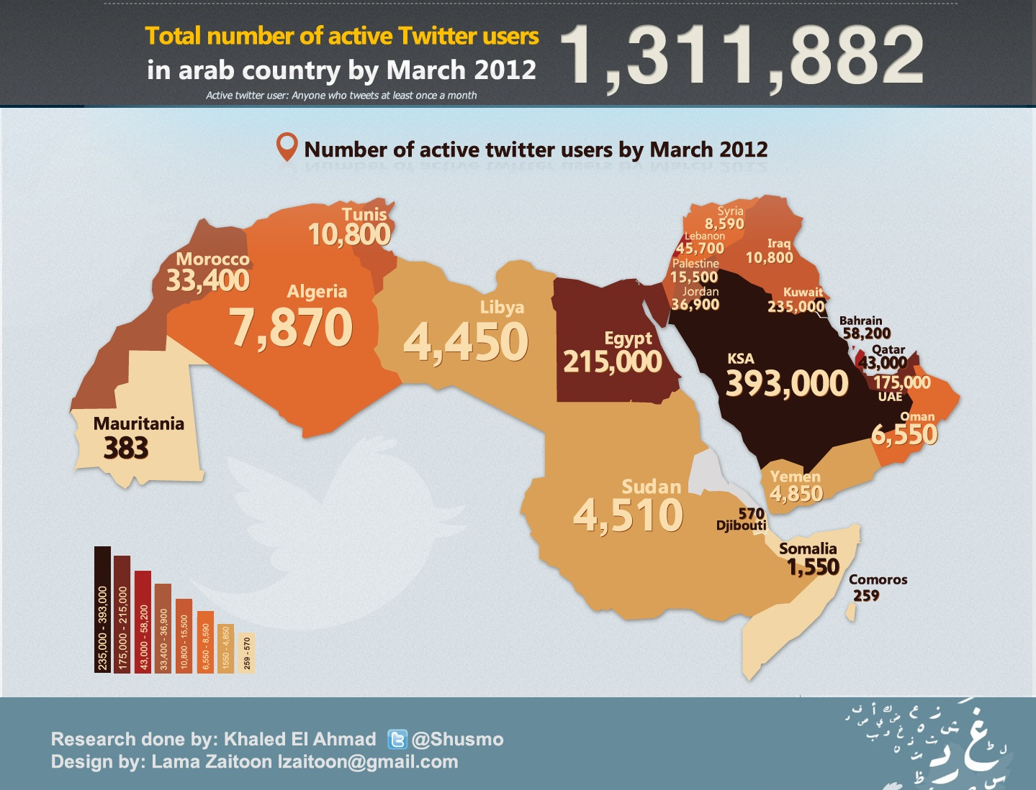

Slide 3
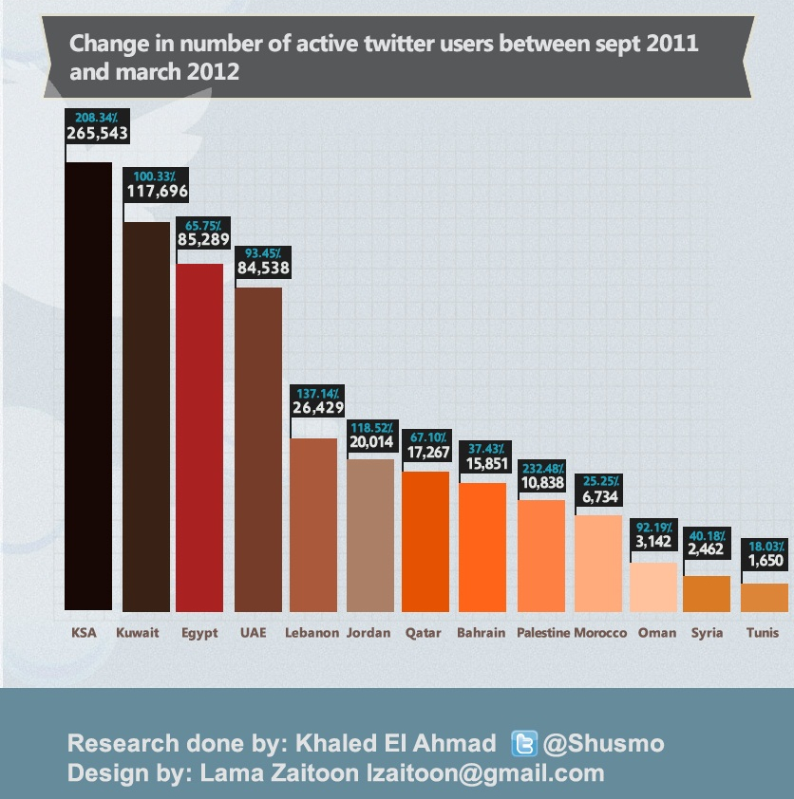

Slide 4
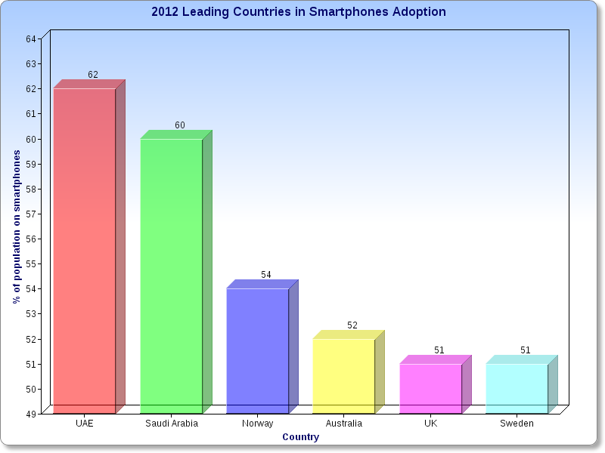

Slide 5
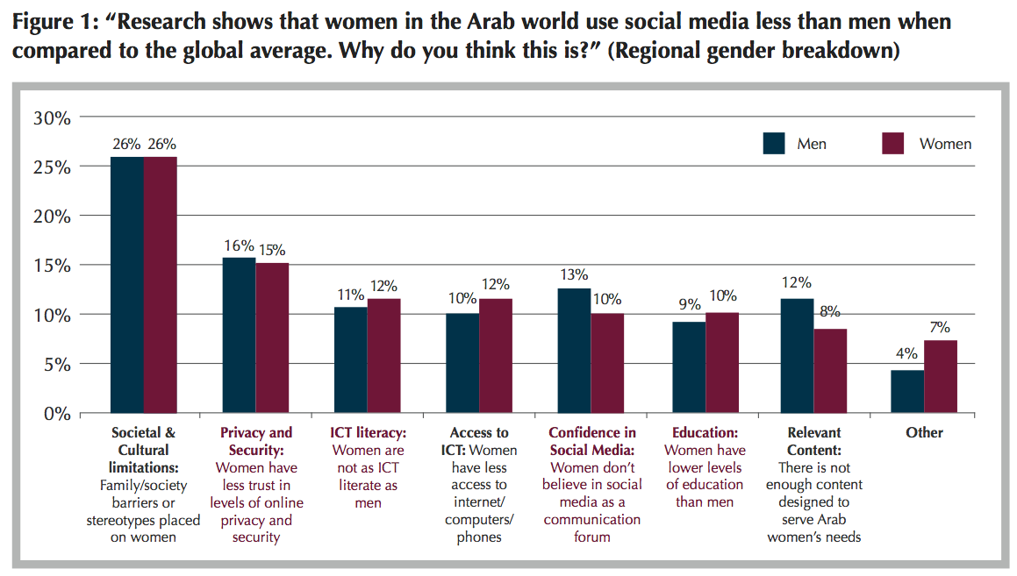
The Role of Social Media in Arab Women’s Empowerment Report, DSG

Slide 6
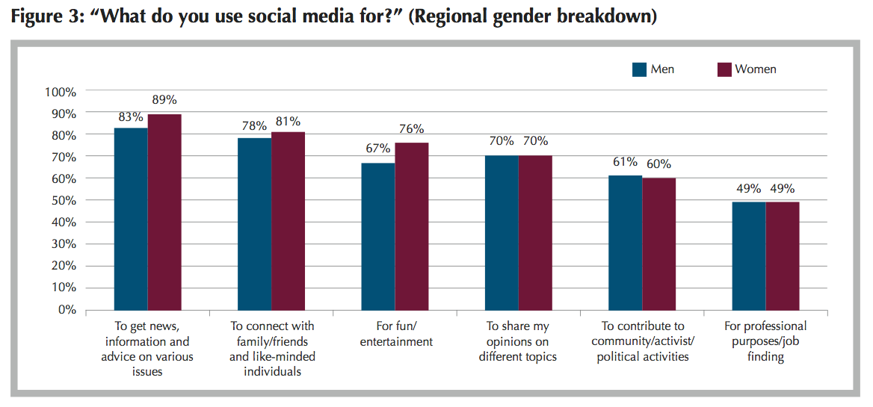
The Role of Social Media in Arab Women’s Empowerment Report, DSG

