Slide 1
Older persons, Autonomy and Independent Life from a Caribbean perspective
drs Raymond Jessurun
ADI representative for the America’s
CLATJUPAM Executive Board Member
CORV ambassador to International Organizations

Slide 2
STRUCTURE PRESENTATION
Main principles under Autonomy and Independent Life for OP
Income OP vs Autonomy Independent Life
Health Care OP vs Autonomy Independent Life
Autonomy Independent Life in Care Situation
Three other Principles of Autonomy and Independence OP
Recommendations

Slide 3
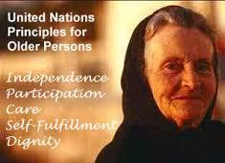
1.1. Right for older persons to Autonomy and Independent life
UN Principle for OP:
Autonomy and independence is a Principle for OP
Interamerican Convention Rights of Older Persons (Draft - art 7 )
Right to live independently and autonomously
UN Principles OP
From Principle to Right

Slide 4
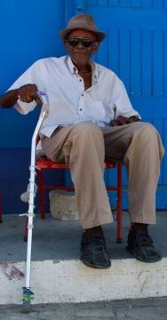
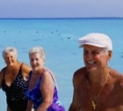
1.2. Who has autonomous and independent life?
Dutch Pensionado
Dutch Caribbean Pensioner
Notes:
= Ability to control
cope with and
make personal decisions
personal preferences
= right of choice
between all available options
Who may call himself/herself a pensionado This agreement offers the retired foreigner a special taxation over his/hers foreign income. To be eligible he or she needs to be
§ a citizen on one of the Netherlands Antilles: Curaçao, Bonaire, St. Maarten, Saba and St. Eustatius,
§ precedent the application not have lived on one of the islands for a minimum of 5 years,
§ within 18 months of settling own a house with a value of at least ANG 450,000,-
§ has a minimum age of 50
How many OP with Autonomy?
How many OP can really choose between all available options?
Degree of individual autonomy
Determined by material, mental and social development condition

Slide 5
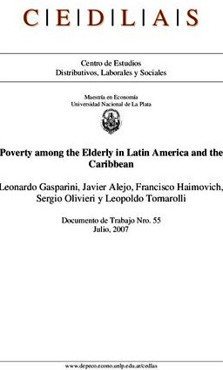
1.3. Aging, autonomy and independence in Caribbean: great concern.
Now 10%
2050 18%
Autonomy Independence in poverty ?
No autonomy or limited autonomy ?
Aging Concern

Slide 6
2. INCOME OP
PRINCIPLE OF AUTONOMY AND INDEPENDENCE FOR OP

Slide 7
2.1 Income => autonomy for OP ?
50% OP no finances to meet daily needs
33% OP no retirement, pension, or paid employment
Avg. spending of a cruise vs a stayover tourist per week US700 – US$1120
47 million to Caribbean (2013)
23 million OP in Caribbean

Slide 8
2.2. Social (Old Age) pensions: difference or discrimination
Saint Martin € 741 US$ 981
France € 741 = US$ 981
Sint Maarten US$ 556
Neth. €1034 = US$ 1368
Trinidad & Tobago US$ 325
Jamaica US$ 15
UK 695 = US$ 958
Maximum Old Age Pensions
OP in Caribbean

Slide 9
2.3. Social Allowances : difference or discrimination
Equal social protection only in French territories
Discriminatory social protection
In other EU-overseas territories
In CARICOM territory
In Latin Caribbean
social insurance only in some countries
coverage varies across region
contributory pensions
significant sections do not receive
informal sector => largely excluded
European Union the norm
OP get nothing or much less
Notes:
Two out of three older people lack any form of health insurance and therefore rely on public health clinics for care.

Slide 10
2.4. Poverty structural violation of UN Principle of INDEPENDENCE OP
(in)accessibility to adequate
1. healthy and nutritious food unable to afford and access
3. housing conditions poor
5. Health care and medication: Access is poor
Access to adequate:
food
water
shelter
clothing
health care
Through …..
Universal principle
In Caribbean

Slide 11
3. ACCESS TO HEALTH CARE
PRINCIPLE OF AUTONOMY AND INDEPENDENCE FOR OP

Slide 12
3.1. Health Care Level in EU
Differences among EU-States in health care?
Only French territories equal quality of health care and equal universal health insurance for all
Discriminatory quality level and coverage in overseas EU-territories (St Maarten vs Dutch Caribbean)
EU ministers on health
European Union Norm

Slide 13
3.2 highest attainable level of health care: Differences or discrimination ?
Universal health care only in some countries (Saint Martin vs Sint Maarten)
Medication: subsidized or free drugs only in some countries
Home Care: government services only in some countries
US Veteran Affairs
In Caribbean
Notes:
Change Europe first then Caribbean
Home care government service only in Antigua, Dominica, Grenada, St Vincent & Grenadines

Slide 14
4. Autonomy independence OP in Care situations
UN PRINCIPLE OF CARE FOR O{P

Slide 15
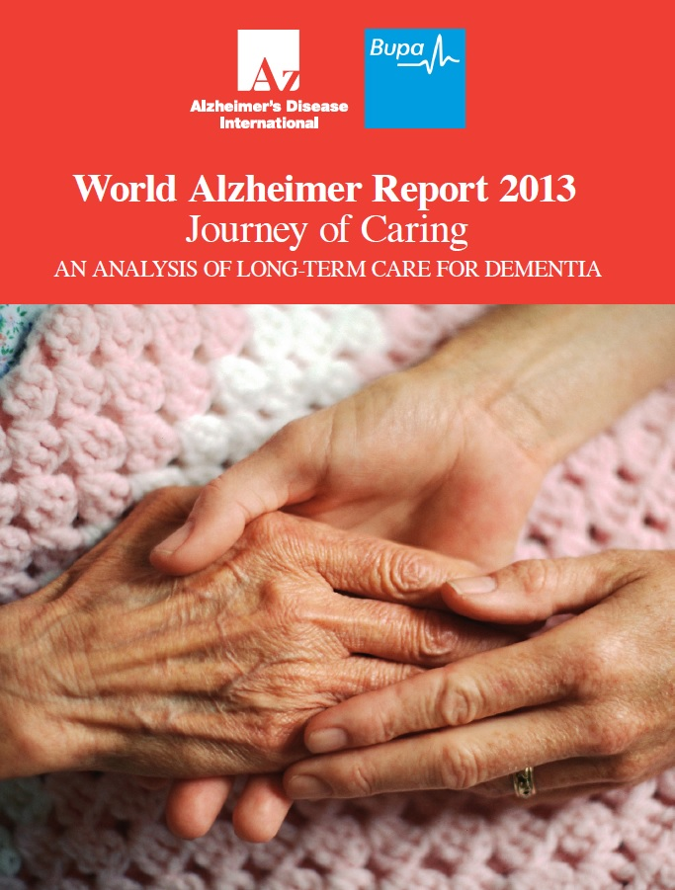
4.1. Need of care for OP by 2050
Journey of Caring: An analysis of long-term care for dementia
dependent people: double
dependent OP : nearly treble
dependent OP in most low and middle income countries: will quadruple
www.alz.co.uk/worldreport

Slide 16
4.2. Need for Dementia Care NOW
Journey of Caring: An analysis of long-term care for dementia
=> 50% PWD need personal care
=> 50% of dependent OP have dementia
4 of 5 OP in nursing homes have dementia
=> over time deterioration in cognition, function and behaviour more needs for care
dementia main risk factor for onset of functional dependence
Dementia largest contribution to need for care
www.alz.co.uk/worldreport

Slide 17
4.3. UN Care Principles for OP where?
10. family and community care and protection
11. access to health care
12. access to social and legal services
13. appropriate levels of institutional care
14. human rights and fundamental freedoms to be enjoyed anywhere
Dementia friendly community where?
Universal basic health care?
Social care and legal service affordable for PWD?
human rights and fundamental freedoms, dignity, beliefs, needs and privacy PWD respected where ?
universal
In Case of PWD
Notes:
ICRPWD - Article 3(a) Respect for inherent dignity, individual autonomy including the freedom to make one’s own choices, and independence of persons;

Slide 18
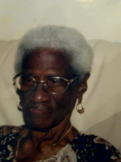
4.4. UN Principle Dignity for OP where?
17. live in dignity and security; free of exploitation and physical or mental abuse.
18. fairly treated without any discrimination , and valued independently of their economic contribution.
Edna
Exploitation and abuse
In dementia care

Slide 19
4.5 How autonomous an OP can be?
access to healthy and nutritious food not affordable?
access to health care and medication is poor?
shelter = housing conditions are poor?
income is inadequate ?
contributory pensions is only for some?
social insurance is only in some countries?
universal health care is only in some countries?
+ no information about nutrition and dementia
+ no appropriate diagnosis nor treatment
+ unadapted home environment and lack of care homes for elderly with dementia
+ income insufficient for paid care
+ no coverage for social care of dementia
any OP in need of care
PWD
Notes:
Slide about older persons
OP with dementia
OP in Care institutions
Years of care

Slide 20
4.6 Discriminatory Care Systems
Cost of private or public care services vs ability of older persons to pay
availability of care services and quality care varies per region / country
division of responsibility between health services and care services.
Inconsistency in level of support and autonomy provided by different care agencies
Care services
Dementia care services Hogewey

Slide 21
5. INDEPENDENCE FOR OP
ADDITIONAL UN PRINCIPLES OF AUTONOMY AND INDEPENDENCE

Slide 22
Other principles under UN Principle of Independence
2. To appropriate educational and training programmes
3. to live in safe environments adaptable to personal preferences and changing capacities
4. To reside at home for as long as possible
2. Low educational and literacy levels (lack of adult education and difficult to access)
3. poor housing conditions and lack of income => no adjustments can be made
4. Inadequate income to go in elderly nursing home
Universal principle of Access
In Caribbean structural obstacles
Notes:
– European dominance of language, social class norms and values in colonial and neo-colonial educational and cultural history

Slide 23
FROM RIGHT ON PAPER TO FULL REALIZATION
IN CONCLUSION

Slide 24
6.1. Recommendation: Autonomy and decision making
To prevent abuse and discrimination:
Right to respect dignity of older persons
Right to autonomous, independent self-determined living
Right to take their own decisions concerning:
Their property
Income, finances,
Place of residence
Health, medical treatment and care
Funeral arrangements
How to realize equal rights for the poor and needy OP if we do not eradicate poverty and discrimination?

Slide 25
6.2 Recommendation : Respect for preferences older persons
Preference to stay at home rather than in institution
Preference for family care rather than professional care.
Preference for independent living rather than professional care.
Need to balance between autonomy independence older person vs dependence of care giver (family or professional)
When to overturn the wishes or decision of older person and how ?
Desire for autonomy
dilemma with autonomy PWD

Slide 26
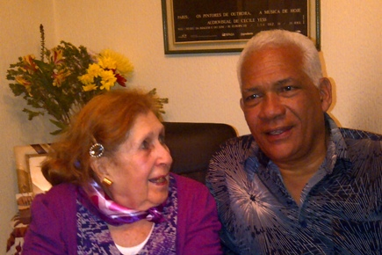
6.3 Recommendation: Respect for Care Preferences OP
Older persons should choose which services they want
Be made aware and understand all the services available to them
Receive information taking in account impairments and minority languages
Be able to meet any member of staff concerned with their care
Should be supported in asking questions about their care
Age discrimination
in providing care
Discrimination
in dementia care

Slide 27
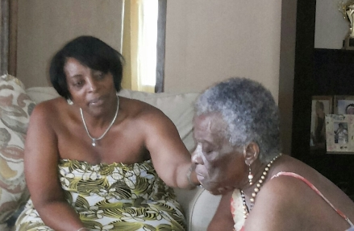
6.4 Recommendation: Respect in Care
consent of the older person should be obtained before introducing any change to the level or form of their care.
Independence and self-care should be promoted wherever possible
including the opportunity to self-medicate (indigenous natural healing practices – use of herbs, medicinal plants)
Stop imposing of care
In dementia care at home
and in institutions

Slide 28
6.5 Recommendation: Social inclusion of older persons
To prevent isolation (loneliness)
Possibility to interact with other older persons
Fully participate in public life, and in social, cultural, educational and training activities
Active aging
Paid and Volunteering opportunities for older persons in social, cultural and economic life
Right to dignity and respect for private and family life (including sexual intimacy)

Slide 29
6.6. Recommendation: Research and analyses on autonomy OP
from:
Physical perspective
Rights perspective (as part of civil and political rights)
Legal perspective
why not from:
physical, mental and social health perspective ?
also a social economic and cultural rights perspective?
global equality perspective regardless state conditions?
Limited perspective
Broader perspective

Slide 30
6.7. Recommendation: for Dementia Care OP
Journey of Caring: An analysis of long-term care for dementia
WHO also emphasises importance of independence, autonomy, participation, personal fulfilment, and human dignity in care:
Be it health, social, formal (paid), informal (family, unpaid), home care, care home, respite, end of life care
Informal care should get practical, emotional and economic support
Care homes should not be a ‘forced choice’
Palliative care for PWD at the end-of-life should not be underutilised
www.alz.co.uk/worldreport

Slide 31
6.8. Recomendation: to improve quality Dementia Care
Journey of Caring: An analysis of long-term care for dementia
Measuring quality of care can be used to inform policy, improve individual facilities, protect public safety and facilitate consumer choice
Identify and share excellence in care for PWD
Advanced care planning useful in structuring and preparing for care needs OP and PWD
Other suggestions – consumer information, person-centred care, better involvement for people with dementia and valuing the development of the dementia care workforce
www.alz.co.uk/worldreport

Slide 32
6.9 Recommendation: concerning trusted persons
to protect against abuse of trusted individuals
to allow older persons to regulate their future affairs in the event they cannot express their instructions in a later stage
to prevent abuse and give appropriate and effective guarantees if restriction required for protection purposes
to provide right to receive support in taking decisions when they feel the need for it
to choose who they trust to help with their decisions
To address risks of abuse of power of attorney
+ different degrees of support needed each stage for PWD
+ to facilitate decision-making based upon principle of supported decision-making
+ to protect will of PWD when designating another person to take decisions on his or her behalf (guarantees, sanctions, ACP and will)
Lack of protective legislation
In dementia care situations and other mental disability or disorder
Notes:
Bankbooks and banksavings accounts have been plundered, real estate have been transferred and prevented from being inherited by all

Slide 33
6.10. Recommendation: binding legal instrument
for the rights of older persons
With structural participation and input from civil society organizations of older persons
instead of more principles and recommendations, Codify international standards and protocols, measures and sanctions to be ratified by all State parties

Slide 34
Thank You
On behalf of older persons in
Latin America and the Caribbean

