Slide 1
Regional Consultation on the Right to an Effective
Remedy for Trafficked Persons
27 September 2013, Bangkok
Assistance and protection of TIP victims in Central Asia:
The UNODC ROCA Activities/Results

Slide 2
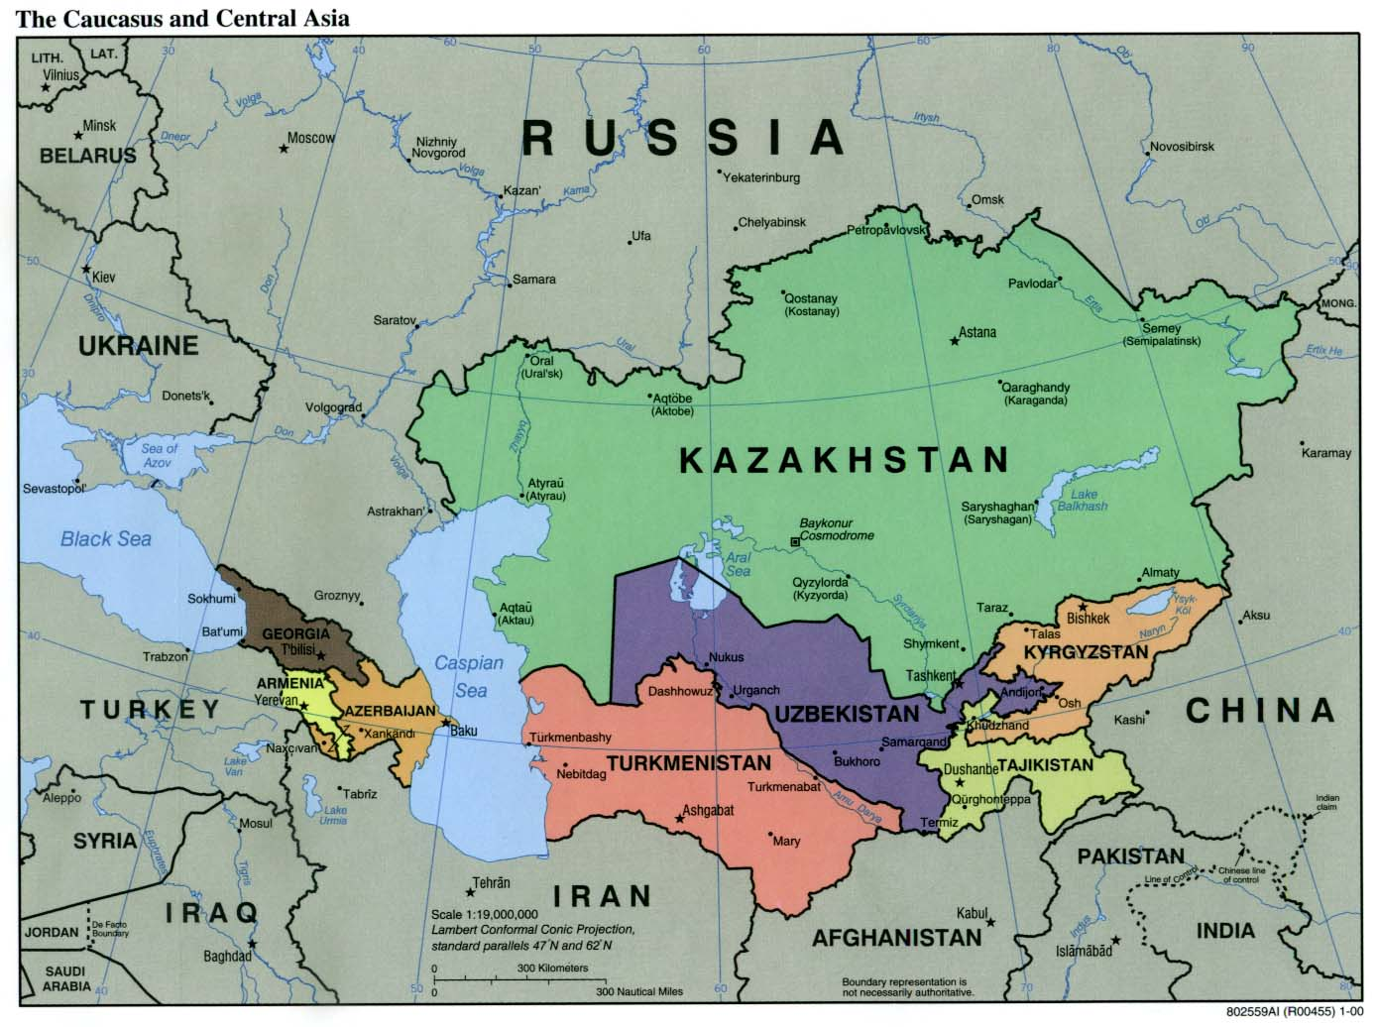

Slide 3
Support to TIP victims in Central Asia by the UNODC ROCA
PROJECT “Strengthening the capacity of the Central Asian Republics to protect and assist victims of human trafficking and smuggled migrants, specially women and children, in partnership with NGO and civil society actors”, 2011-2013, jointly with UNFPA
Donors: EU and US
Beneficiaries: Kazakhstan, Tajikistan, Turkmenistan and Uzbekistan
MAIN OBJECTIVE:
To enhance the capacity of the CA States to more effectively identify TIP victims and smuggled migrants, and to provide them required assistance/protection
MAIN EXPECTED OUTCOMES:
- Law enforcement agencies, NGOs and other actors actively cooperate for the purpose of responding to the needs of TIP victims/smuggled migrants and protecting their rights
- Shelters improve availability and quality of services

Slide 4
Challenges
Inadequate legislation and weak criminal justice responses
Lack of or insufficient cooperation between government agencies and NGOs
Uneven and insufficient services to victims
Unclear definitions of Trafficking in Persons
Criminalization of the victims’ conduct
Non-existent or non-functioning identification and referral mechanisms
Low level of state-ownership in anti-trafficking efforts
Absence of all-inclusive and clearly defined co-operation and co-ordination mechanisms, and corresponding SOPs, for identifying and assisting victims
Notes:
Inadequate legislation and weak criminal justice responses. Trafficking in persons and migrant smuggling are not sufficiently prevented because of a lack of understanding of these phenomena, poor knowledge and practical skills including poor implementation of recently adopted anti-trafficking legislation as well as existing stereotypes amongst law enforcement officials towards victims of human trafficking and smuggled migrants more largely. While general legislation is in place to protect those victims willing to testify against their traffickers, only few victims are prepared to come forward, often because of lack of trust in the police and the courts, and lack of confidence in the legal system due to the absence of witness/victims protection legislation and mechanisms.
Lack of or insufficient cooperation between government agencies and civil society actors. Currently, NGOs working to protect and support victims of human trafficking and smuggled migrants often face administrative hurdles to their work and are sometimes viewed with suspect by government counterparts. NGOs may themselves be wary of working with the government or law enforcement believing that they do not put the needs of the victims first. No specific cooperation procedures have been developed for investigating human trafficking cases. Operational practices relating to protection and assistance measures for victims of trafficking entailing cooperation between State actors and civil society organisations are not yet established or widespread.
Uneven and insufficient services to victims: Shelter services availability and quality differs dramatically both within and between countries in the region. Professional shelters offering holistic services in partnership with government. NGO and civil society actors are a necessary component to ensure that trafficking victims do not suffer secondary traumatisation caused by their treatment from institutions and individuals. In this regard, one of the key needs in the Central Asian region is to support the work of service providers to enable them to reach as many victims as possible, especially in light of the growing demand for their services.
Unclear Definitions of Trafficking in Persons: Unduly complicated or unclear definitions of trafficking in persons and exploitation make it unnecessarily difficult for investigators and prosecutors to prove the crime of trafficking. Perhaps this explains why so few traffickers have actually been punished under criminal code articles addressing the crime of trafficking in persons. Prosecutors punish traffickers under related criminal code articles, such as kidnapping, or pimping that carry lesser punishments. In some criminal code articles that address trafficking in persons, the terms neither reflect the Trafficking Protocol, nor do they reflect the complexity of the crime. These definitions confuse law enforcement officials and complicate their ability to determine who actually constitutes a victim. This indicates a general lack of understanding of the methods used in trafficking in persons or the crime itself. National legislation often does not accommodate the notion that a person may consent to engage in prostitution, but can also be exploited and become a victim of trafficking. The focus of the legislation should be on prosecuting those that organize trafficking offences, and not on the victim’s behavior or chosen profession. Therefore, it is essential that the legislation state that the consent of the victim to the trafficking offense is irrelevant, and is not an argument for the defense. When the victim is a minor this is even more relevant, due to the minor’s lack of agency. In many jurisdictions a defendant is not cleared of charges for statutory rape simply because the minor consented to sexual relations with the defendant. The law views a minor as someone not capable of making adult decisions, being susceptible to influence and manipulation, therefore they are considered vulnerable and in need of protection, even protection from themselves. Likewise, a person who accepts employment abroad, including prostitution, due to reasons of poverty or a difficult home life should also be considered vulnerable and in need of protection. In almost all known trafficking cases, it cannot be said that victims, even those employed as prostitutes, ever consented to the ill treatment and enslavement that defines the crime of trafficking in persons. It is also a widely recognized principle in international law that a person’s freedom is an inalienable right that cannot be voluntarily abandoned. The Trafficking Protocol recognizes this principle and therefore requests States parties to annul the consent of the victim.
Criminalization of the Victim: In most Central Asian states victims of trafficking in persons are still being charged or prosecuted for crimes that are a direct consequence of their situation as a trafficked person. Usually this occurs in countries of destination, but it can also occur when victims return to their countries of origin, where they can be penalized for unlawful or unauthorized departure. Victims in Central Asia are typically penalized for illegally crossing the state border, carrying fraudulent documents, and for prostitution. The UN General Assembly, the Committee on Rights of the Child and the Committee on the Elimination of Discrimination against Women have affirmed the importance of non-criminalization of victims of trafficking in relation to status-related offenses. Another penalty often faced by victims of trafficking is prolonged detention. The timely and accurate identification of a victim is important so that a victim can be quickly moved from temporary detention to a shelter. Prolonged detention of a trafficking victim is a violation of a number of international standards, such as freedom of movement and rules against arbitrary detention. The International Covenant on Civil and Political Rights (ICCPR) has been signed by all Central Asian states and explicitly protects the right to freedom of movement.
Child Victims of Trafficking
International law recognizes a distinction between child and adult trafficking. The international legal definition of child trafficking is different from the definition of trafficking in adults in that the crime of trafficking in children requires only an action for the purposes of exploitation. It is not necessary to show that the child was deceived or coerced. Some Central Asian countries have adopted separate legislation that addresses child trafficking and reflects this distinction, others are missing this distinction. It is not clear what standard operating procedures are being used by law enforcement to determine the identity of a child victim of trafficking. It is important that these procedures allow for the presumption of age or status. Child victims often lie about their real age or appear much older than they actually are. The international standard suggests that where the age of the victim is uncertain, and there are reasons to believe that the victim is a child, the presumption shall be that the victim is a child. Pending verification of the victim’s age, he or she is to be treated as a child and is to be accorded all special protection measures stipulated in the UNICEF Guidelines for the Protection of the Rights of Child Victims of Trafficking
4

Slide 5
Challenges
Issue of defining and offering adequate services for male victims of human trafficking. Although current shelters also have capacities to handle male victims, the number of assisted men is low while trafficking for purpose of labour exploitation (mainly male victims) has grown and shows tendencies of continuing to grow in all of the CA countries
Victims of internal human trafficking are mostly unidentified
With the exception of Turkmenistan, where the irregular migration is not an issue of concern, smuggled migrants and other vulnerable groups remain at risk in the CA countries as there appear to be no co-ordinated approaches to identify trafficked persons among them
Legal assistance is a complex issue of concern due to lack of skilled lawyers available to work with a target group and lack of knowledge among the shelter staff
Trafficked women suffer from heavy stigmatisation from society in all CA countries and this can be one of the main reasons for victims refusing assistance services

Slide 6
Activities/Results
Assessments of TIP/SOM laws/practices including various types/status of cooperation among state agencies and NGOs, and of quality of shelters’ services in Kazakhstan, Tajikistan, Turkmenistan and Uzbekistan (33 state agencies ,14 NGOs, 7 shelters (2012)
Standard Operating Procedures (SOP) Manual for law enforcement personnel (2012)
Regional train-the-trainers course for judges and prosecutors “Applying international standards to ensure protection and assistance measures towards TIP victims and smuggled migrants”, in cooperation with OSCE and IOM , Tashkent, Uzbekistan (2012)
Regional train-the-trainers course for law enforcement officers on “International best practices and SOP on effective identification and protection of victims of human trafficking and smuggled migrants “, in cooperation with UNICEF, IOM and OSCE, Almaty, Kazakhstan (2012)
Notes:
Standard Operating Procedures (SOP) Manual for law enforcement personnel has been developed - As the result of the assessment mission undertaken from 26 March through 10 April 2012 in Kazakhstan, Tajikistan, Turkmenistan and Uzbekistan, the project produced the analysis of the national mechanisms of identification and protection of victims and witnesses as well as the draft of Standard Operating Procedures (SOP) manual for law enforcement officers on identification and protection of victims of human trafficking and smuggled migrants. The SOP gives, among others things, practical examples of the means by which anti-trafficking and migrant smuggling legislation, norms and protocols can be applied in the course of law enforcement practitioners’ day-to-day work in particular in regards to identifying and protecting victims and witnesses
Train-the-trainers course for judges and prosecutors: On 25 - 27 June 2012, in Tashkent, Uzbekistan, the project, in cooperation with UNICEF, IOM and OSCE – held a regional train-the-trainers course for judges and prosecutors entitled “Applying international standards to ensure protection and assistance measures towards victims of human trafficking and smuggled migrants”.
28 trainers/instructors from all five Central Asian countries representing national training centers under Supreme Courts, Ministries of Justice and General Prosecutor’s Offices participated in the course. The participants provided a positive evaluation on the training methodology, quality of materials and the high professionalism of international experts from Serbia and Israel.
Train-the-trainers course for law enforcement officers: On 25 -27 September 2012, the project held the regional train-the-trainers course for law enforcement officers on international best practices and SOP on effective identification and protection of victims of human trafficking and smuggled migrants in Almaty, Kazakhstan. The main participants of the course were the 24 trainers/experts currently working at the specialized national training centers which provide advanced training for law enforcement officers under the Ministries of Interior, National Security Services and Migration Agencies of all Central Asia countries. The course allowed the participants to study main topics of the SOP manual including the tools by which law enforcement personnel can provide assistance and protection including the modules on pro-active and re-active investigation techniques, criminal intelligence gathering, analysis, and information exchange. The course was evaluated very positively by the participants who stressed the value of the exchange of practices and training tools developed by national training centers from other Central Asia countries and UNODC.

Slide 7
Activities/Results
National Consultative Meetings among state agencies and NGOs, and national training workshops on the availability and quality of shelter services in each of the four countries (2012-2013) led , inter alia, to better accessibility of state agencies by NGOs and increased number of the formal types of cooperation, i.e. joint quarterly and annual work plans
Pocket size Aide Memoire for law enforcement officers on the rights of TIP victims and smuggled migrants developed in Russian and translated into all four national languages
Training film “Victims not Villains” on victims’ interviewing techniques made (under Global Legal Assistance Programme) in Eng and dubbed into Russian, Uzbek and Tajik languages, and widely distributed among LEAs and national training centers– received excellent feedbacks from criminal justice practitioners and NGOs on its high quality and practical applicability
Notes:
Assessment report on the current status of cooperation between Civil Society and Government of Kazakhstan, Tajikistan, Turkmenistan and Uzbekistan, in particular law enforcement agencies pertaining specifically to human trafficking and migrant smuggling issues, was produced by the International Consultant as a result of interviews of the officials from totally 24 state agencies, 10 NGOs and 17 offices of international organizations. One of the major problems identified by the assessment was unduly complicated or unclear definitions of trafficking in persons and exploitation that made it difficult for investigators and prosecutors to prove the crime of trafficking. Also, while many NGOs and law enforcement officers reported the increased trust and interaction among them, the various forms of cooperation were on an informal or ad hoc basis.
National Consultative Meetings - project conducted a series of National Consultative Meetings, which took place in Tajikistan (19 October 2012), Uzbekistan (23 October 2012), Kazakhstan (15 November 2012) and Turkmenistan (22 November 2012). During the meetings, participants discussed ways to improve the mechanisms of cooperation among governmental agencies and NGOs to ensure efficient protection and assistance to the victims of human trafficking and smuggled migrants. The members of the National Anti-Human Trafficking Interagency Commissions and representatives of governmental agencies, various NGOs, OSCE, IOM and the donors (US Embassy, EU) attended the meetings. The meetings reviewed the assessment report with regard to status of cooperation mechanisms among NGOs and law enforcement agencies. The main outcomes of these meetings in some countries were the agreement between NGOs and Government agencies to sign MOUs or Joint Plans of Actions to provide better assistance and protection services to victims and further strengthen national referral mechanisms in line with the existing National Action Plans to combat human trafficking. In particular, in Uzbekistan, it was decided to include specific activities into the new National Action Plan to combat human trafficking for 2013-2014 to strengthen the cooperation between NGOs and law enforcement agencies. In Turkmenistan, the meeting led to the proposal for UNODC to provide assistance in the creation of the National Anti-Human Trafficking Interagency Commission and proposal to conclude MOUs between NGOs and law enforcement agencies. In Tajikistan, the meeting led to request of the provision of support to review of the new Law on Migrants and design a new project on interview rooms for children in courts. In Kazakhstan, the meeting led to the proposal for UNODC to consider joint activities in the frame of the new National Action Plan to combat human trafficking for 2012-2013 on strengthening the cooperation mechanisms between NGOs and law enforcement agencies.
Assessment of the current stock and quality of shelters for victims of human trafficking The major and common problems identified, among other things, in all four Central Asia countries include the following: (i) non-existent or non-functioning identification and referral mechanisms; (ii) issue of defining and offering adequate services for male victims of human trafficking;. (iii) although current shelters (except for Turkmenistan) also have capacities to handle male victims, the number of assisted men is low; (iv) although trafficking for purpose of sexual exploitation remains strong, labour exploitation has certainly grown and shows tendencies for continuing to grow stronger in all of the CA countries; (v) with the exception of Turkmenistan, where the irregular migration is not an issue of concern, smuggled migrants and other vulnerable groups remain at risk in the CA countries as they appear to be no coordinated approaches to identify trafficked persons among them; (vi) legal assistance is a complex issue of concern due to several factors due to lack of skilled lawyers / attorneys available to work with a target group; (vii) lack of knowledge among the shelter staff may result in not getting legal advice by victims in critical moments during the legal proceedings; (viii) trafficked women suffer from heavy stigmatization from society in all CA countries and this can be a reason for victims refusing assistance services. Despite these shortfalls, the analysis finds that, with proper targeted support to civil society organizations/NGOs, there are solid prospects for improving the quality of services for victims of human trafficking and smuggled migrants.
National workshops for shelters - were conducted in Tajikistan, Kazakhstan, Turkmenistan and Uzbekistan and according to the participants’ feedback, the workshops led to improved knowledge and skills on i) basic international standards and necessary tools to provide basic social services, ii) strengthening the network of professionals and NGOs which provide quality services to victims of human trafficking and smuggled migrants and facilitate exchange of experience within the country as well as iii) on methods of dealing with the “burnout” syndrome among the staff providing assistance to victims of human trafficking and smuggled migrants
Aide Memoire.

Slide 8
UNODC Regional Office for Central Asia +99871 1208050 www.unodc.org/centralasia http://www.unodc.org/centralasia/en/xacx44.html

