Slide 1
Monitoring the Human Rights to Water and Sanitation
UN Special Rapporteur on the human rights to safe drinking water and sanitation
Léo Heller
UNICEF/Waterlex HRWS Roundtable Indicators Meeting
9-10 February 2017
Geneva

Slide 2
Mandate of the Special Rapporteur
Mandate created in 2008
Léo Heller appointed in 2014
Separate rights to water and sanitation recognized in 2015/2016
Annual reports: Human Rights Council & General Assembly
Minimum 2 country missions per year
Respond to allegations of human rights violations
Facilitate the provision of technical assistance in the implementation of the HRtWS, including cooperation with relevant stakeholders
United Nations Human Rights Council, Geneva
Contribute to discussions on the post-2015 development agenda with special regard to the elimination of inequalities, and the full realization and sustainability of the HRtWS.

Slide 3
Annual reports
Focus on central and cross-cutting themes with important consequences for the realisation of the HRtWS
Annual frequency provides good dynamism to develop on subjects of current and forthcoming relevance
General Assembly
Human Rights Council
2015
Different levels and types of services (A/70/203)
Affordability
(A/HRC/30/39)
2016
Development cooperation
(A/71/302)
Gender equality
(A/HRC/33/49)

Slide 4
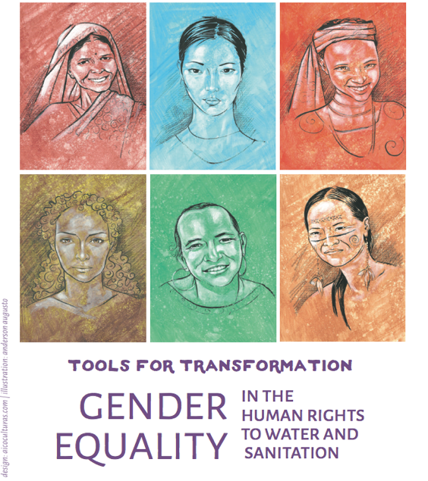
Annual reports
Different levels and types of services
States importance of measuring progressive realisation, i.e. recognizing different starting points and baselines of States.
Affordability
Points out different types of expenses for WSS and difficulties in measuring household expenditure on these services
Emphasizes importance of monitoring more than service tariffs
Development cooperation
Highlights need for national ownership and control over development in the processes of planning, implementation, and monitoring.
Gender equality
Women’s participation must be a part of monitoring efforts to ensure services (e.g. sanitary solutions) are acceptable and meet their needs
Draws attention to importance of monitoring intra-household inequalities
Leaflets for public distribution on diverse aspects related to the human rights to water and sanitation!
All available in English, French and Spanish.

Slide 5
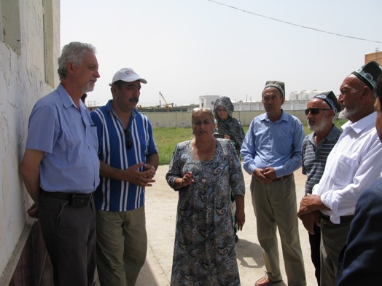
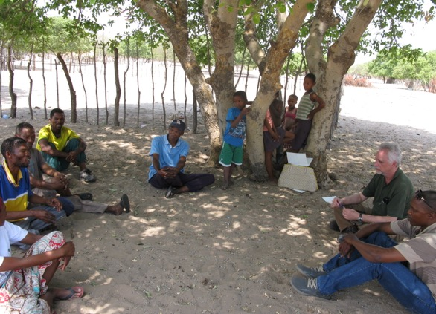
Country missions
2015
Tajikistan
Monitoring of water quality of non-centralized water sources still limited
Water suppliers may self-monitor but are not obliged to report to any authorities
Vast majority of sanitation solutions not regulated, managed or monitored by State
Data on WSS coverage does not capture marginalized groups (e.g. refugees, asylum seekers, stateless)
Botswana
No national regulator. Ministry of Health only does partial surveillance of water quality
National service provider (WUC) not obliged to report results of monitoring to authorities
Some entire areas lacking available monitoring data.
Individual boreholes and sources outside central network are vulnerable.

Slide 6
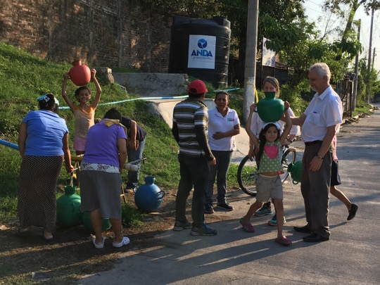
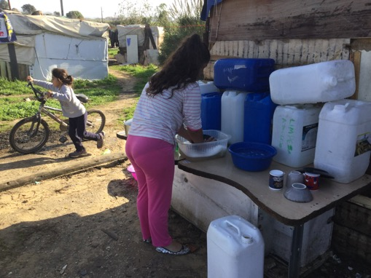
Country missions
2016
(-) No independent regulatory mechanism to monitor performance of national service provider, local authorities or other providers
(+) Ministry of Environment taking steps to prevent and monitor pollution through inventories of emissions and concentrations in receiving environments
Recommendation to include user participation in water quality monitoring
El Salvador
Portugal
(-) Insufficient amount of disaggregated information (e.g. covering disadvantaged groups like Roma)
National regulator (ERSAR) performs regular assessment of affordability of WSS based on average municipal incomes

Slide 7
Country missions
Lessons learnt
Country missions allow for in-depth legal, regulatory and policy reviews regarding WSS
Universal Periodic Review and treaty body mechanisms are informed of relevant cases affecting the HRtWS
Cases adjudicated through international or regional courts considered
More than consider indicators, qualitative assessments are made possible through interviews with authorities and field visits, often interviewing populations living in most vulnerable conditions, unserved or underserved.

Slide 8
Communications
Special Procedures may issue communications to States and other entities (e.g. business corporations) to address alleged human rights violations and other situations of concern to human rights.
Strengths/weaknesses
Cases enter into States’ Universal Period Review
Increasingly used but still weak popularity compared with other human rights as an accountability mechanism.
Need to spread awareness and empower community groups to reclaim their human rights through this mechanism
Possibilities
Discussions on indicators for WATSAN can help a more systematic approach for the communication mechanism
Spreading awareness of violations of the HRtWS through internet and social media

Slide 9
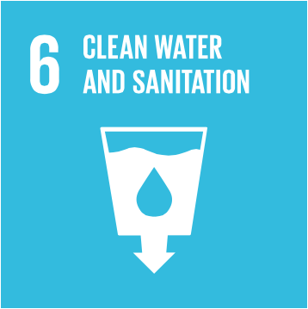
SDGs endorse the human rights based approach
“A world where we reaffirm our commitments regarding the human right to safe drinking water and sanitation and where there is improved hygiene” (“Transforming Our World”)
Goal 6: Ensure availability and sustainable management of water and sanitation for all
Target 6.1 By 2030, achieve universal and equitable access to safe and affordable drinking water for all.
Target 6.2 By 2030, achieve access to adequate and equitable sanitation and hygiene for all and end open defecation, paying special attention to the needs of women and girls and those in vulnerable situations.

Slide 10
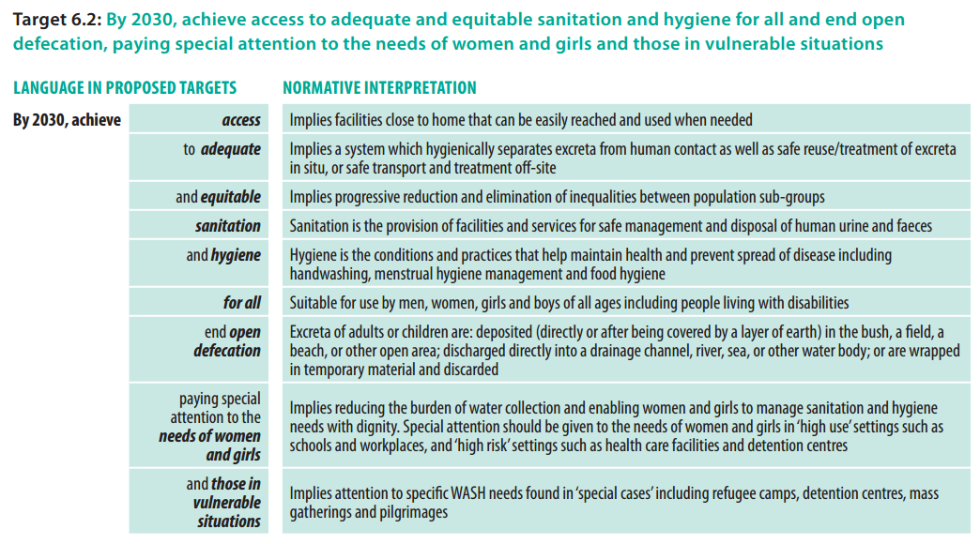
WASH Post-2015
Greater incorporation of human rights
JMP, WHO/UNICEF (2016). WASH Post-2015 Proposed indicators for drinking water, sanitation and hygiene

Slide 11
Interlinkages between SDGs
Main synergies
Source: UN Water (2016). Water and sanitation interlinkages across the 2030 Agenda for Sustainable Development, Geneva.

Slide 12
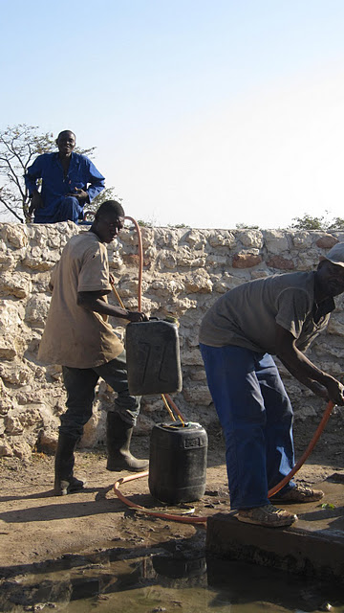
Thank you! For further information…
srwatsan@ohchr.org
http://www.ohchr.org/EN/Issues/WaterAndSanitation/SRWater/Pages/SRWaterIndex.aspx
@SRWatSan

