Slide 1
Intersessional Expert Meeting on ‘the full enjoyment of human rights by all women and girls and the systematic mainstreaming of a gender perspective into the implementation of the 2030 Agenda’ Session 4 – Accountability 2-3 May 2018 - Geneva
Lucy McKernan
Geneva Representative Global Initiative for Economic, Social and Cultural Rights

Slide 2
Accountability
Accountability is critical to the success of the SDGs
Accountability is a fundamental human rights principle
2030 Agenda – High Level Political Forum - weak accountability
Role of human rights mechanisms

Slide 3
CEDAW’s General Recommendation No. 37
‘Gender-related dimensions of disaster risk reduction in the context of climate change’ (2018)
Milestone – first General Comment on climate change of a human rights treaty body
Clear message – climate change is not gender neutral
Participation – high priority
Underlines urgency
Interconnectivity & coherence

Slide 4
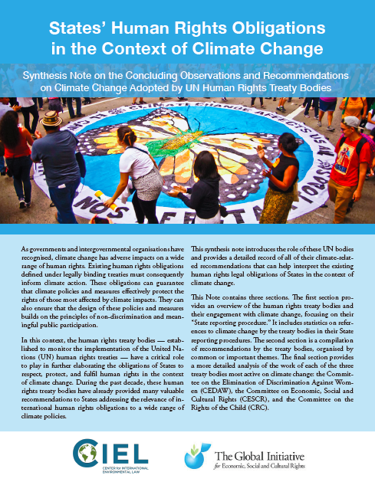
Research on human rights & climate change in the UN Treaty bodies
Insights from the research of CIEL & GIESCR on references to climate change in the State reporting procedure of the human rights treaty bodies

Slide 5
Climate change in the HRTB’s Concluding Observations
Chronological breakdown of Lists of Issues (left) and Concluding Observations (right) explicitly mentioning climate change

Slide 6
References to climate change in the COBs of all HRTBs
By category of document issued during the state reporting procedure
By category of country under review

Slide 7
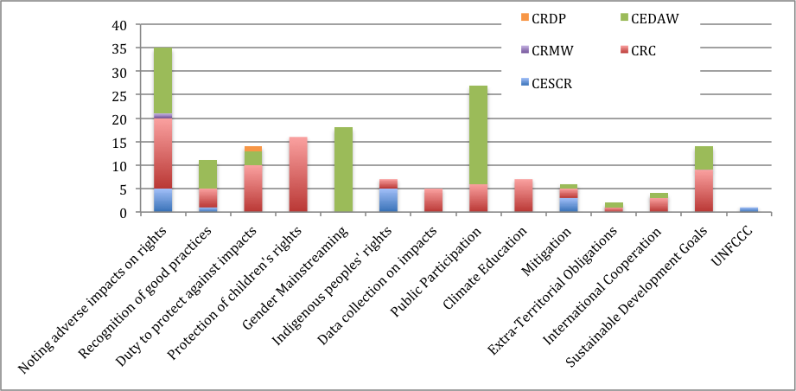
References to climate change in the COBs of all HRTBs

Slide 8
Gaps, challenges, opportunities
Gaps:
Role of developed countries
Climate finance
Just transition – right to work, social protection
Specific impacts on women - food, water, health
Challenges:
Implementation
Coherence – silos
Private sector and international financial institutions
Opportunities:
TBs’ State reporting procedure
TBs’ Communications procedure – Inquiries?

Slide 9
Lucy McKernan
Geneva Representative
Global Initiative for Economic, Social and Cultural Rights
lucy@globalinitiative-escr.org

