Slide 1
Policy Guideline on Good Health and Well-Being - SDG 3
In-Person Training Module
Presenter's name
Event or meeting title Location, (Date)

Slide 2
Welcome!
You each have one minute to come to the front of the room, introduce yourself and share: What is something that you care deeply about?

Slide 3
Objectives of the module
Become familiar with the resource package and its components.
Gain an understanding of the current situation in terms of access to health for people with disabilities.
Identify concrete steps that policymakers can take to guarantee inclusive health care services in the process of implementing SDG 3 with a disability-rights lens.
Learn how to obtain additional information to support implementation of access to health in your own context.

Slide 4
What’s in the toolkit?
Policy Guidelines
Human Rights Indicators for the CRPD
Data Sources Guidance
Training Materials
Videos

Slide 5
Agenda
Start time: 00:00
Disability & Ableism (if applicable)
Data contest!
The Road to Health
Meal time: 00:00
Video Viewing
Implementation Challenge
Next Steps
Closing time: 00:00

Slide 6
What did you think about disability when you were 8-12 years old?

Slide 7
In trios:
Share what you remembered
What do you notice in common between the stories?
Come up with a list of words that you associated with disability during that time of your life.

Slide 8
Ableism
“a value system that considers certain typical characteristics of body and mind as essential for living a life of value. Based on strict standards of appearance, functioning and behaviour, ableist ways of thinking consider the disability experience as a misfortune that leads to suffering and disadvantage and invariably devalues human life”.
Special Rapporteur on the rights of persons with disabilities, Report on the impact of ableism in medical and scientific practice, A/HRC/43/41, 2019

Slide 9
BREAK! Come back at :00

Slide 10
WELCOME TO THE DATA CONTEST!
The team with most points will win a prize!

Slide 11
Question 1 - Name two ways in which persons with disabilities experience health and health care inequalities. (5 points)

Slide 12
Question 1 - Name two ways in which persons with disabilities experience health and health care inequalities. (5 points)
Studies show that some persons with disabilities live between 15 to 25 years less than the rest of the population. Inequalities in access to health care, including primary care, health literacy and economic resources explain the lower health outcomes of persons with disabilities.
Persons with disabilities are more likely to live in poverty and around half of them cannot afford health care, including essential medicines.

Slide 13
Question 2: What percentage of persons with disabilities cannot afford health care, compared to other persons? (5 points)
23 per cent
52 per cent
80 per cent

Slide 14
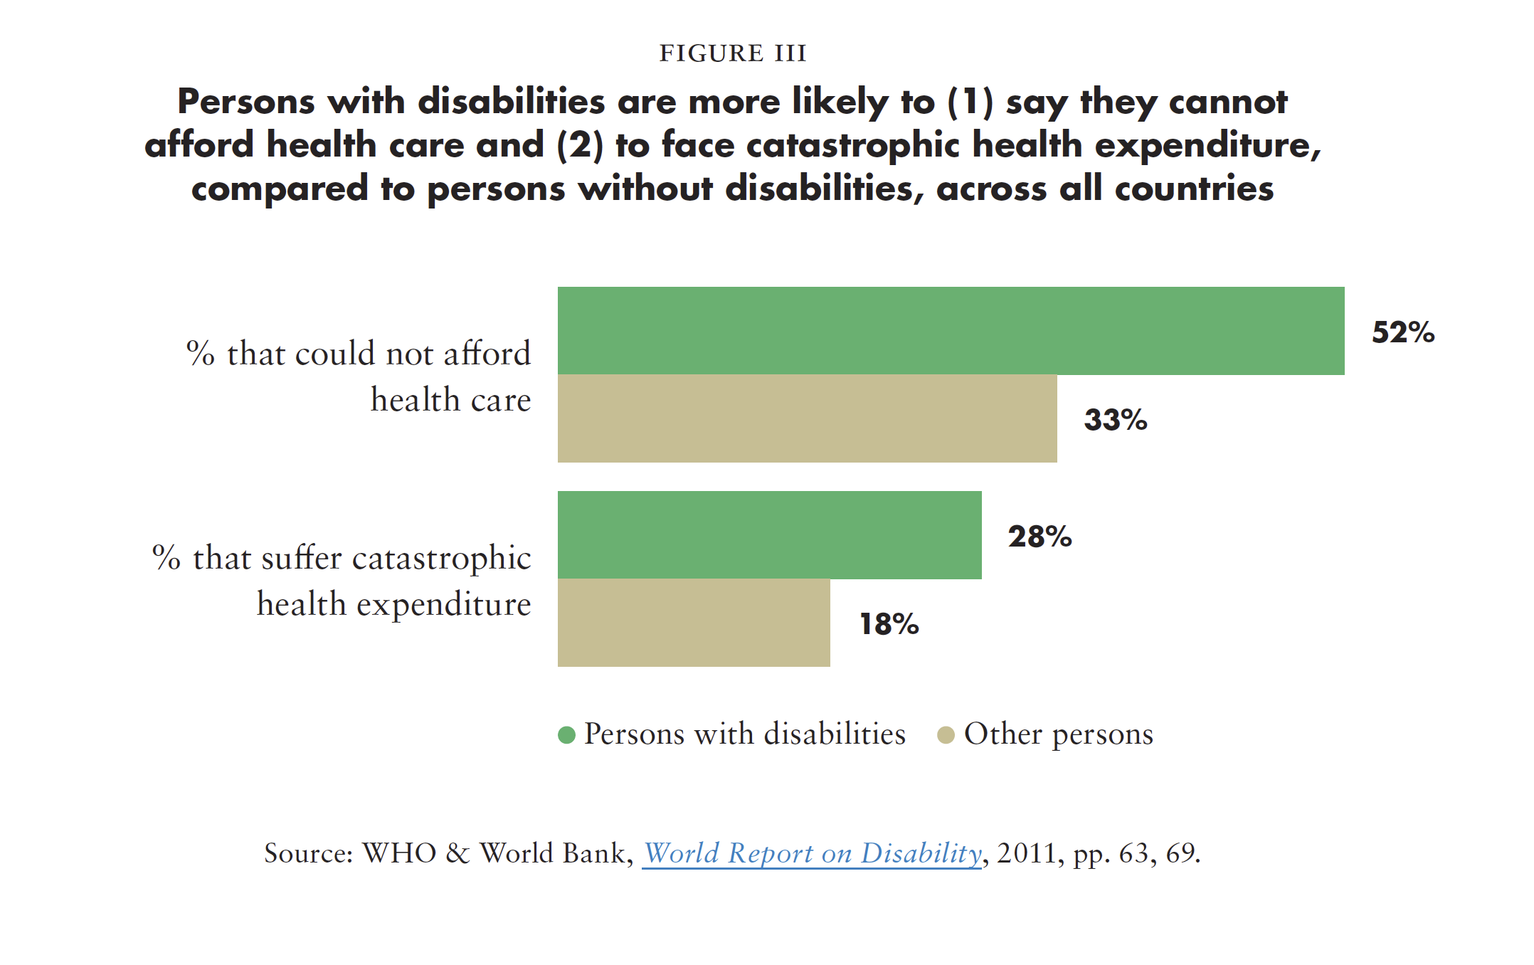
Question 2: What percentage of persons with disabilities cannot afford health care, compared to other persons? (5 points)
Source: WHO & World Bank, World Report on Disability, 2011, pp. 63, 69.

Slide 15
Question 3 - What proportion of persons with disabilities indicated that they needed but could not get health care? (5 points)
13 per cent
4 per cent
22 per cent
None of the above

Slide 16
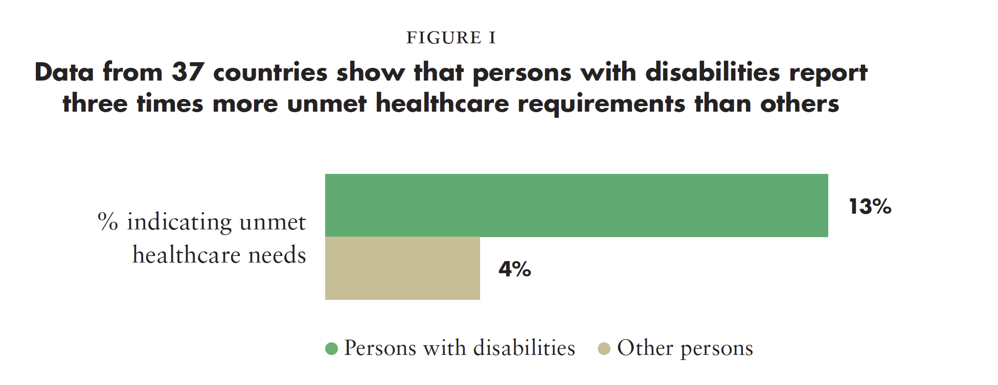
Question 3 - What proportion of persons with disabilities indicated that they needed but could not get health care? (5 points)
Source: United Nations Department of Economic and Social Affairs, Disability and Development Report, 2019. Figure II.13, p. 53.

Slide 17
Question 4 - True/False - Existing mental health laws and policies continue to restrict rights by authorising involuntary treatment and detention based on actual or perceived impairment. (5 points)

Slide 18
Question 4 - True/False - Existing mental health laws and policies continue to restrict rights by authorising involuntary treatment and detention based on actual or perceived impairment. (5 points)
Only 2 per cent of health budgets are directed to mental health and existing investment continues to neglect community-based and participatory service models (in many low-and middle-income countries)
Globally, persons with psychosocial continue to experience human rights abuses in mental health services.
WHO, Mental Health, The Global Heath Observatory

Slide 19
Question 5: Challenge! (10 points)
Two members of your team share policies or practices in their countries that are aimed at ensuring healthy lives and promoting well-being for all persons with disabilities at all ages.

Slide 20
Road to Health Scenarios
5
4
3
2
1
1
2
3
4
5

Slide 21
Come back at :00
LUNCH BREAK!

Slide 22
Short Video
As you watch and listen, pay attention to the different stories highlighted and the issues shared and proposed.

Slide 23
Station 1: Health Information Systems
AKARI
SAMUEL
AMARA
IAN

Slide 24
Station 2: Medicines and Technology
AKARI
SAMUEL
AMARA
IAN

Slide 25
Station 3: Health Workforce
AKARI
SAMUEL
AMARA
IAN

Slide 26
Station 4: Service Delivery
AKARI
SAMUEL
AMARA
IAN

Slide 27
Station 5: Financing
AKARI
SAMUEL
AMARA
IAN

Slide 28
Station 6: Leadership, Governance and Legal Framework
AKARI
SAMUEL
AMARA
IAN

Slide 29
BREAK! Come back at :00

Slide 30
Next Steps
(Add here any follow-up information)

Slide 31
Closing
Name one commitment you’re making to advance health policies in your country in benefit of persons with disabilities after today’s session and who in your specific context can hold you accountable for it?

Slide 32
Resources
SDG-CRPD resource package link
Policy Guidelines
Human Rights Indicators
Data Sources Guidance
Training Modules
Videos
(Add other relevant resources)

Slide 33
Thank you!
For further information,
please visit:
www.ohchr.org

